Slide 1

The relevance of informetric studies to University research and visibility
Dr. OB Onyancha
Dept of Information Science
UNISA

Slide 2

Questions, questions and questions?
  On what basis should an institution allocate research funding to individual researchers?
  How possible is it for institutions to identify research trends and the growth of knowledge in different scientific disciplines for decision making processes?
  How can libraries and information services estimate the comprehensiveness of secondary periodicals?
  Is it possible to identify the uses of different sources and subjects?
  What about identifying most productive researchers, institutions and countries in various disciplines?
  Can we be able to forecast past, present and future research or publishing trends?
  How can we identify core periodicals in different disciplines?
  Can we determine obsolescence of published literature?
  How visible is one’s (individual and institutional) research, website, and similar activities?
  What is one’s research and web impact?

Slide 3

UNISA scenario or case!!
On 14 Sept 2010, the CHS at UNISA organized a stakeholders meeting to draw up research strategic plan for 2011
Challenges | Low research output per capita (0.42 instead of 1.16) Aging cohort of top researchers Slow completion rates of postgraduate students Not enough rated associate and full professors Lack of management skills related to research etc. of managers
Increased research outputs in research focus areas
Increased postgraduate throughput from 17.82 to 22% by 2015
10% increase un ODL research outputs per annum
Increased cohort of trained researchers; increased research output from 0.42 to 1.16 per annum; Increased number of NRF rated researchers Increased collaborative research projects
Possible KPI’s and targets

Slide 4
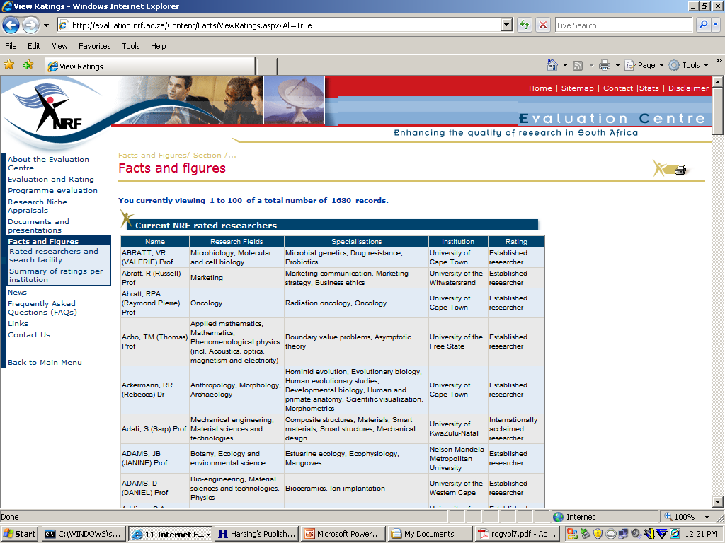
NRF Scenario
Peer reviewers are asked to provide an appraisal/ evaluation on the following:
The quality of the research-based outputs of the last eight years as well as the impact of the applicant's work in his/her field and how it has impacted on adjacent fields.
An estimation of the applicant's standing as a researcher in terms of both a South African and international perspective.
Applicant is then rated accordingly

Slide 5
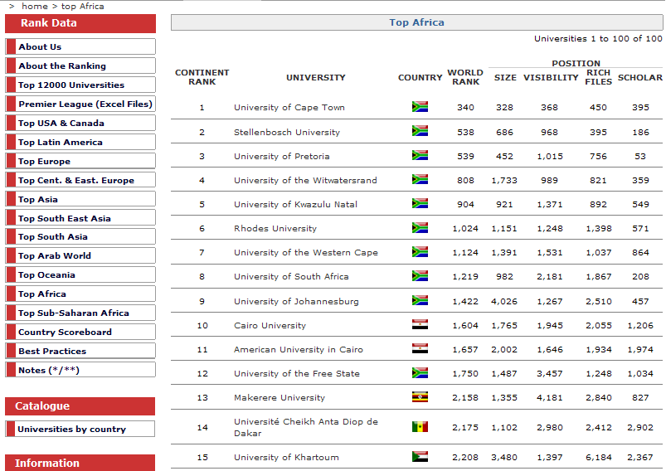
International rankings scenario
Size = number of web pages
Visibility = in-links
Rich files = .doc, .pdf etc files
Scholar = documents in Google Scholar

Slide 6
Methodologies employed?
Peer review and Bibliometrics
Source: Geisler (2001:39)
Each has its strengths and weaknesses

Slide 7
What is informetrics?
Informetric studies involve various approaches including Bibliometrics, Scientometrics, Cybermetrics and Webometrics
Informetrics
Bibliometrics
Scientometrics
Cybermetrics
Webometrics
  Informetrics consists methodologies that examine “patterns that show up not only in publications but also in many aspects of life, as long as the patterns deal with information” (Diodato, 1994:ix)

Slide 8
Peer review vs informetrics/bibliometrics
PEER REVIEW
The partiality of peers
The ‘old boy’ network
The ‘halo’ effect may result in a greater likeIihood of funding for more ‘visible’ scientists
Reviewers often have quite different ideas about what aspects of the research they are assessing
The peer review process assumes that a high level of agreement exists among scientists about what constitutes good quality work
BIBLIOMETRICS
Publications count
Informal and formal, non-journal methods of communication in science are ignored
Publication practices vary across fields and between journals
It is often very difficult to retrieve all the papers for a particular field
Multiple authorship
Citations count and analysis
Assumes intellectual link exists between citing and cited works
Work that is incorrect maybe highly cited.
Database limitations
Self-citation may artificially inflate citation rates;
Weaknesses of peer-review and bibliometric methods

Slide 9
Commenting on the use of citations (Bibliometrics), Garfield (1996) says
Citation analysis becomes controversial mainly when it is used as a tool in making decisions about funding or the tenure of individuals or groups, especially when it is perceived to be an uninformed use of citation data. Many of these unpublished citation analyses, like most un-refereed work, may, in fact, involve the abuse of SCI data and rightly evoke hostility or unease. After all, some highly published authors are little more than bureaucrats who attach their names to every paper they can. Unless such details are known to the evaluators, citation data could be used to perpetuate unjust distribution of resources
But the opposite may also be true. In several countries where research funding is often highly political, many of the most deserving researchers receive a small fraction of research funds in contrast to parasites who hadn't published a paper for a decade or more. Many well-funded clinical researchers publish in obscure national journals in the local language to hide their lack of international significance. In contrast, younger researchers not only publish in the international journals but are also well cited. Their impact on their scientific fields becomes clearly visible through citation analysis

Slide 10
Is it ALL in vain?
Informetrics (including bibliometrics, scientometrics, webometrics and cybermetrics) approaches are increasingly becoming popular among:
  Researchers
  Funding agencies
  Universities
  Research centres
Establishment of subject specific
  Journal of Informetrics
  Scientometrics Journal
International conferences and societies
  International Society for Scientometrics and Informetrics
  ISSI conference 2011, Durban [ALL ARE INVITED]

Slide 11
Application in research.. After research..?
Focus shifts to evaluation
Why?
  Rating, Impact, recruitment, funding tenure, ranking, and promotion
According to the OECD (1997) governments conduct research evaluations for the following reasons:
optimizing their research allocations when faced with budget stringencies;
re-orienting their research support;
rationalizing or downsizing research organizations; and
augmenting research productivity.
However, funding seems to be main driving force. “All organizations that fund and conduct scientific research are increasingly ‘under the gun’ to better evaluate the performance of their programs…. they must account for their expenditures and must justify their investment decisions” Geisler (2001:39).

Slide 12
Which measurement indicators and data sources?
Indicators
  Research outputs
    Publications
      Conference papers, books, book chapters, journal articles, etc
    Patents – innovations
  Research impact
    Citations
  Research outcomes
    Masters and PhD projects supervised
Sources
  Databases
    ISI
    SABINET
    IRs
    IPs
    Scopus
    Institutional research output administration systems
  Web
    Google scholar
    Search engines

Slide 13
How and what should be evaluated in institutional research and visibility?
Example of informetric study specific to university research and visibility
Mapping research areas and collaboration in the College of Human Sciences, University of South Africa
Ocholla and Mostert’s study of the research trends of Arts, Humanities and Social Sciences at the University of Zululand, 1994 - 2008

Slide 14
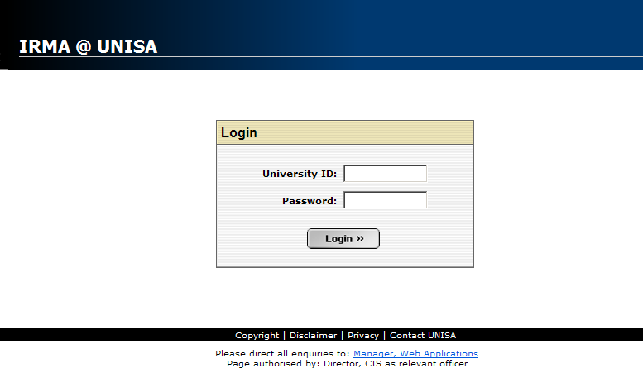
University Office Package for Institutional Research Management (IRMA)

Slide 15
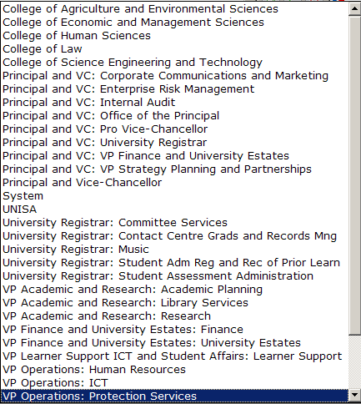
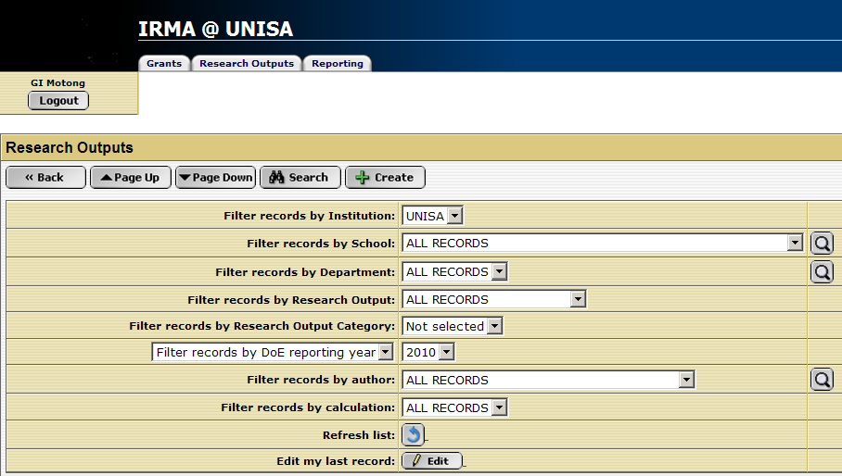

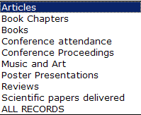
Filtering & data mining of information in IRMA
The system does not allow for searches to be conducted on, for example, the most commonly researched topics and, by extension, the trend of research on a given topic
This limitation can however be overcome by the use of informetric techniques and methods, e.g. content analysis approaches and techniques.

Slide 16
Output by department, 2008
Department | Publications |  |  |  | Total items | DoE score
 | Articles | Books | Chaps in books | Conf proceeds
Christian spirituality | 27 |  | 2 | 1 | 30 | 26.50
English studies | 23 |  | 1 |  | 24 | 24.33
Old Testament | 22 |  |  | 1 | 23 | 22.00
New Testament | 18 | 1 |  |  | 19 | 19.00
Health studies | 20 |  |  |  | 20 | 16.22
Communication science | 10 |  | 1 | 2 | 13 | 15.33
Classics | 6 |  | 2 |  | 8 | 15.00
Teacher education | 17 |  | 1 | 1 | 19 | 14.44
Human sciences | 3 |  | 2 |  | 5 | 13.00
Archaeology | 9 |  | 2 | 2 | 13 | 12.98
Educational studies | 17 |  |  | 1 | 18 | 12.86
History | 7 |  | 2 |  | 9 | 12.16
Music & Art | 11 |  |  |  | 11 | 10.50
Philosophy | 5 |  | 1 | 1 | 7 | 10.25
Graduate studies | 12 | 1 |  |  | 13 | 10.08
Total | 263 | 2 | 18 | 13 | 296 | 300.44

Slide 17
Expected research output
Position Title | Total
Academic CoD | 3
Assistant Curator | 1
Associate Professor | 77
Chair: NRF | 1
Executive Dean CHS | 1
Junior Lecturer | 19
Junior Researcher | 1
Lecturer | 123
Professor | 98
Research Director | 3
Researcher | 1
Senior Lecturer | 137
Senior Researcher | 4
Grand Total | 469
 |  | Expected research Output per person
 | No of staff | Per 5 yrs | Per year | TOTAL
Professor | 98 | 7 | 1.4 | 137.2
Ass Professor | 77 | 6 | 1.2 | 92.4
Sen Lecturer | 137 | 5 | 1.0 | 137.0
Lecturer | 123 | 4 | 0.8 | 98.4
Jun Lecturer | 19 | 3 | 0.6 | 11.4
TOTAL | 454 |  |  | 476.4
The total of 476.4 units excludes research outputs of the other categories of academic staff (such as CODs and other researchers) and admin staff
UNISA’s research output in 2008 was therefore short by 476.40-300.44 = 175.96
NOTE: Some academics produced more than expected

Slide 18
Most common terms
TITLE TERM | HITS
SOUTH | 37
AFRICAN | 33
AFRICA | 29
EDUCATION | 12
AIDS | 11
HIV | 11
NURSES | 10
SCHOOL | 9
SOUTHERN | 9
SCHOOLS | 8
STUDY | 8
CASE | 7
DEVELOPMENT | 7
HUMAN | 7
LANGUAGE | 7
MUSIC | 7
RESEARCH | 7
ART | 6
TITLE TERM | HITS
LITERATURE | 6
READING | 6
SPIRITUALITY | 6
STATE | 6
CHURCH | 5
EARLY | 5
EASTERN | 5
EVALUATION | 5
EXPERIENCES | 5
GENDER | 5
HIGHER | 5
INVESTIGATION | 5
JESUS | 5
LEARNING | 5
SELECTED | 5
TEACHERS | 5
WORLD | 5
CHRISTIAN | 4
TITLE TERM | HITS
ETHICS | 4
FEMINIST | 4
IDENTITIES | 4
JOHN | 4
LEARNERS | 4
LITERACY | 4
MISSION | 4
STUDENTS | 4
WAR | 4
WOMEN | 4
ZIMBABWE | 4
BLACK | 3
CARE | 3
COMMUNITY-BASED | 3
ENVIRONMENTAL | 3
ETHIOPIA | 3
GENOCIDE | 3
HEALTH | 3

Slide 19
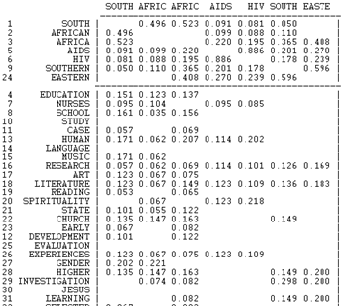
Core/periphery model of most researched topics
Core terms of CHS research
Emphasis is HIV/AIDS research in E and S Africa
Peripheral terms of CHS research

Slide 20
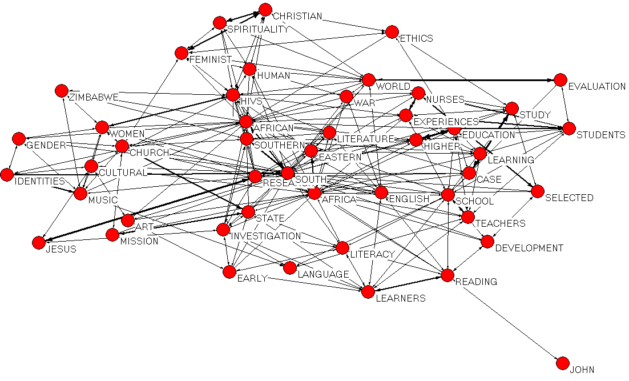
Social map of common terms
Reveals related terms through their co-occurrence in titles. The more frequently two terms co-occur, the stronger is their relationship

Slide 21
Collaboration in research by department
Department | Number of publications per x number of authors |  |  |  |  |  | TOTAL | No. of Co-authored items | Collaboration coefficient
 | 1 | 2 | 3 | 4 | 5 | 6
Sociology |  | 3 |  |  |  |  | 3 | 3 | 1.00
Health studies | 1 | 4 | 15 |  |  |  | 20 | 19 | 0.95
Information science | 2 | 6 |  | 1 |  |  | 9 | 7 | 0.78
Teacher education | 5 | 8 | 3 | 3 |  |  | 19 | 14 | 0.74
Archaeology | 4 | 5 | 2 | 2 |  |  | 13 | 9 | 0.69
Psychology | 3 | 3 | 1 | 1 | 1 |  | 9 | 6 | 0.67
Linguistics | 5 | 6 |  | 1 |  |  | 12 | 7 | 0.58
African languages | 5 | 4 | 1 | 1 |  |  | 11 | 6 | 0.55
Educational studies | 9 | 4 | 3 | 2 |  |  | 18 | 9 | 0.50
Social work | 1 | 1 |  |  |  |  | 2 | 1 | 0.50
Graduate studies | 8 | 3 | 1 | 1 |  |  | 13 | 5 | 0.38
A total of 187 (63.18%) papers were singly authored while 109 (36.82%) were each co-authored by between 2 and 6 authors

Slide 22
Internal vs external collaboration
Department | Internal collaboration | External collaboration | Total | % Internal collaboration | % external collaboration
Health studies | 6 | 13 | 19 | 31.58 | 68.42
Teacher education | 8 | 6 | 14 | 57.14 | 42.86
Archaeology | 0 | 9 | 9 | 0.00 | 100.00
Educational studies | 4 | 5 | 9 | 44.44 | 55.56
English studies | 3 | 5 | 8 | 37.50 | 62.50
Information science | 3 | 4 | 7 | 42.86 | 57.14
Linguistics | 4 | 3 | 7 | 57.14 | 42.86
African languages | 2 | 4 | 6 | 33.33 | 66.67
Christian spirituality | 6 | 0 | 6 | 100.00 | 0.00
Psychology | 3 | 3 | 6 | 50.00 | 50.00
External collaboration was the predominant practice among the CHS researchers with a total of 5 departments recording 100% external collaboration (i.e. collaboration with authors from outside UNISA)

Slide 23
Other areas of study
How many publications, citations, books, patents, etc has a particular author, group of authors, institutions and/or countries/geographic regions, produced?
How much has been produced on a given topical issue, discipline, country, regional area, etc?
How many publications have each been authored by how many authors?
How many publications were published in a given source (journal, magazine, etc?)
In how many languages are documents published?
What is the citation impact of individual authors, departments, faculties and even the whole institution?
Which are the most heavily cited works?
What is the correlation between research inputs and outputs?
What is the institution’s web presence and impact?
What is the trend of institutional repository deposits and use of materials?

Slide 24
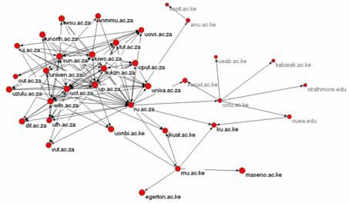
…Visibility?
Web visibility
  in-links and out-links
  Number of pages
  Rich texts
Factors influencing Research visibility
Language of publication
Journals of publication
  Internationality
  Circulation
  Citation impact
Collaboration in research
Individual visibility
Departmental visibility
Institutional visibility

Slide 25



Research Output/impact
Web presence

Slide 26








Self-Archiving in OAI-compliant Institutional repositories
Impact cycle begins:
Research is done
Researchers write
pre-refereeing
“Pre-Print”
Pre-Print is self-archived in University’s Eprint Archive
Submitted to Journal
12-18 Months
Post-Print is self-archived in University’s Eprint Archive
Pre-Print reviewed by Peer Experts – “Peer-Review”
Pre-Print revised by article’s Authors
New impact cycles:
Self-archived research
impact is greater (and faster) because access is maximized (and accelerated)
Refereed “Post-Print” Accepted, Certified, Published by Journal
Researchers can access the Post-Print if their university has a subscription to the Journal
New impact cycles: New research builds on existing research
Source: Harnard (2005)
Notes:
To maximise research access, supplement the existing system:
Do as before, but also:
Self-archive the preprint in your university’s Eprint Archive, so every would-be user can access it.
Self-archive the postprint in your university’s Eprint Archive, so every would-be user can access it.
Research access is maximized and so research impact is maximized.

Slide 27
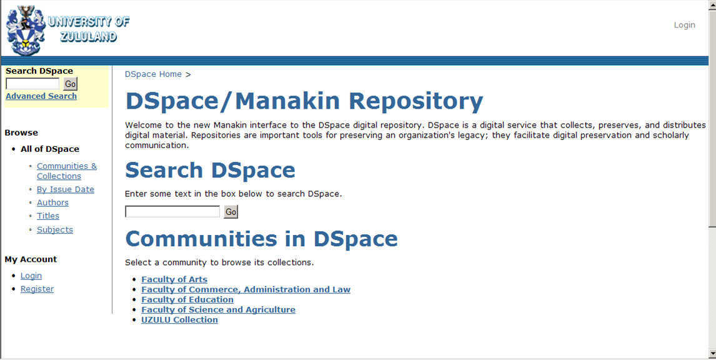
UNIZUL Institutional repository
Arts = 223
Commerce, Administration and law = 14
Education = 60
Science and Agriculture = 72
Dissemination of research findings to gain visibility

Slide 28
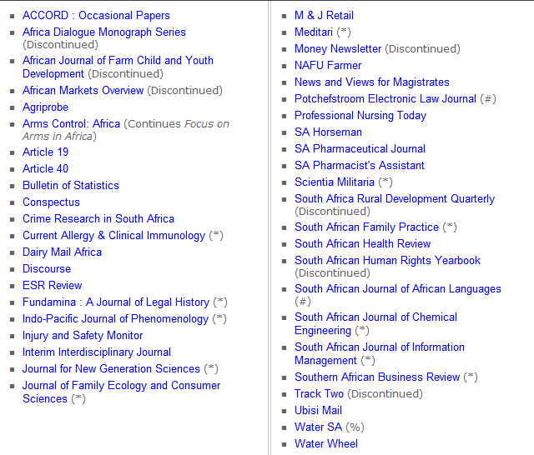

14 in DOAJ
Open access journals? About 20 are OA
Language of publication? Largely English with Afrikaans
Frequency of publication? Mainly quarterly – Others are irregular
Circulation? Majority - 2000
Consider co-publication with other countries? Minimal co-publication

Slide 29
Other issues to consider
  Ratio of research in natural sciences to social sciences, on one hand, and to Arts and humanities, on the other, in SA is 1:9.20 and 1:28.01 respectively. For growth of Social Sciences and Arts and Humanities research output to be realized
    Encourage multidisciplinary research?
    Research within the focus/niche areas – expansion of areas
    Research within the Millennium Development Goals
    More funding, Perhaps!
  Visibility (influence/impact)
    Collaboration with international scholars
    Presentation and/or publication of research findings both nationally and internationally
    Application for NRF rating – Researcher visibility?
    Web presence is required
  Converting theses and dissertations into research articles
  “The incumbent will draft scientific articles based on data published in dissertations and theses of postgraduate students and data collected by academic staff during research for non-degree purposes” (Sunday Times, Business Times section, 10 August 2008:6)

Slide 30
Conclusion
Informetric approaches should be seen as complementary to other scientifically proven methods of research evaluation/assessment such as peer review and not a substitution – Mixed Methods Research comes in.
AND
The findings generated by informetric studies should be viewed as essential but not as the only pointers of research activities and impact and visibility of individuals, institutions and even countries

Slide 31
Thanks
Contact details
Dr. OB Onyancha
University of South Africa
College of Human Sciences
Dept of Information Science
Box 392 UNISA 003
onyanob@unisa.ac.za

