Slide 1

Western Art Music in History and Society
Dr Annemie Behr
stimia@unisa.ac.za
University of South Africa
Notes:
The purpose of this video is to introduce a series of modules on Western Art Music in History and Society, offered at the University of South Africa. These modules are an integral part of the Bachelor of Music program and are also accessible to Bachelor of Arts students. Their content broadly encompasses Western Art Music, History, and Society.

Slide 2
UNISA modules
MHS1511: Early Music to Baroque
MHS2611: Classic and Romantic Music
MHS3711: Modernism and 20th Century Music
MHS3714: Opera and Choral Music
Notes:
The series consists of three modules providing a chronological survey of Western Art Music from the Ancient World to the present. These modules are structured within the music degree to progress sequentially from level one to level three. Additionally, there is a fourth module dedicated to Opera and Choral Music, where these genres are explored in their contemporary forms with a focus on South African, African and global contexts. Introduction videos for each module will be made available separately.
For now, I introduce some fundamental aspects that will be worth revisiting whenever a new module is undertaken.

Slide 3
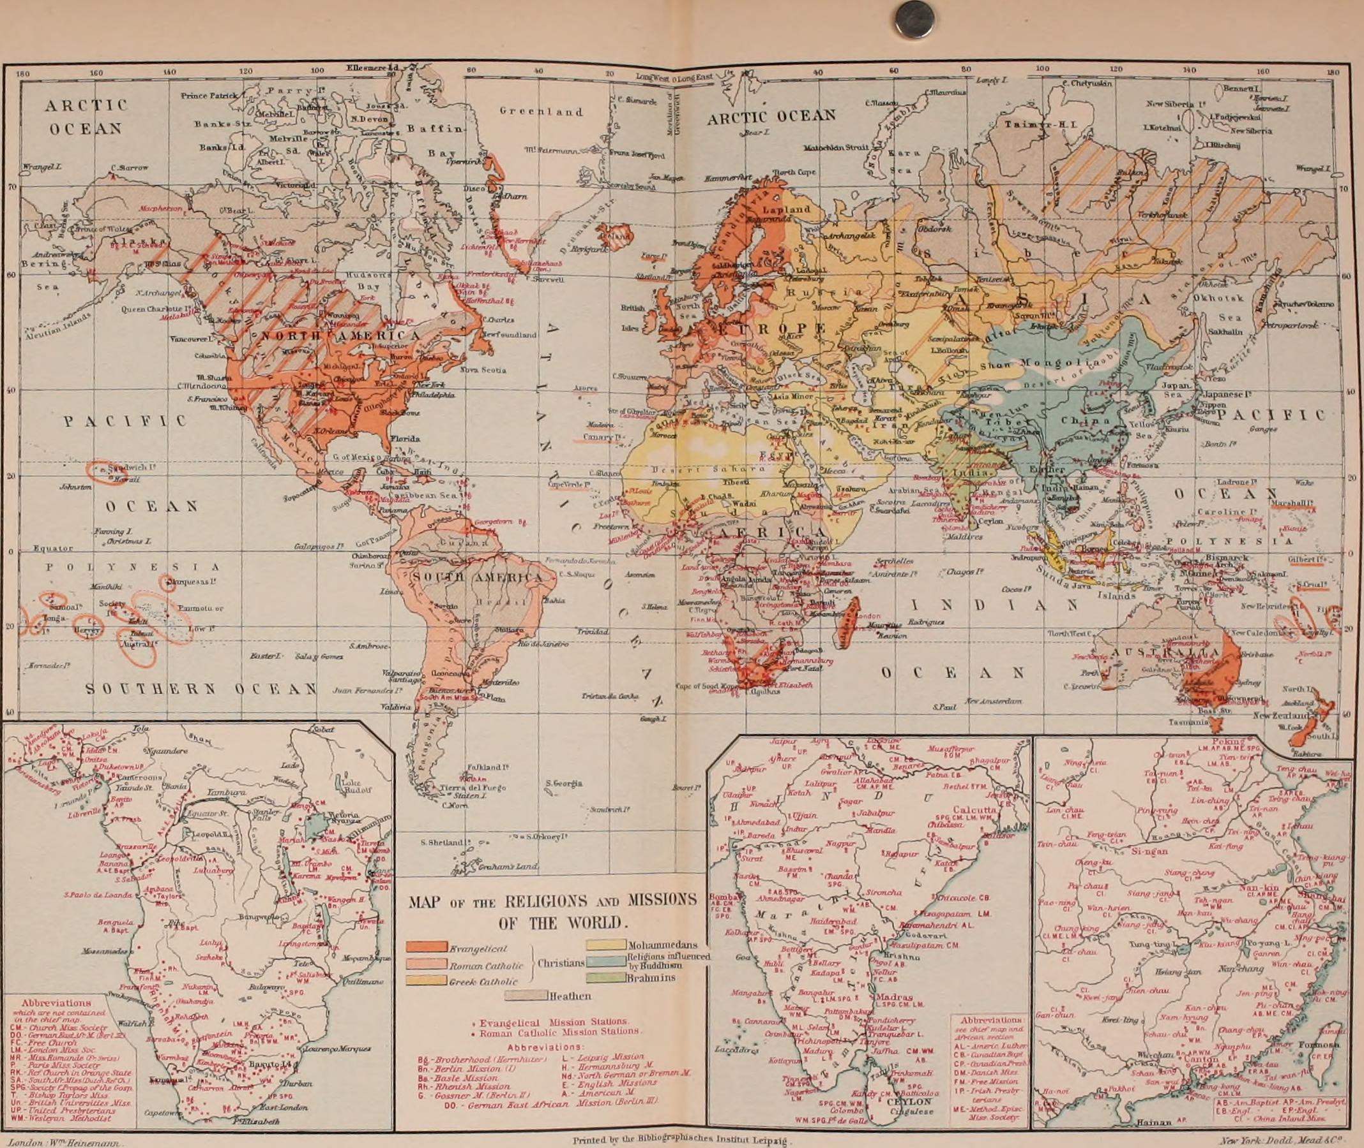
Internet Archive Book Images. 2014. The history of the world; a survey of a man's record. Wikimedia Commons. Available at: https://commons.wikimedia.org/wiki/File:The_history_of_the_world;_a_survey_of_a_man%27s_record_(1902)_(14773616532).jpg; Accessed 13 March 2023.
Notes:
https://commons.wikimedia.org/wiki/File:The_history_of_the_world;_a_survey_of_a_man%27s_record_(1902)_(14773616532).jpg
It is important to recognize that these modules are semester-based, allowing only twelve weeks to cover extensive periods of history. The first module, for instance, covers a music history spanning an entire millennium! It is thus crucial to bear in mind that these modules aim to provide only a survey, essentially like a map that offers a condensed representation of the vast world of Western Art Music history. Consequently, they inherently fall short in capturing the true depth and complexity of the subject matter, including the tangible realities of various aspects.
After completing these modules, rather than feeling like you have gained a comprehensive understanding of the subject, you may come to realize how much you still don’t know. It is normal for such a survey to leave you with a heightened awareness of the vast amount of knowledge that exists beyond what is covered in these courses.

Slide 4

Soriano, David S. 2023. Bird in Flight. Wikimedia Commons. Available at: https://commons.wikimedia.org/wiki/File:Bird_In_Flight.png; Accessed 13 March 2023.
Notes:
https://commons.wikimedia.org/wiki/File:Bird_In_Flight.png
Imagine it like this: You are a bird – in fact, we are a flock flying together, migrating from one place to another. Every now and again, one of us dives down to grab a worm or sit on a branch for a while, but we quickly return to the sky so as not to miss the journey. The souvenir you grab from the ground will be different from the one I choose, but each item we collect represents a small piece of the landscape that we can see from above, yet will never fully know.

Slide 5
Content:
what we think
Engaging content:
how we think
Notes:
What we learn in our courses has less to do with the content itself and more to do with the skills required to engage with the content. Here, "content" refers to "what" we think, while "engaging content" refers to "how" we think.

Slide 6

Why Western Art Music?
Colonisation:
  How did we get here?
Decolonisation:
  How do we proceed from here?
Notes:
The content of this series of modules - the essence of our thinking - is Western Art Music. However, there is a concern to address: many students who enroll for music studies at UNISA have little to no background in Western Art Music or show limited interest in it. You might wonder, “If I am interested in Jazz, or popular music, or African music; why should I bother with classical music? What relevance do Bach, Mozart and Beethoven hold?” You may be surprised to learn that this question extends far beyond South Africa and Africa. People worldwide ponder the significance of Western art music from various perspectives and for diverse reasons.
*In our context, this question is deeply intertwined with a troubling history of colonization, which has influenced how African communities view themselves. It represents a history of power, domination, oppression, and exploitation. Through the study of Western Art Music's history, we confront the question: "How did we get here?" Understanding this history is important for multiple reasons, including the continued practice, enjoyment, and creation of this music on the African continent. Furthermore, our music education systems and curricula still predominantly favor the theoretical principles of Western Art Music over other forms of musical knowledge. As we progress through this series, we will discover and contemplate more reasons behind this question.
*As we explore how we arrived at this point, we must also consider how to proceed from here. In 2015, students of the #Rhodesmustfall movement called for decolonizing education in South Africa. Therefore, the question of what decolonization means in the study of Western Art Music in history and society should be a central topic in many of our conversations throughout this series.
As an introduction to the series, it would be beneficial to discuss the concept of "history" itself - how we perceive it and how it shapes our thinking.

Slide 7
History as storytelling
(her)story
  Who tells the stories?
  Whose stories are told?
Power: History is told by the victors, not the victims.
Patriarchy, “whiteness”, Eurocentrism, coloniality
Notes:
I propose that we approach history as a mode of storytelling.
*Have you, by any chance, come across the term "herstory" on social media or while browsing the internet? I use this feminist term to illustrate what I mean by history as storytelling. "Herstory" is a wordplay coined and utilized by feminists to challenge the patriarchal values that have shaped the construction, consumption, and understanding of history for centuries. It draws attention to two essential questions that will be recurring themes in this series:
1. Who is telling the story?
2. Whose stories are being told?
In the Western context, feminists highlight that "history" is often cast as "his story," narrated by men rather than women. Consequently, history tends to present an imbalanced and biased perspective. Women's roles as social actors and political agents are underrepresented in the historical accounts presented by men.
*The broader principle that the term "herstory" implies, and which we must remain conscious of, is how history is intricately tied to power. You might have come across the saying that history is often told by the victors, not the victims. Decolonial thinkers, therefore, object not only to the male-centric aspect of history like feminists but also to its "whiteness" and Eurocentrism.
*As you progress through this series of modules, keep in mind the key themes of patriarchy, whiteness, Eurocentrism, and coloniality. From the outset, I encourage you to approach this course with a critical mind. Be critical of everything: your lecturer's notes, study guides, prescribed books, and every source you consult while preparing your assignments. Adopting a critical perspective will enrich your understanding and allow for a more inclusive exploration of history and its various narratives.

Slide 8
Avoid the Master Narrative
who is telling the story and whose story is told?
why does this specific person write this specific story?
how can the story be different?
Mozart is the best composer of all time, and his works are all masterpieces.
Notes:
Whatever you read, always ask yourself: who is telling the story, and whose story is being conveyed? Once you begin with these questions, you will naturally progress to the following inquiries: why is this specific person writing this particular story, and what might their underlying agenda be? Are there alternative ways to narrate the same story from different perspectives? How can the story be presented differently?
I urge you to be cautious of a common trope that appears in many histories of Western Art Music, one that I often encounter in students' assignments as well: the notion of the "Master composer" and the "Masterwork." These ideas often manifest as extreme statements like, "Mozart was the greatest composer of all time, and all of his works are masterpieces." Such narratives perpetuate the biases of conventional histories that seek to portray Western civilization as superior while marginalizing other civilizations as primitive.
Stay vigilant against falling into this trap of reinforcing the "Master composer" narrative and be open to exploring a more diverse and inclusive perspective on the history of Western Art Music. Recognize that artistic excellence is not limited to any single culture or civilization and that a richer appreciation of music history comes from acknowledging and celebrating the contributions of various cultures and individuals.

Slide 9
Conclusion
Western Art Music’s resonances in Africa and Europe are different.
Project: to decolonise the study of Western Art Music
Storytelling through…
…cycles of listening and responding:
history
music
ourselves
each other
Notes:
As we embark on our studies of Western Art Music in history and society, I encourage us to approach this journey with an awareness of our own location and histories:
*we find ourselves on the African continent, where Western Art Music resonates differently than it does on the European continent.
*For this reason, I suggest that we make decolonizing the study of Western Art Music a central focus as we progress through these modules. Implicit in this recommendation is the recognition that the study of Western Art Music at African universities has not been fully decolonized yet. I invite all undergraduate music students to actively participate in this essential decolonizing project while preparing assignments, collaborating with peers, and engaging in class discussions. We can do so by adopting history as a mode of storytelling, continuously questioning who is telling the stories and whose stories are being told. Moreover, let's begin sharing our own stories and learning from the narratives our peers will share.
*These stories will evolve through repeated cycles of listening and responding:
*we will listen and respond to history;
*we will listen and respond to Western Art Music;
*we will listen and respond to ourselves; and
*we will listen and respond to each other.

