Slide 1

Unisa 2022 Founders Lecture
“The Realisation of the African Renaissance through the African Continental Free Trade”

Slide 2
THE PAST LECTURES

Slide 3
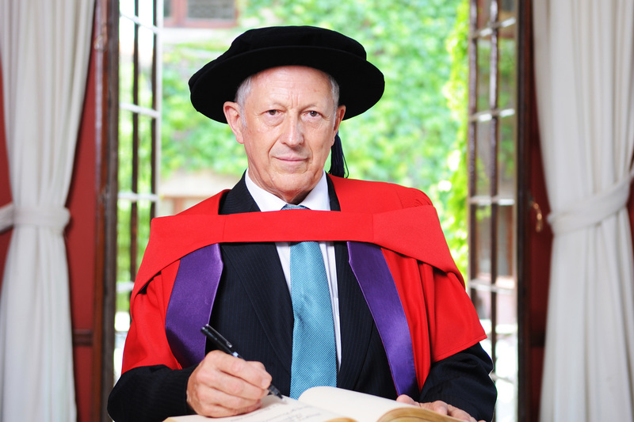

2006 - Prof George Ellis
Current position:
Retired Position when presented the Lecture: Professor of Complex Systems:
University of Cape Town.
Topic: The role of a University in a democracy: Breadth, Depth, Tolerance

Slide 4
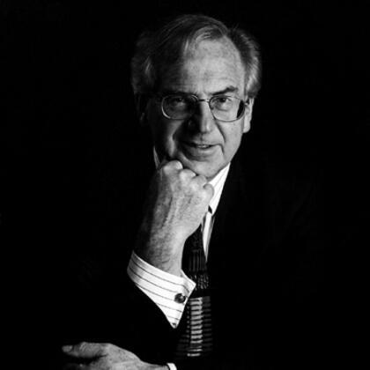
2007 - Lord Stewart Sutherland
Deceased: 2018
Former Provost: Gresham College, and President of the Royal Institute of Philosophy.
Topic: The Role of Truth in Determining the Health of a University

Slide 5
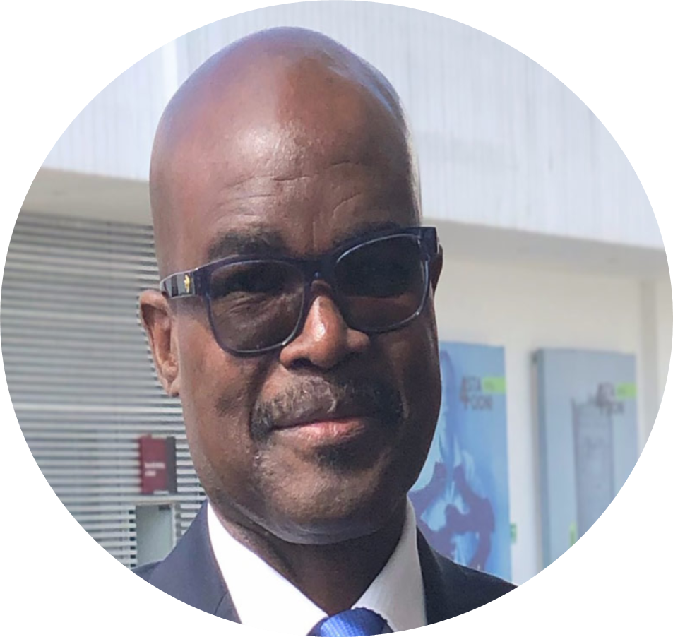
2008 - Prof Paul Zeleza
Current Position :
Vice-Chancellor of United States International University Africa
Position when he delivered the Lecture: Professor of African Studies and History: Pennsylvania State University. Topic: Critical Issues in Higher Education in Intellectual Development in Africa

Slide 6
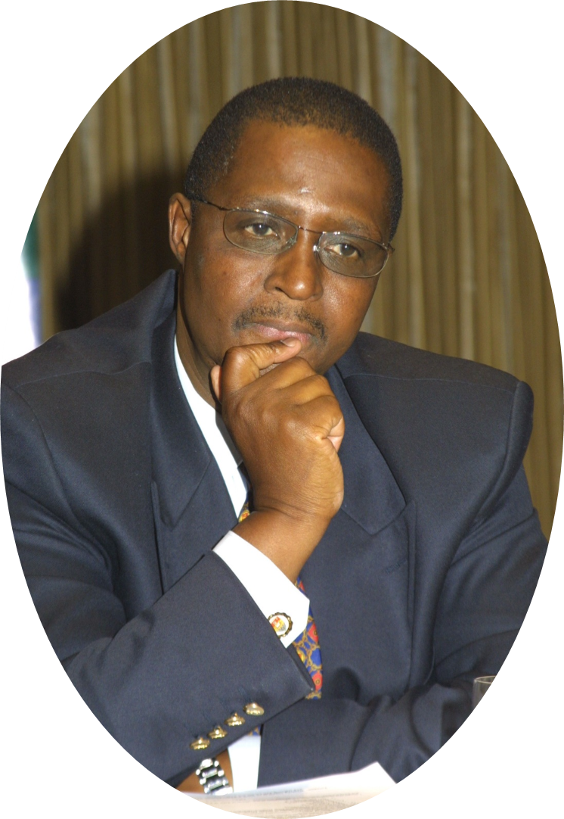
2009 - Prof Barney Pityana
Current position:
Chairperson of National Lottery Commission.
Position when he delivered the Lecture: Former Principal and Vice-Chancellor: Unisa.
Topic: The Necessity for Change in Higher Education Towards a Truly African Expression and Experience of Higher Education

Slide 7
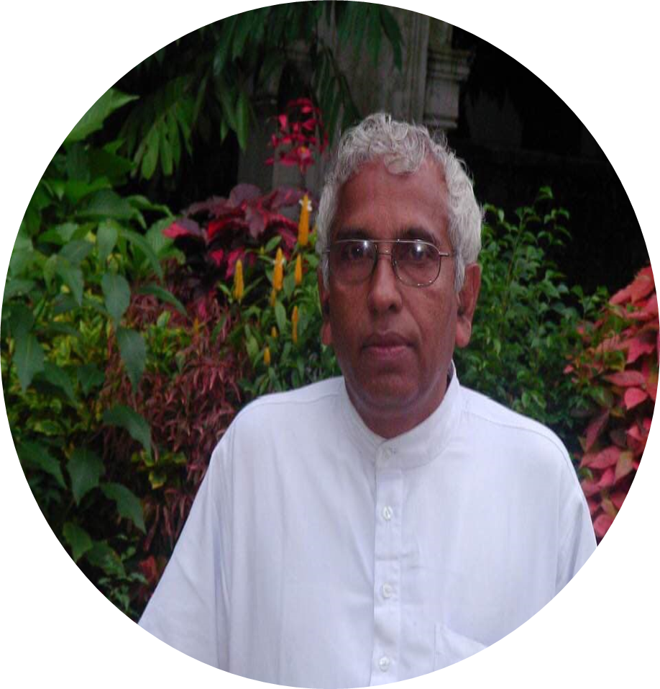
2010-Dr Thirumalayaperumal Karunakaran
Current Position:
Vice-Chancellor, Gandhigram Rural Institute-Deemed University. Topic: The Concept of a University in a Developing Society

Slide 8
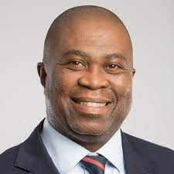
2011 - Dr Philemon Mjwara
Current Position :
Director-General: Department of Science and Technology.
Topic: The role of innovation for sustained economic growth in the 21st Century: Is this what South African needs in the next decade?

Slide 9
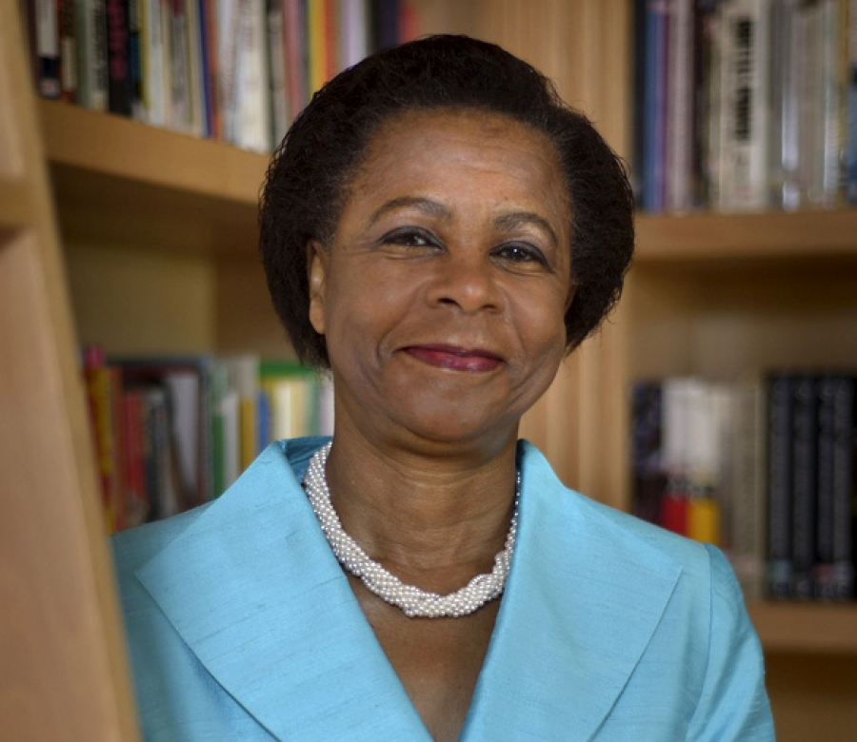
2012- Dr Mamphele Ramphele
Current position:
Founder: Citizens Movement.
Topic: Educating and training the 21st Century South African Citizen.
Re-Imagine and rebuild education in South Africa

Slide 10
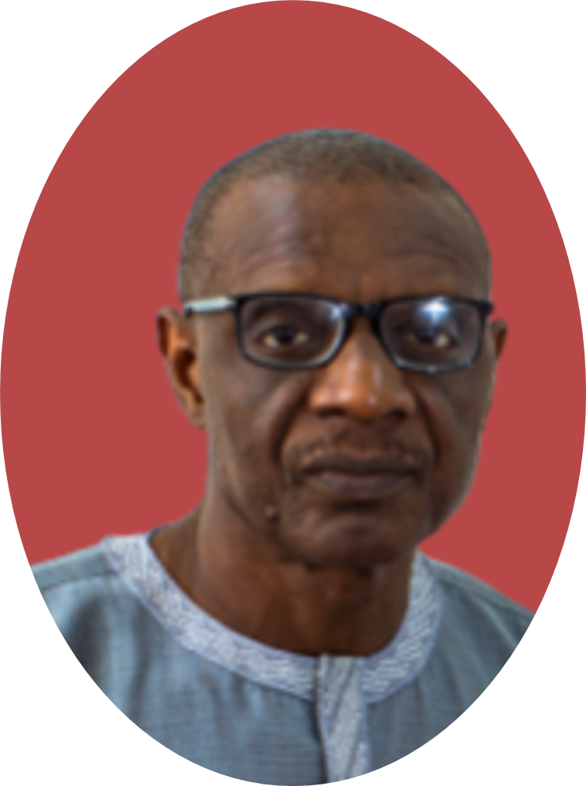
2013 - Dr Ebrima Sall
Current Position:
Executive Secretary: Council for the Development of Social Science Research in Africa (CODESRIA).
Topic: The University and Social Transformation in Africa: Revisiting an Old Problematic in the Era of Globalisation.

Slide 11
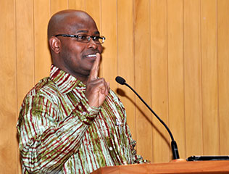
2014 - Prof Adebayo Olukoshi
Former: Director UN African Institute for Economic Development and Planning.
Topic: The theme of the renegade behaviour which Mphahlele addresses frontally in the poem is one which resonates very much with me in what I have described for this lecture as the season of anomie that our continent is going through.”

Slide 12
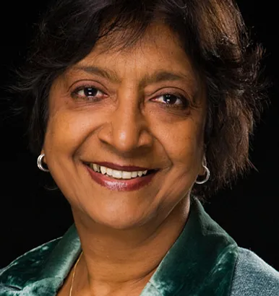
2015 - Judge Navi Pillay
Current Position:
President of the Advisory Council of the International Nuremberg Principles Academy.
Position held when delivered the Lecture: Former United High Commissioner
for Human Rights.
Topic: The impact of the model law on access to
information for Africa

Slide 13
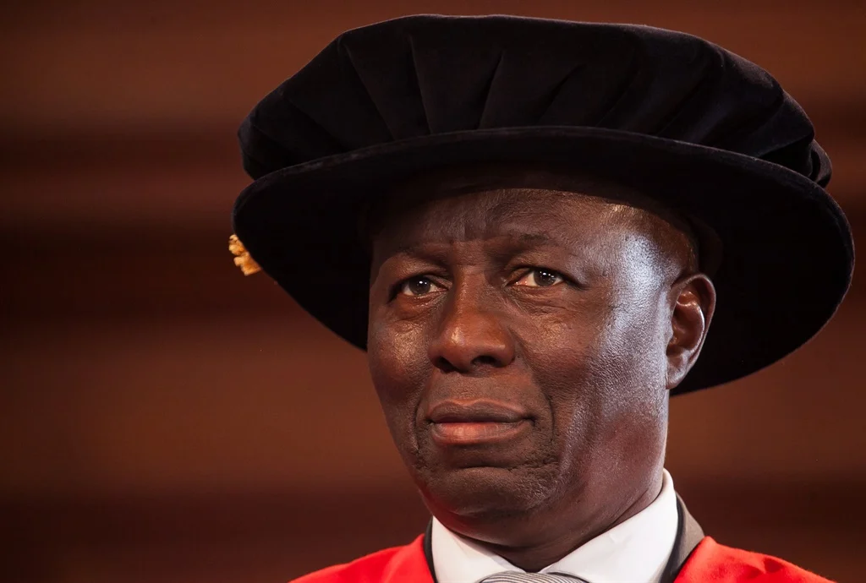
2016 – Justice Dikgang Moseneke
Current position:
Retired Judge
Position when he delivered the Lecture: Former Deputy Chief Justice of South Africa.
Topic: Is the claim that university #FeesMustFall is at odds with the democratic projects?

Slide 14
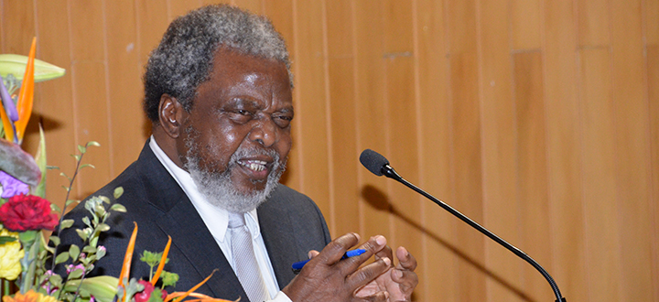
2017 - Prof Muxe Nkondo
Current Position:
Board member of The Mzansi National Philharmonic Orchestra and Unisa member of Council
Position when he delivered the Lecture:
Unisa Council Member.
Topic: Understanding and Institutionalising Decolonisation for Inclusive Higher Education
in South Africa

Slide 15
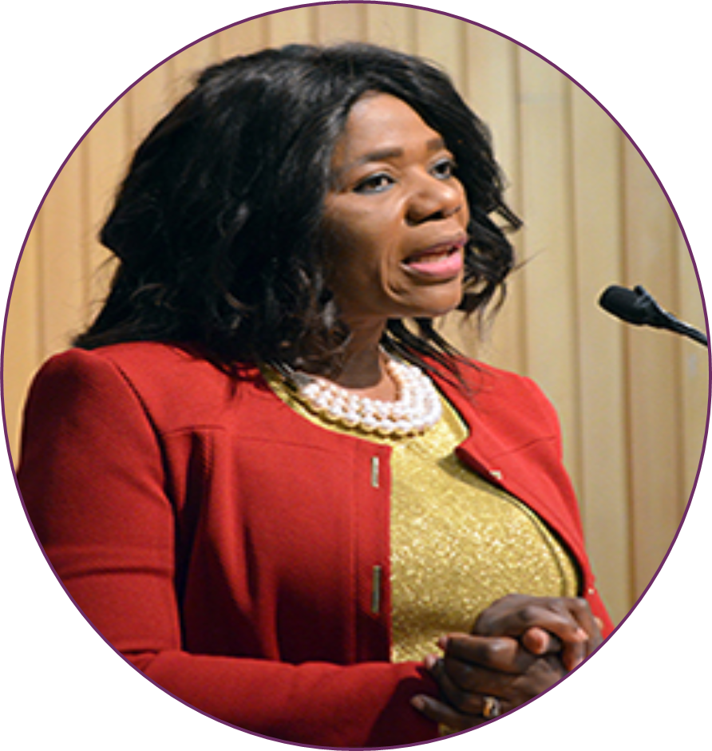
2018 - Prof Thuli Madonsela
Chair: Law Trust in Social Justice and Law Professor: University of Stellenbosch, and Former Public Protector of South Africa.
Topic: ‘Ethics in democracy’

Slide 16
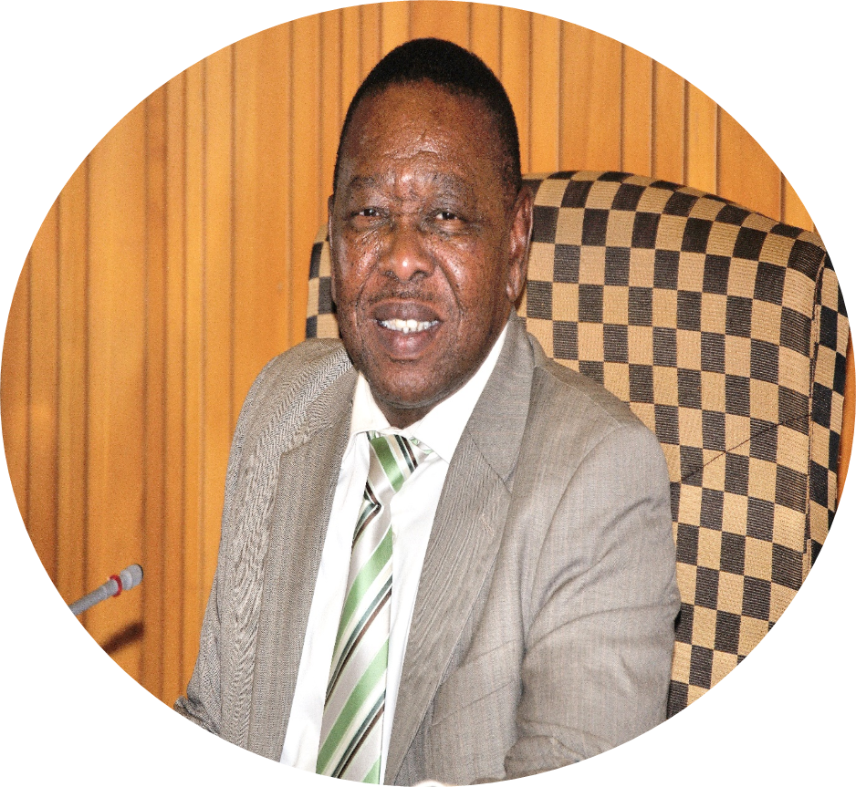
2019 - Dr Blade Nzimande
Current Position:
Minister of Higher Education, Science and Technology.
Topic: The role of transformative higher education in a development state and its response to the challenges and opportunities posed by the industrial revolution

Slide 17
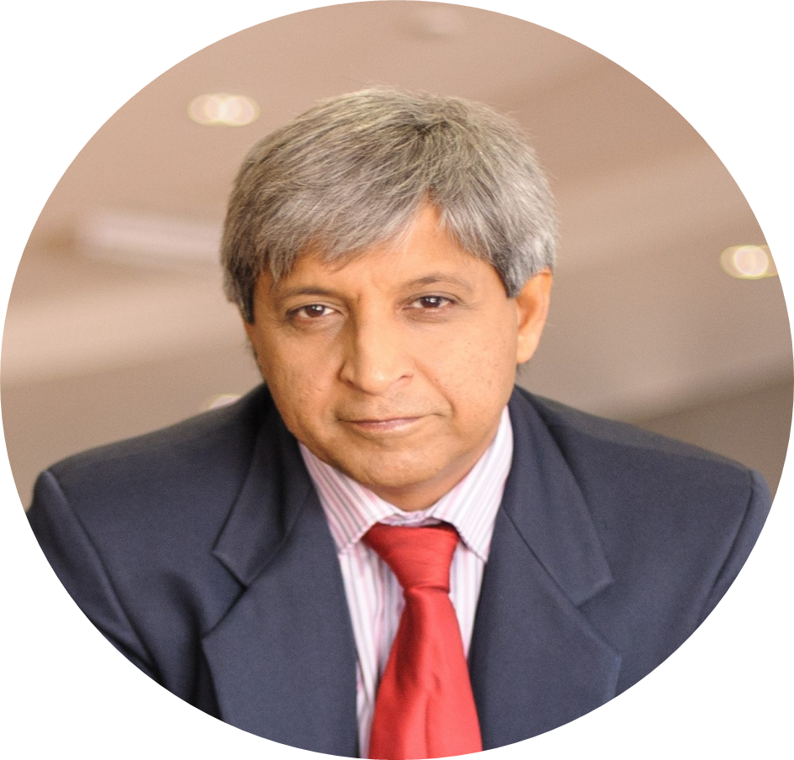
2020 – Prof Adam Habib
Current position:
Director of the School of Oriental and African Studies, University of London.
Position when he delivered the Lecture: Vice-Chancellor and Principal: University of the Witwatersrand (Wits).
Topic: Covid 19 : what it reveals about who we are and what could be?

Slide 18
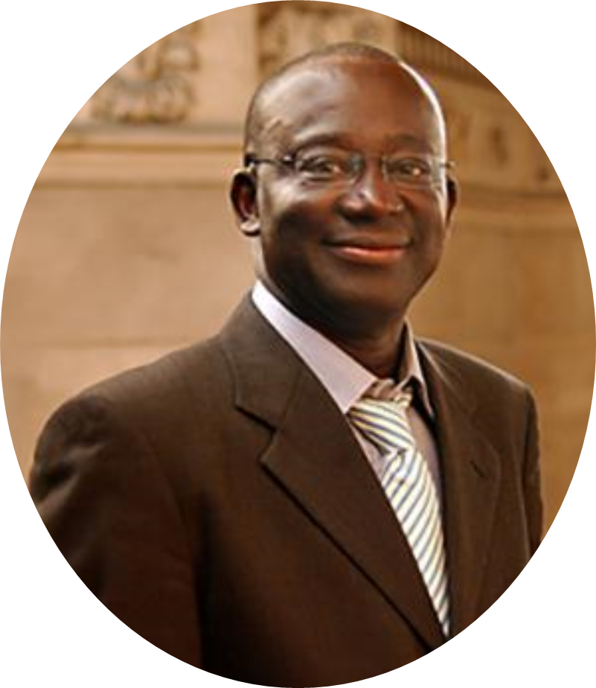
2021 – Prof Mamadou Diouf
Current position:
Director: Institute for African Studies: Columbia University.
Position held when he delivered the Lecture: Leitner Family Professor of African Studies and History, Middle East and South Asian and African Studies (MESAAS). Columbia University.
Topic: Explorations in “Reclaiming Africa’s futures”: The Sources of African Humanities

Slide 19
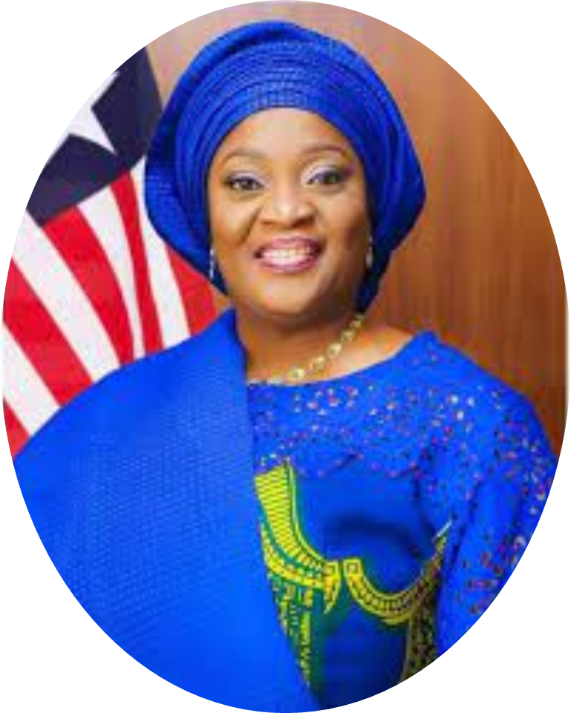
2022 - Her Excellency
Madam Dr. Jewel Howard-Taylor
Vice President
of the Republic of Liberia.
Topic: “The Realisation of
the African Renaissance through the African Continental Free Trade”

