Slide 1

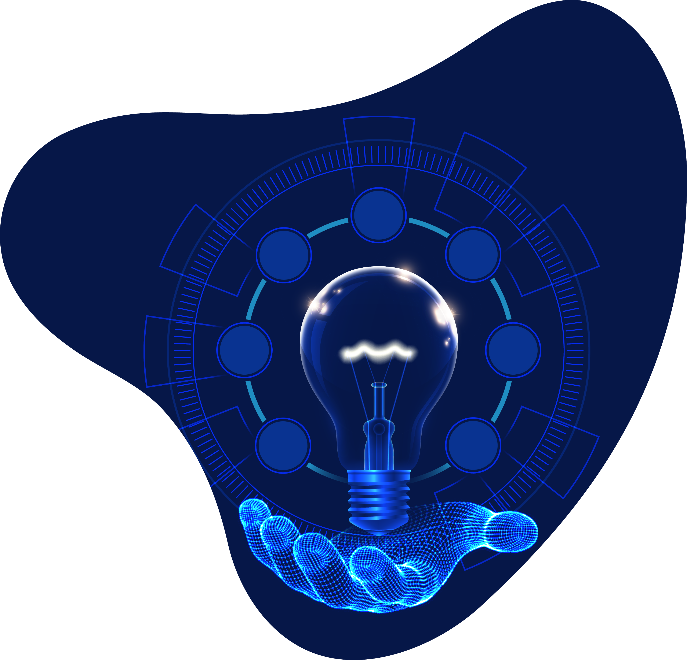


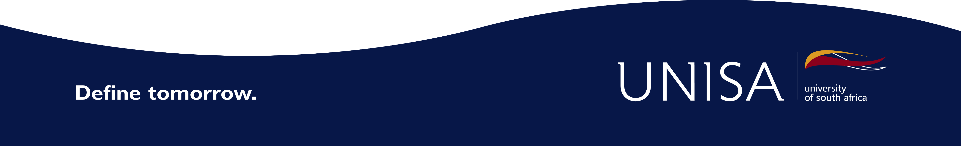
Digital Preservation and Digitisation at Unisa Library and Information Services

Slide 2
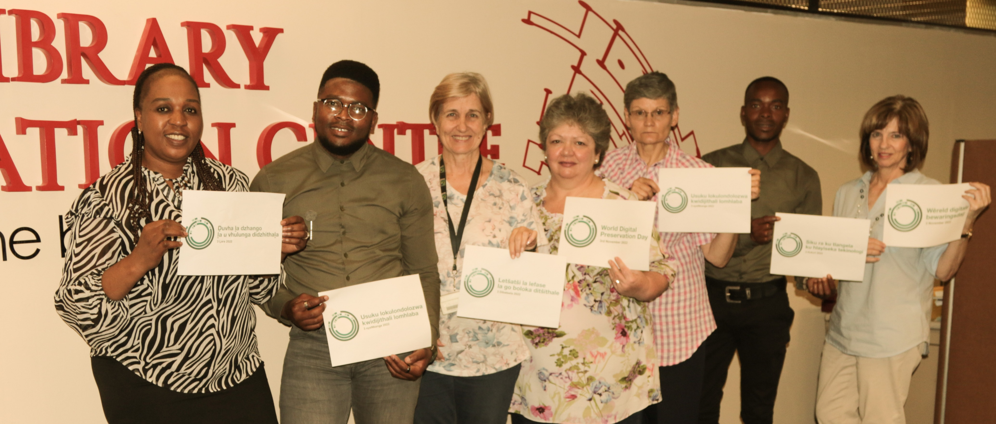
Unisa Library supports World Digital Preservation Day
Library and Information Services

Slide 3
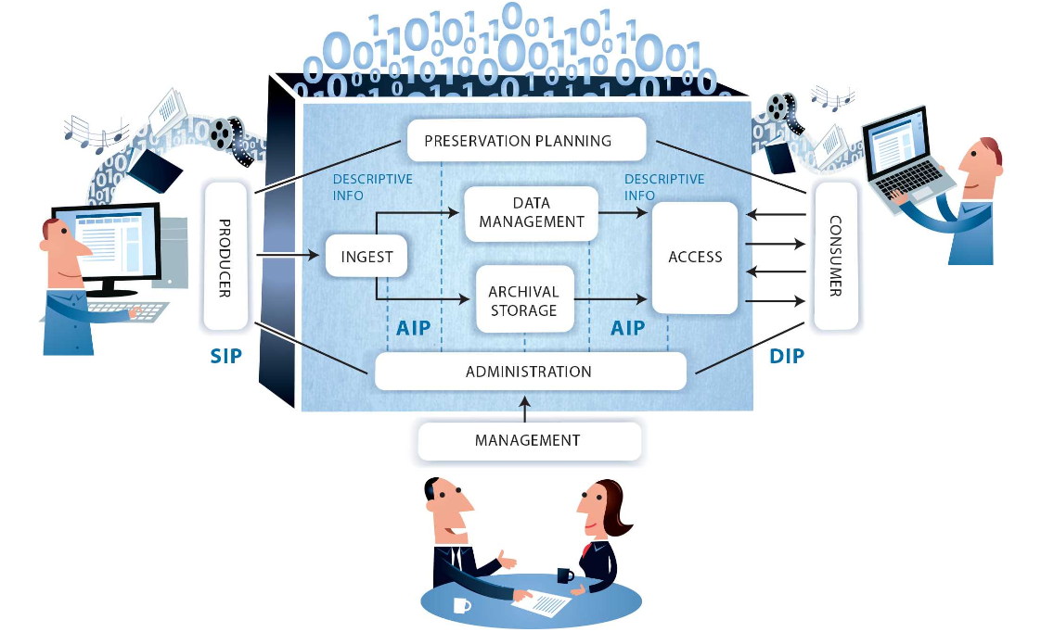
Preservation Life Cycle
Library and Information Services
The digital preservation lifecycle refers to all of the stages required to preserve and sustain access to digital content; from creation to ingest, management and administration to access and reuse.
Digital preservation - Wikipedia
www.dpconline.org/digipres/tags/preservation-lifecycle

Slide 4
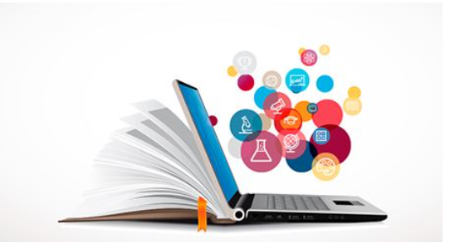
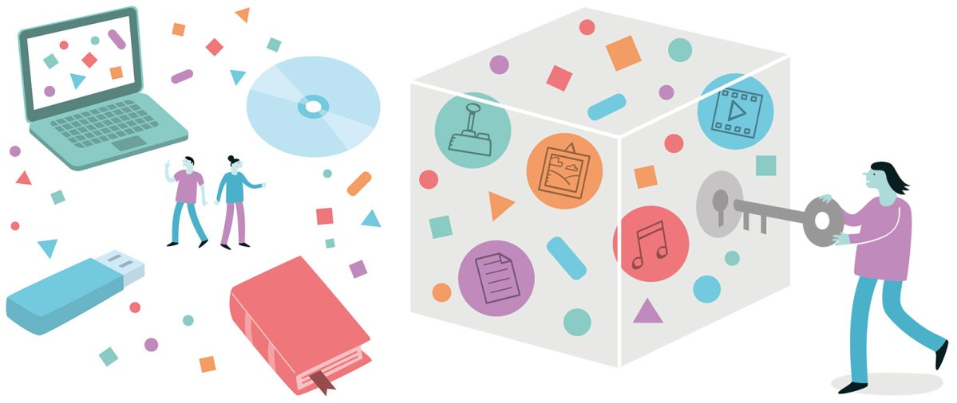
Digitisation versus Digital Preservation
Library and Information Services
Digitisation
It is the process of taking traditional library materials, that are in the form of books and papers and converting them to the electronic form, where they can be stored and manipulated by a computer.
Digital Preservation
The processes and operations in ensuring the technical and intellectual sustainability of digital content through time, to maintain access to digital materials beyond the physical media, format or technological obsolescence.
It requires policies, planning, resource allocation (funds, time, people) and appropriate technologies and actions to ensure accessibility, accurate rendering, and authenticity of digital content.
https://blog-ica.org/2020/06/10/getting-started-in-digital-preservation-taking-your-first-steps/
Seifi, L. (2011). Digitization and digital preservation of the heritage collection in select libraries in India and Iran: a comparative study. Retrieved From: http://hdl.handle.net/10603/17836

Slide 5

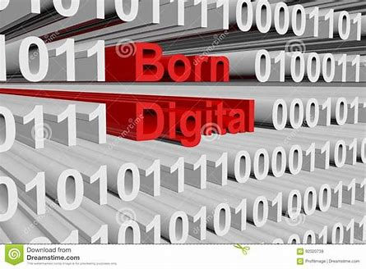
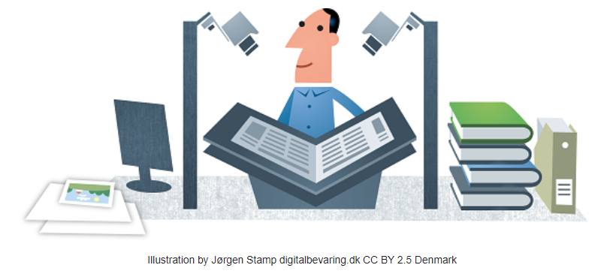
Creating digital content (Digitisation) vs Born Digital Content
Library and Information Services
Creating digital surrogates for example digitisation of theses and dissertations that were originally submitted in printed format.
Born-digital materials for example theses and dissertations submitted in electronic format
Creating digital materials - Digital Preservation Handbook (dpconline.org)
https://www.dreamstime.com/stock-illustration-born-digital-form-binary-code-d-illustration-image92020739

Slide 6
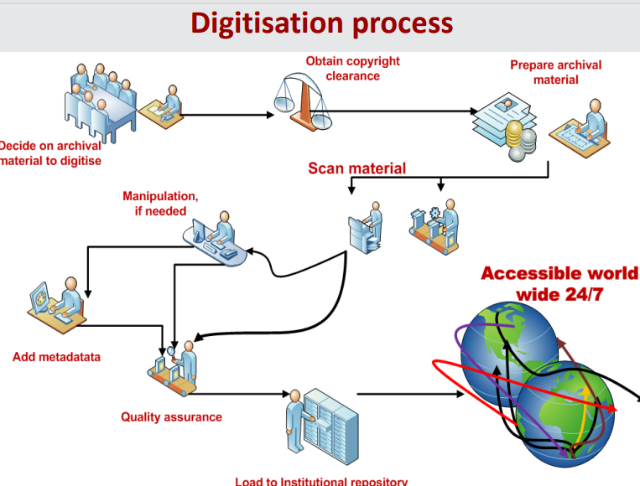

Slide 7
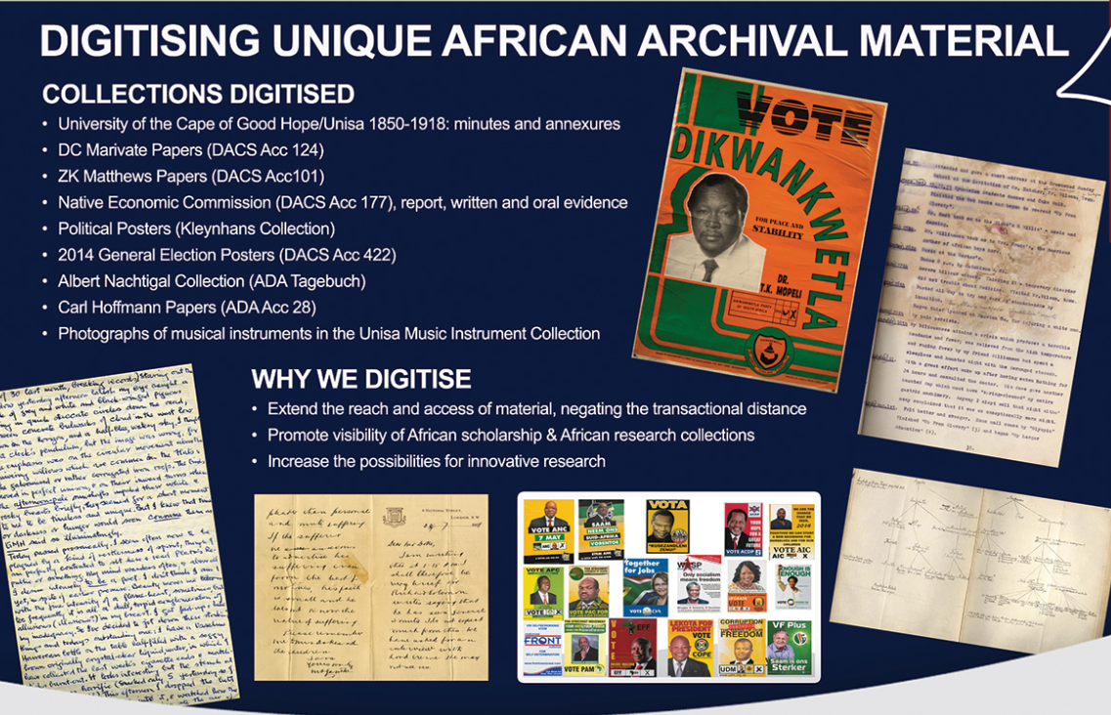
Selection process Assessment of need for digitisation
Library and Information Services

Slide 8
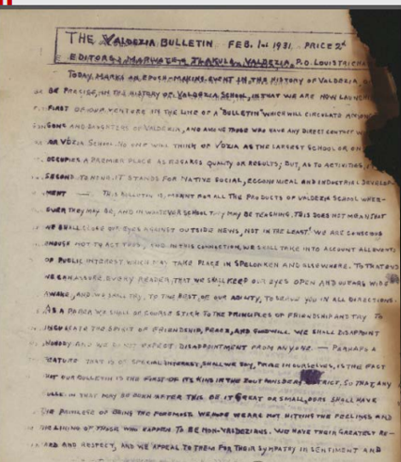
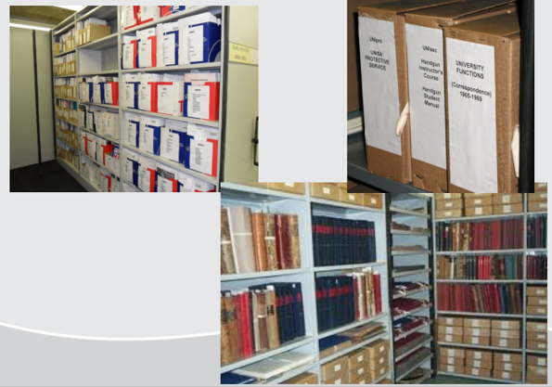
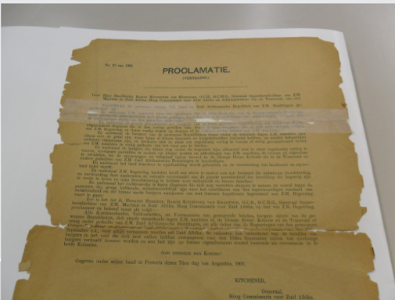
Selection of brittle unique archival materials to digitise for preservation purposes
Preparation for digitisation includes retrieval of the items from the shelves, removal of staples, pins, cello tape, repairing tears and broken corners, etc.

Slide 9
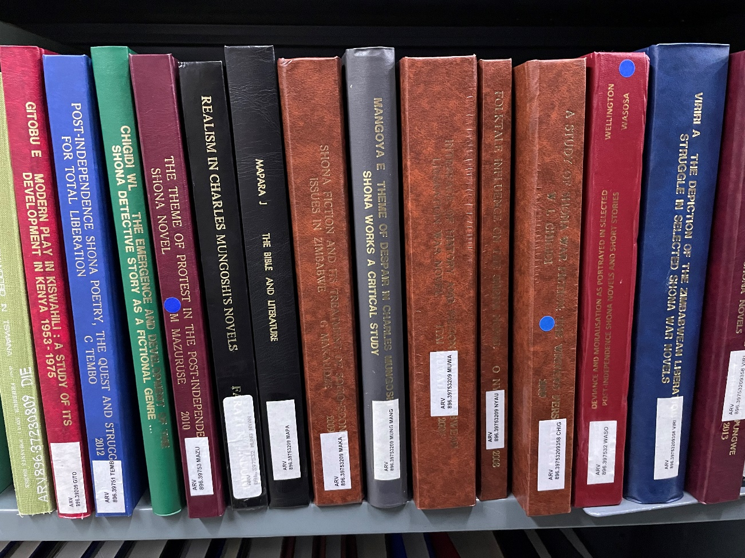
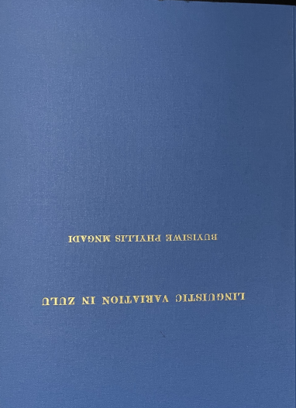
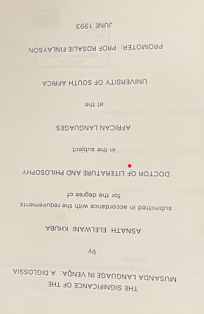
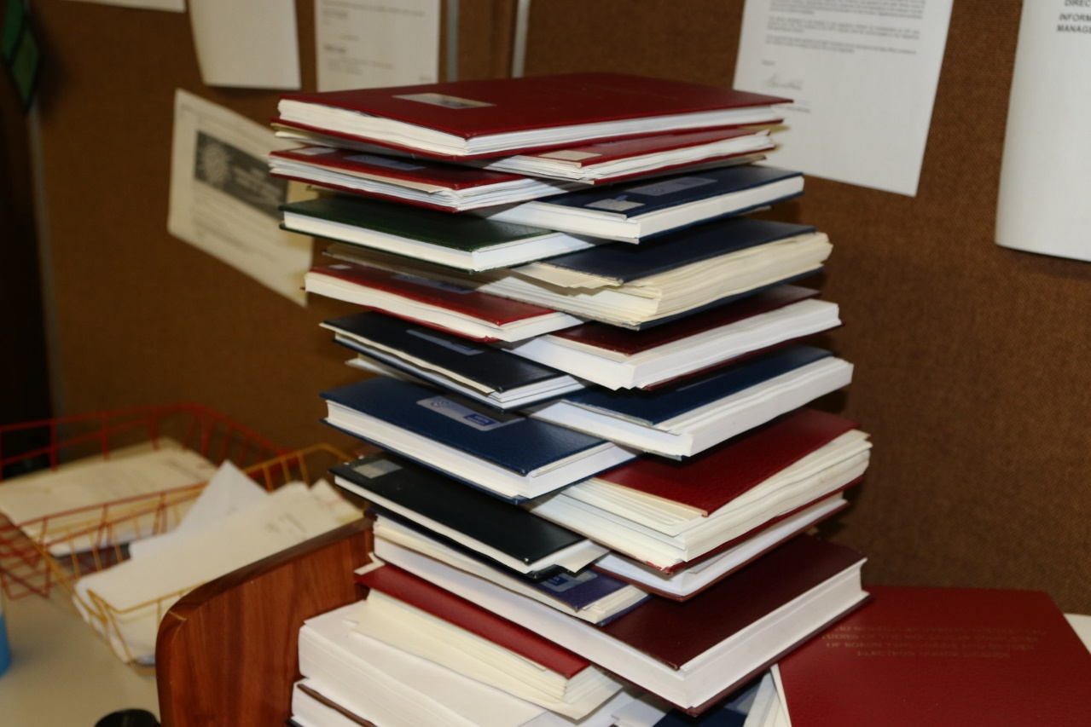
Preparation for digitisation includes retrieval of the items from the shelves, cutting of the spines
Selection of African Language theses and dissertations from the shelves to preserve African Indigenous content
Library and Information Services

Slide 10
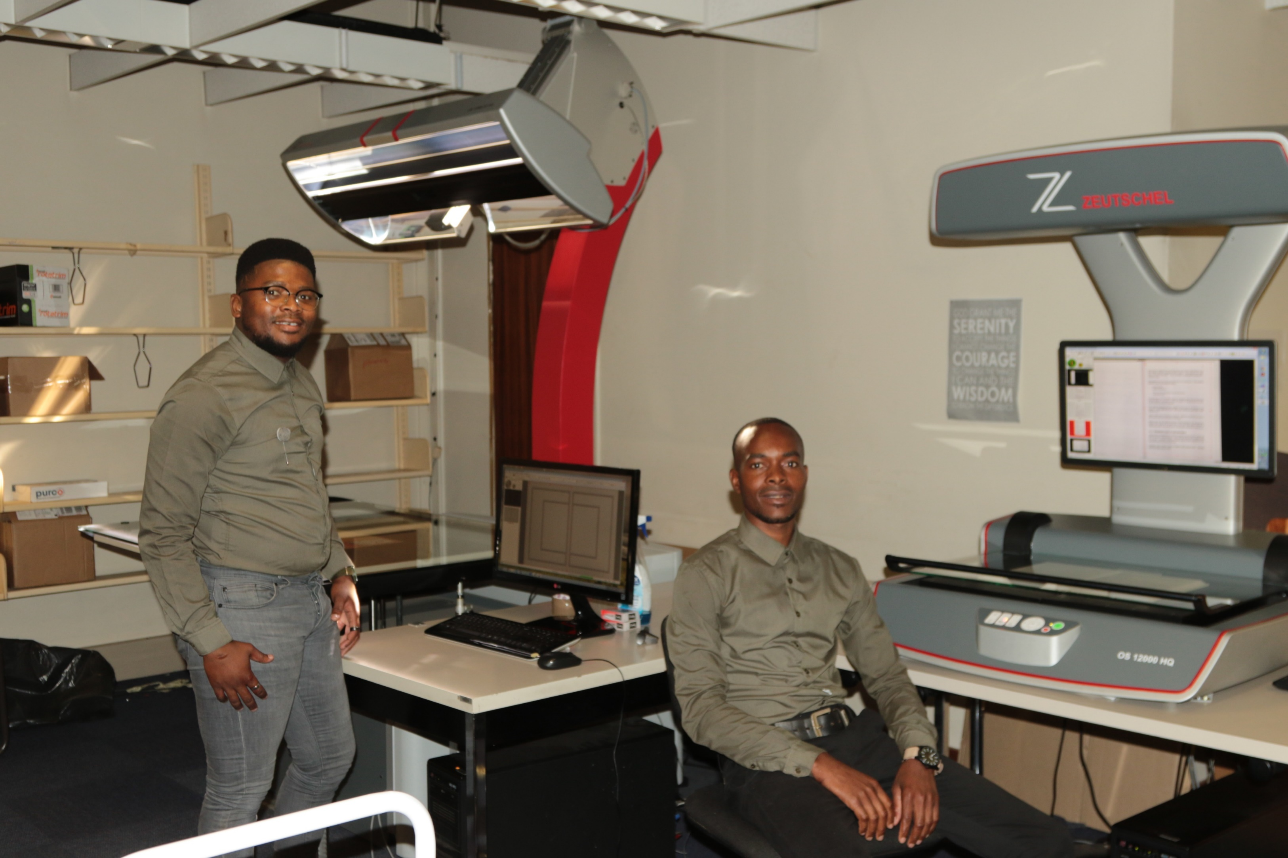
Digitisation Specialists scan the documents on overhead or high speed scanners depending on the condition of the original document
Library and Information Services

Slide 11
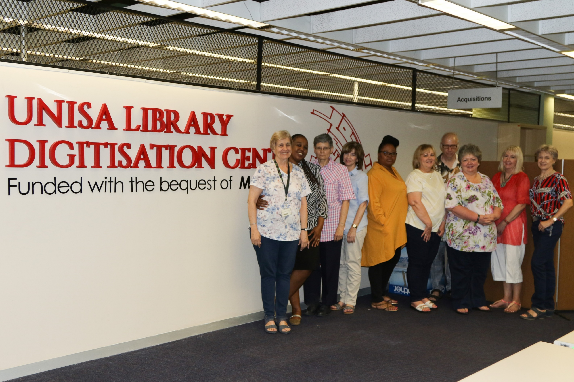
Metadata and uploading are done by the Metadata specialists in the Cataloguing Division
Library and Information Services
Descriptive metadata for resource discovery and preservation of digital copies
Document storage on UnisaIR and preservation copies on server
Persistent urls

Slide 12
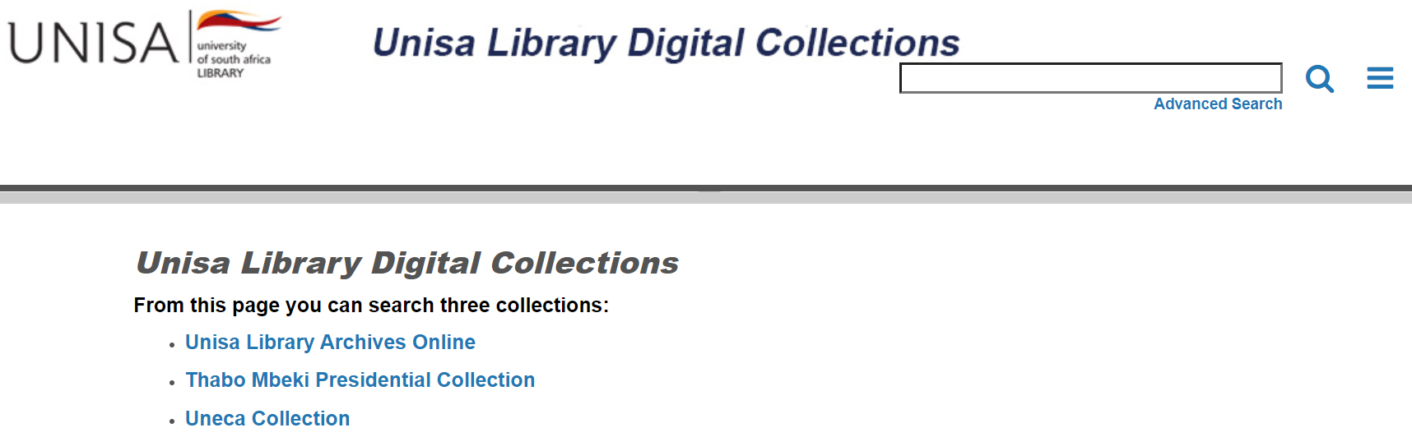
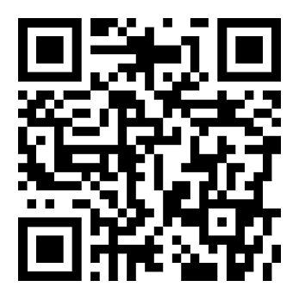
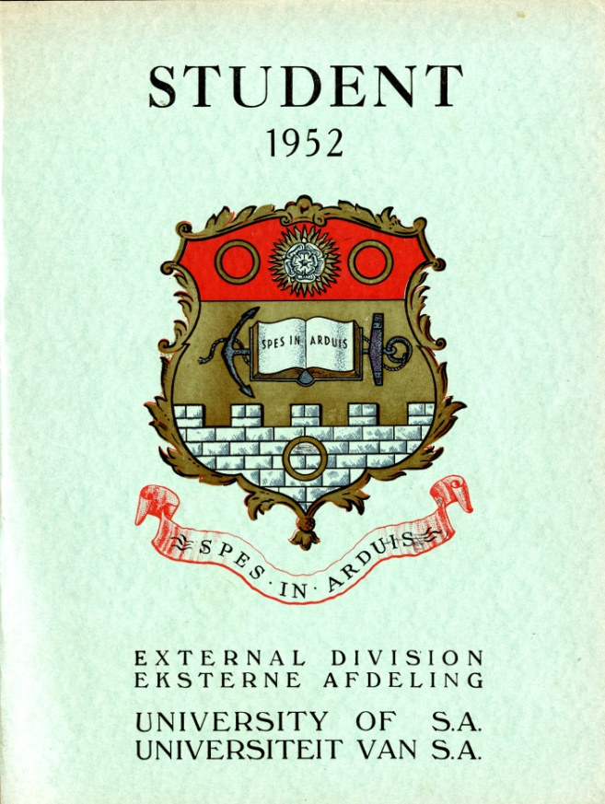


Digital Objects delivered via ContentDM
  Digital collection of selected special archival material from UNISA Library Archives
  Open Access collection
  Stores, manages & provides access to digital collections
  Multi-media platform

Slide 13
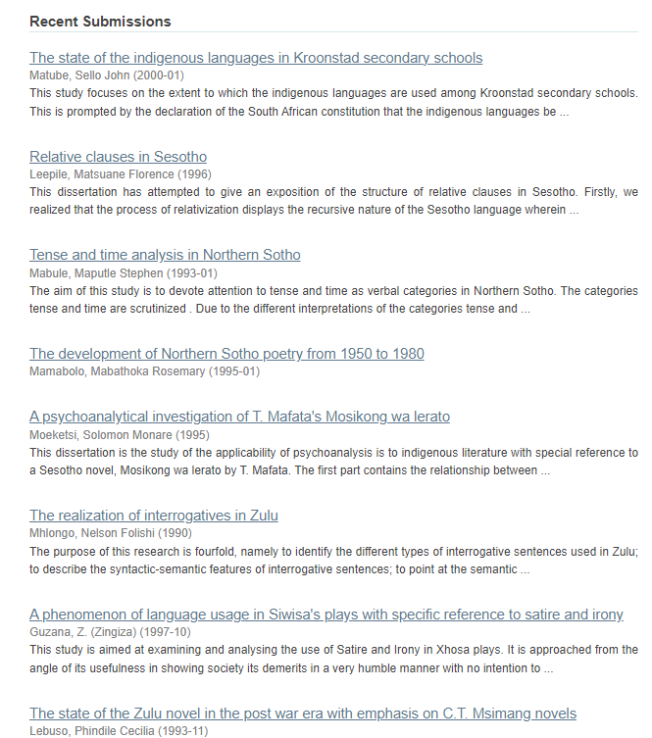
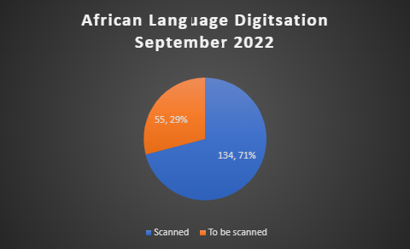
Theses and Dissertations (African Languages) (unisa.ac.za)
Digitised African Language theses and dissertations are described in terms of the Qualified Dublin Core Metadata and uploaded to the Unisa Institutional Repository (UnisaIR)
At the end of September 2022, the project was 71% completed

Slide 14
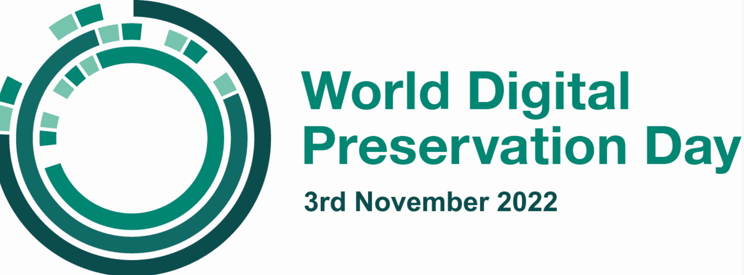

Slide 15


Slide 16
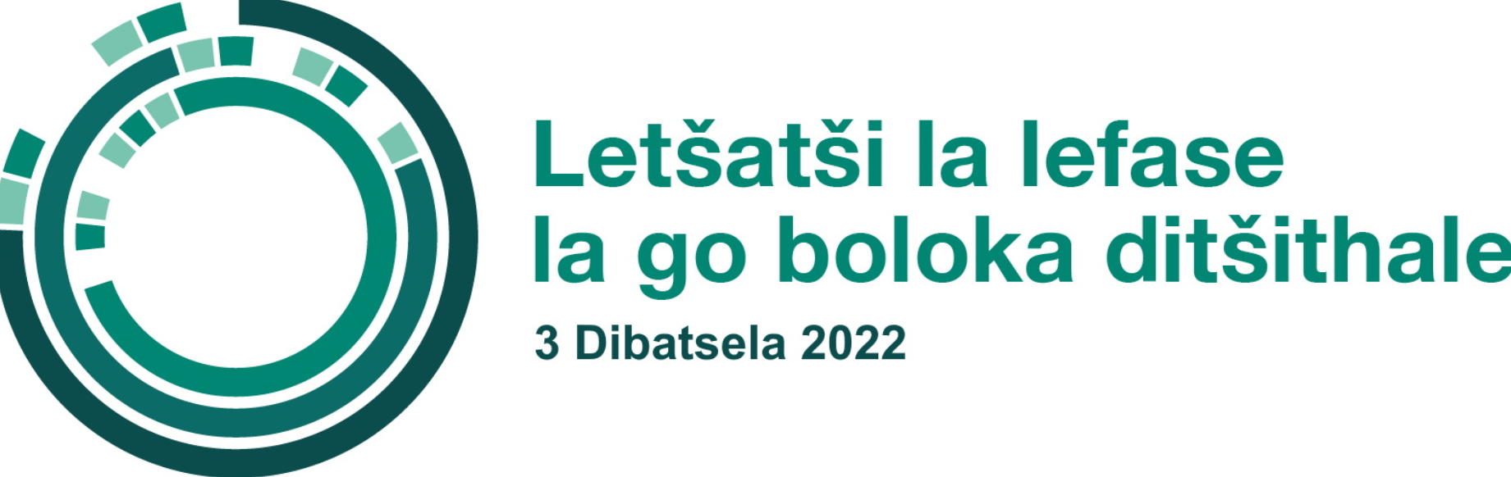

Slide 17


Slide 18


Slide 19
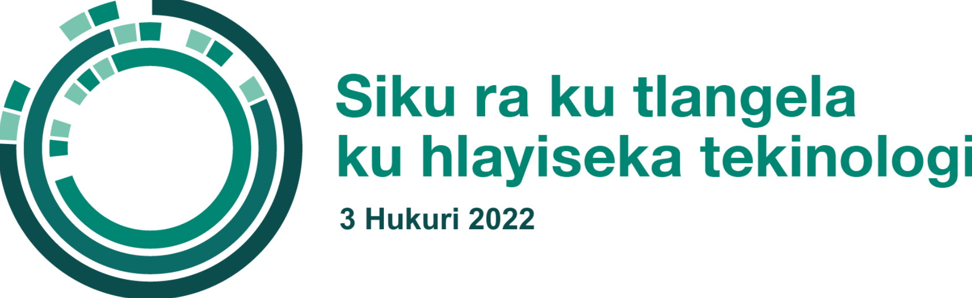

Slide 20


Slide 21


Slide 22


