Slide 1
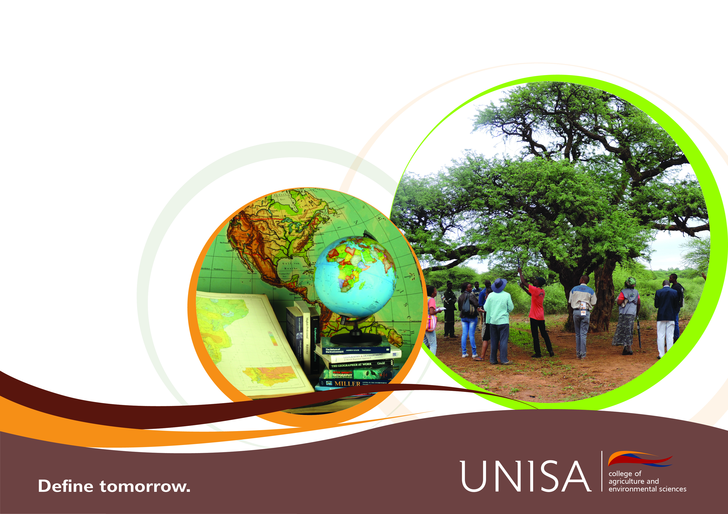
The Importance of Open Access in Reducing Climate Change's Threat on the Human Right to Clean Drinking Water
Prof Anja du Plessis

Slide 2
Contents
Current global trends of freshwater resources.
Predicted effects of increased climate variability.
Connection between achieving climate justice and human right to clean drinking water.
The important role of Open Access.
The move towards “Smart Management”.

Slide 3
Global Freshwater Trends: Availability
Declining at an exponential rate.
Primary driving forces include:
  Continued population growth; rural-urban migration; expanding urban settlements, increased demands by all water use sectors.
Primary drivers + Climate change = Increased water stress.

Slide 4
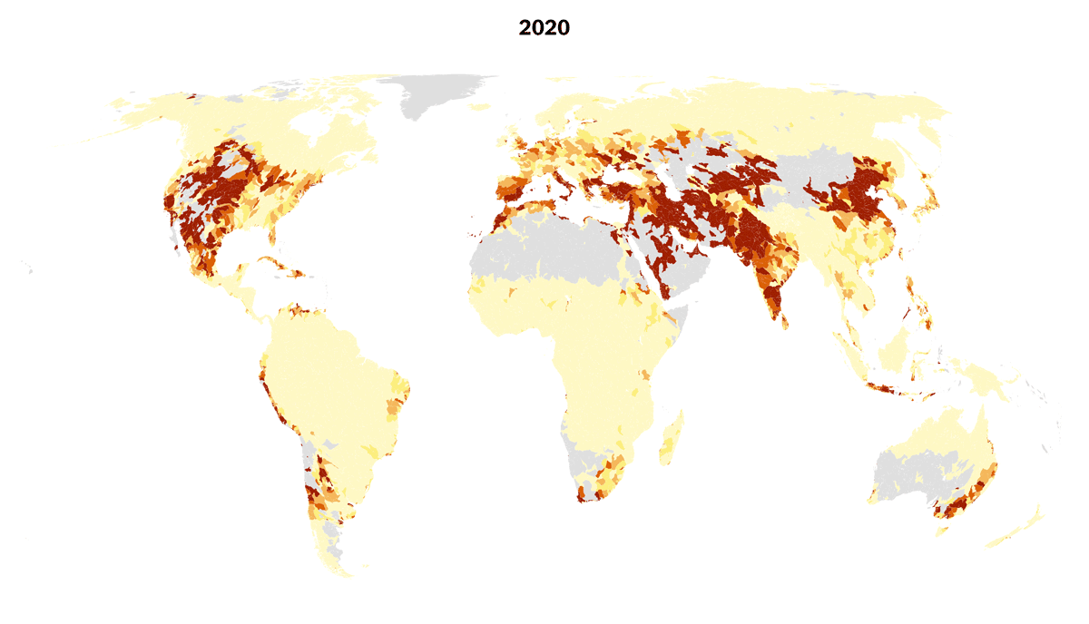
Increased Water Stress

Slide 5
Current Water Stress Statistics
A 40% global water deficit by 2030 - under a business-as-usual scenario.
One-fourth of the global population will face an increasingly urgent risk – “Day Zero”.
17 countries are currently already under extremely high water stress.
More “Day Zero” scenarios are expected in the future.

Slide 6
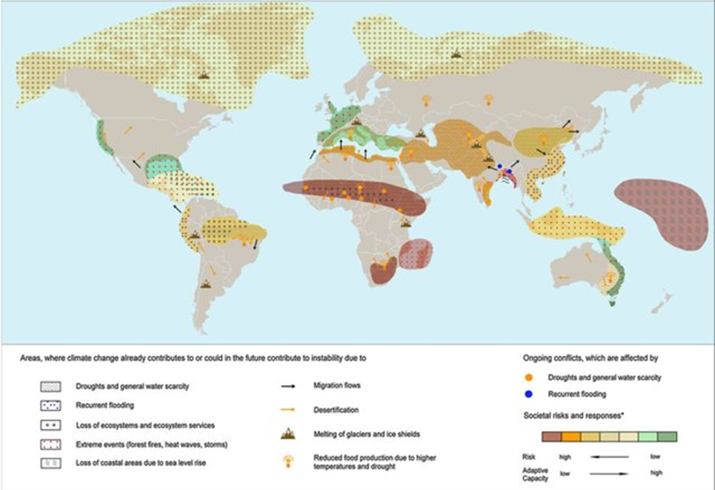
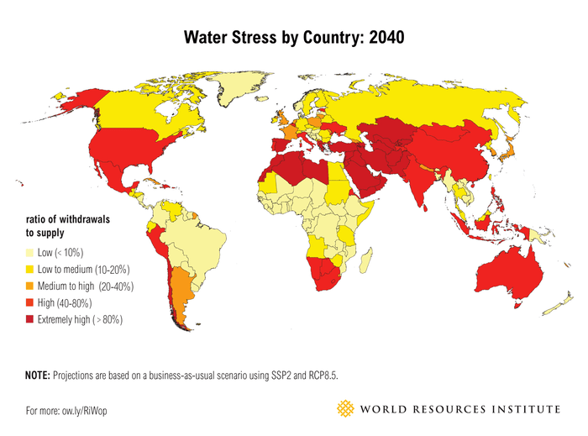
Climate Change and Water Stress Hot Spots

Slide 7
Global Examples of Increased Water Stress
Most of Sub-Saharan Africa is already experiencing both physical and economic water scarcity.
The Ganges Basin in India is depleting by an estimated 6.31 cm per annum due to insatiable population and irrigation demands.
Mexico City, built on ancient lake beds, is currently sinking in some areas at a rate of 22.8 cm per annum.

Slide 8
Building a Fragile Future
Misuse of water resources - Undervaluing water.
Poor water governance and management.
Over extraction of groundwater resources.
Increased urbanisation with deteriorating infrastructure – Current water shortages in the Gauteng Province.
Deteriorating water quality – leading to water resources not being of a suitable standard for use.

Slide 9
Climate Change and Water Resources
Predicted hydrological changes - Adding extra pressure on the sustainable management of water resources.
Increased extreme weather events - such as droughts, heatwaves, unparalleled rainfalls, thunderstorms and storm surge events, to mention a few.
Exacerbate current water threats and observed trends.
Increased risks of water pollution and pathogenic contamination.

Slide 10
Climate Change and Water Quality
Pollution is predicted to increase.
Urban water supply is particularly at risk due to high population densities and increased rural-urban migration.
Climate-induced harmful algae blooms are currently increasing due to increased water temperatures.
Characterised by toxic, food web-altering, hypoxia-generating blooms of harmful cyanobacteria.

Slide 11
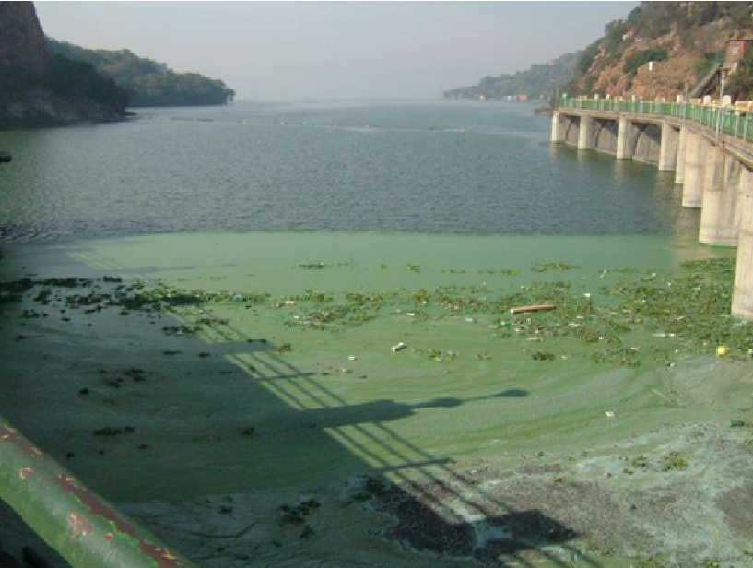
Harmful Algal Blooms
An example of harmful algae blooms in the Hartebeespoort Dam, South Africa.
Due to increased temperatures, the management thereof is severely affected by increased climate variability.
Image placeholder

Slide 12
Climate Justice: Linking Climate Change to Human Rights
“The climate crisis is the biggest threat to our survival as a species and is already threatening human rights around the world.”
Differing social, economic, public health, and other adverse impacts on vulnerable populations.
The need for long-term mitigation and adaptation strategies.

Slide 13
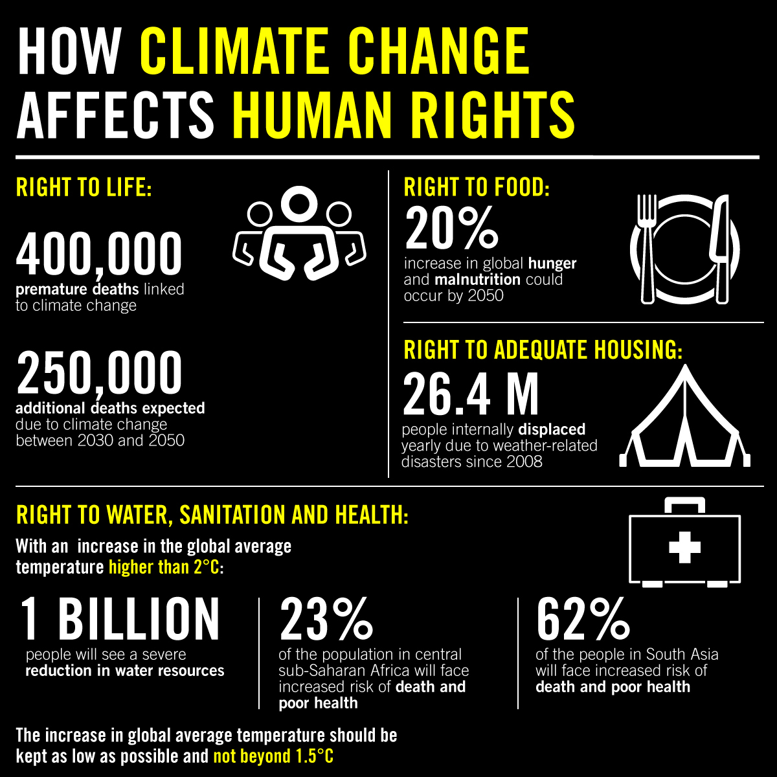

Slide 14
Climate Justice and the Human Right to Clean Drinking Water
The human right to clean drinking water is of particular risk and concern due to the possible domino effect on all the others.
This is the most basic of all human rights, together with sanitation, and a key one in the fight against climate change.
Affected primarily by extreme weather events which in turn affect the hydrological cycle resulting in “too much” or “too little” water.

Slide 15
Current Global Statistics of Safe Drinking Water and Sanitation
Two billion people - or one in four - lack access to safe drinking water.
Close to half the world’s population - 3.6 billion people – do not have adequate sanitation.
Approximately 2.3 billion people are unable to wash their hands at home due to lack of water or soap.
Majority of populations who do not have access to water and sanitation are mostly in poor and/or vulnerable countries – who are also the ones most vulnerable to the effects of climate change.

Slide 16
Current Reality for Marginalised Populations
Estimates show that almost 600 million children are projected to be living in areas of extremely high water stress by 2040.
Those left furthest behind, end up bearing the brunt of increasing water scarcity and poverty.
Marginalised populations - women, children, and those living in extreme poverty – will face an immense and unjust cycle where the lack of access to water and sanitation will be aggravated by extreme weather events.
This will lead to more expensive and unaffordable services.

Slide 17
The Importance of Open Access
Assists with connecting the dots.
Offers benefits both for mitigation (stopping climate change) and adaptation (adjusting to the new normal).
Provides available solutions which are well known and readily available.
Open Access data can also inform good practice.

Slide 18
The Move Towards “Smart Management”
An understanding is required regarding the adaptation needs and mitigation opportunities of water and sanitation systems.
The risks which climate change poses to sustainable services needs to be well understood.
Climate and water policies should be aligned to improve equitable access to water, reduction of climate risks and increase the money made available for adaptation and/or mitigation strategies.

Slide 19
The Move Towards “Smart Management”
The root causes of the water crisis on a global or national/local level needs to be clear.
You cannot manage which you cannot “see”.
Capacity to manage water sources sustainably and efficiently needs to be improved upon.
Expansion of monitoring networks as well as collected data being made available in the public domain will be key.

Slide 20
The Way Forward
Urgent measures need to be identified and implemented to slow the effects of climate change and adapt to the damage already done.
Without sanitation, the right to education cannot be guaranteed.
Without hygiene, human health is reduced.
Without reliable and equitable access to water, inequalities will persist.

Slide 21
Concluding Remarks
Effective climate action requires the elimination of inequalities, which includes the access to water and sanitation as a foundational requirement.
We need to move towards expanding monitoring networks and ensure that data are made available – Smart Management Practices.
This will in turn require a hierarchical “Big Data” quality assessment framework.

Slide 22
Concluding Remarks
The hierarchical “Big Data” quality assessment framework should focus on the following:
  Availability –Accessibility and Timeliness
  Usability – Credibility
  Reliability – Accuracy, Consistency, Integrity and Completeness
  Relevance – Fitness for use
  Presentation Quality - Readability

Slide 23
The move towards smart management practices will require a collective effort in ensuring that collected data are accurate, reliable and complies with good data management practices to ensure informed decision-making and implementation of appropriate measures.

Slide 24


