Slide 1

MNB3702 Discussion Class
Theme 3: Management and implementation
Chapter 17 / Lesson 7
By Jessica Nel

Slide 2
Lesson 7 – Customers and suppliers of the global business (Chapter 17)
Global world is made up of people of diverse cultures, values, norms and religions
Marketing plays a crucial role in the global business - – building relationships with international consumers and fulfilling their needs
Supply chain management seeks to make good on marketing’s promise to these customers (Place)
Formal and informal institutions have an effect on marketing and supply chain activities
Both functions can provide sustainable competitive advantage (VRIO)
B-2-B relationships and the country of origin effect
Notes:
As we have learned throughout this module, the global world is made up of people of diverse cultures, values, norms and religions. An MNE needs to create and deliver goods and services that will be valued by diverse consumers. Marketing plays a crucial role in the global business by keeping its operations centred on these international consumers – building relationships with them and fulfilling their needs. Supply chain management seeks to make good on marketing’s promise to these customers, by delivering on those identified products and services.
This lesson starts with a discussion of how the MNE may better understand diverse international consumers and the ways in which it can deploy the marketing mix to serve these consumers. It considers the “place,” element of the marketing mix as heavily reliant on an agile, adaptable and aligned global supply chain network to deliver goods and services to international markets. The effects of formal and informal institutions on marketing and supply chain activities are discussed, followed by an overview of the contributions that marketing and supply chain can make to sustainable competitive advantage. Lastly, the discussion of international marketing activities as they apply to the business-to-business relationship and the positive, or negative, influence of a good or service’s country of origin are deliberated.

Slide 3
Serving diverse consumers
Needs vary across the world
  Cultural differences
  Regulatory environments
  Resources and income levels
Marketing mix needs to be customised based on these needs and the availability of media and distribution channels. Research these aspects through:
  Experimental adaptation
  Survey-based research
  Anthropological studies
Research reduces costs of entry and prevents language blunders
Notes:
Consumers today are not satisfied with standardised products, demanding customised and personalised goods and services that meet their specific preferences. In a global market, this demand means that MNEs are faced with the challenge of tailoring their offerings to meet a vast expanse of different needs, languages, cultural sensitivities and income levels. They also need to become increasingly innovative, adapting faster and delivering new variations of their products to connected customers that want the newest and latest models with no delay (“Global trends”, 2015).
MNEs’ marketing requirements are exponential in comparison with a domestic organisation. Marketing decisions and activities cross borders, have high risk and massive capital requirements, are governed by institutional laws, and need intensive technology use to engage effectively with a wide variety of consumers in different countries.
Marketing research is particularly vital in order to understand international consumers. It is usually done on an as-needed, or a project, basis by the organisation itself or by a third-party marketing research organisation. In gathering both quantitative (numeric) and qualitative (descriptive) data, an MNE can avoid making costly mistakes, such as giving a product a name that may have negative connotations in other languages ("Marketing information systems" by eLearning Support Initiative). The MNE can learn more about the ways they need to adapt their strategies through trial-and-error (experimental adaptation), survey-based research and anthropological studies, discussed in the prescribed book.

Slide 4
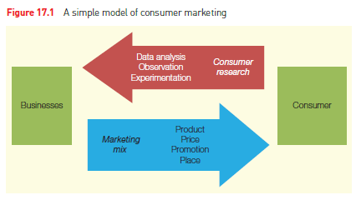




Marketing mix
INFORMATION GATHERING
PRODUCT/SERVICE OFFERING
Source: Peng & Meyer (2019: 476)
Watch this video: https://youtu.be/vRTuaTg0V5c
Notes:
Figure 17.3 on page 476 gives a very basic overview of consumer marketing. CLICK The consumer has needs and preferences – based on their unique individual identity, their geographic location and other behavioural, psychographic, and demographic influences. CLICK Through consumer research (like trial-and-error, survey-based research and anthropological studies), the MNE (CLICK) gathers information on their consumers to inform and adapt their marketing mix and to engage with and give (CLICK) their global consumers what they need or want.
According to the traditional marketing mix, decisions need to be made regarding the four “Ps” (4Ps) of the marketing mix: product, price, promotion and place. At a global level, the marketing mix also takes into account the pressures for centrally organised operations versus the pressures for localisation that we have discussed throughout the module. All organisations must consider the consumer at the heart of the marketing mix, but on the global stage, it is especially challenging.
Watch this video: https://youtu.be/vRTuaTg0V5c

Slide 5
Product
Product
  The offerings that customers purchase.
  Even for a single category (such as women’s clothing or sports cars), product attributes vary tremendously.
  For firms interested in doing business around the world, the leading concern is standardisation versus localisation.
Marketing segmentation
  A way to identify consumers who differ from others in purchasing behaviour.
Multi-tier branding
  A portfolio of different brands targeted at different consumer segments.
Notes:
The MNE should study consumer wants and needs in order to attract them with a good or service that they want to purchase. The prescribed book introduces the student to the standardisation-versus-localisation debate with regard to product or customer value decisions (Peng & Meyer, 2019: 476). In lessons 5 and 6, you were made aware of the pressures for local responsiveness versus the need for an operationally integrated MNE (the integration-responsiveness framework). Standardisation offers the advantage of economies of scale to the MNE (at this point, you can refer back to Lesson 4 – The advantages of the MNE – to refresh your memory on economies of scale). Localisation, on the other hand, offers a greater chance that the product will be successful in that market. Everything boils down to costs – while a highly customised product appeals to local consumers and provides them with increased value, it might not be possible for an organisation to carry the costs of customising their offering when they serve such a vast range of customers throughout the world. Nonetheless, many consumers are averse to standardised offerings and the MNE must attempt to strike a balance. Do you remember the Levers of Adaptation from Lesson 4 (Chapter 14?) Do you see the link? One of the levers of adaption is when Companies VARY the product – offering smaller sizes of washing machine in Europe as opposed to America. Companies might also use a product focus to take advantage of the fact that wide differences can exist within broad product categories in the degree of variation required to compete effectively in local markets. An example is TV programs: action films need less adaptation than local newscasts. Alternatively Firms may also use a market segment focus to sell the same product but position it in a different segment (Peng & Meyer, 2019:389). The case study from Assignment 1 shows that VoD and broadcasters are positioning their services across a range of segments – using market segmentation to localise the product element of their marketing mix. Netflix, for example, focused more on the tech-savvy and wealthier African consumer, where IROKO and Tuluntulu were more conscious of the consumer with less disposable income.
So, in the product element of the marketing mix in this chapter, we see the levers of adaptation at play. Another recommendation is to review the unique set of features, design, name, and brand that can be focused on the target customer, identify the most important aspects that require customisation, and maintain the other components to take advantage of global scale and reduce costs. Brands, for example, can be customised using multi-tier branding which caters to different consumer segments – without the consumer being aware that, what they thought was a local brand, is actually one of a portfolio of brands owned by a major multinational enterprise. Customisation can also be done at different levels – from niche customers, to country, to region even. It may also depend on the nature of the product or service in relation to the culture of the market – entertainment and food offerings need greater customisation than construction materials, for example

Slide 6
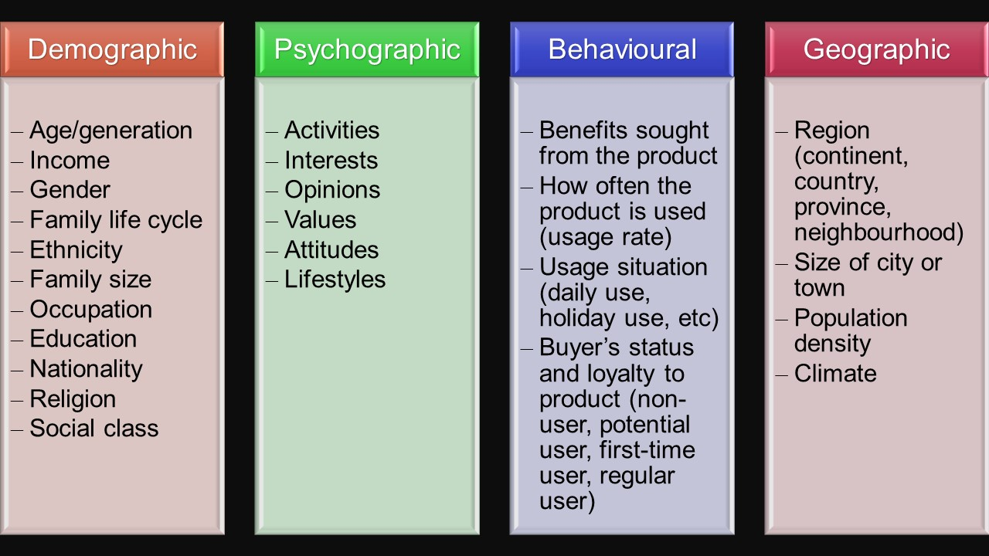
Types of market segmentation
Attribution: Adapted from "How markets are segmented", eLearning Support Initiative, University of Minnesota is licensed under CC BY-SA 4.0
Notes:
Let’s look a bit more closely at market segmentation as a focus strategy. MNEs may choose to segment their market and offer solutions to broader profiles in an attempt to satisfy customisation while maintaining financial viability. Some common ways of segmenting consumers – by behaviour (What benefits do customers want, and how do they use our product?), by demographics (How do the ages, races, and ethnic backgrounds of our customers affect what they buy?), by geography (Where are our customers located, and how can we reach them? What products do they buy based on their locations?) and through psychographics (What do our customers think about and value? How do they live their lives?). Using something like ethnicity to segment a market, for example, may require even further segmentation (sub-segmentation) – Africans are not all the same and African countries are exceptionally diverse. If you were to use language as a means to separate ethnic identity, you would encounter more than 470 languages in Nigeria and some 242 in the Democratic Republic of Congo! There is also a significant diversity in terms of religion, although Christianity and Islam enjoy the largest following.
Do you see how many ways there are to segment a market and bring in some level of adaptation?

Slide 7
Price
Price
  The expenditures that customers are willing to pay for a product.
Price elasticity
  How demand changes when prices change.
Total cost of ownership
  Total cost needed to own a product, consisting of initial purchase cost and follow-up maintenance/service cost.
Not all consumers are highly price sensitive. Luxury products that are status symbols of upwardly mobile middle classes attain their status exactly because not everyone can afford these products.
Notes:
What about price? The price element of the marketing mix considers the amount that consumers are willing to spend to acquire a good or experience a service (Peng & Meyer, 2019: 478). It is the customer’s cost to satisfy that want or need. The prescribed book introduces the concept of price elasticity (the change in demand in response to a change in price) and highlights that lower income groups, of which there are many in emerging economies, are particularly price sensitive and companies need to respond to accommodate them. You would have come across the term, “the total cost of ownership” (TCO) in the book. In international marketing, the MNE would have to consider the income groups in multiple countries and the prices for a product may vary as it accommodates each country’s TCO. By considering the TCO, the marketer moves from an inward, price-focused dimension, to an outward, customer-cost dimension. It is important to remember that the price of a product is not the only cost-determining factor when satisfying a need for a product or service. Indeed, TCO really is the sum of all the costs including the purchase price, the operation and maintenance during the product’s lifetime and the possible price of a competitive product or service. Hence it includes all hidden costs, present or future.

Slide 8
Question
Can you think of a brand that charges a high price for the use of its product?
Notes:
Can you think of a brand that charges a high price for the use of its product? What about one that tries to leverage total cost of ownership? Apple products work together, with their own chargers etc.

Slide 9
Promotion
Promotion
  All communications that marketers insert into the marketplace.
  Includes TV, radio, social networks, billboards, coupons, etc.
  Marketers face a strategic choice of whether to standardise or localise promotional efforts.
  Standardised promotion can save a lot of money on advertising agencies and project a globally consistent message.
  Advertising messages are culturally embedded: they are received differently in different countries.
  Online advertising is also changing; generation Y and Z do not just buy because they see a magazine advert; they are influenced by different forms of social interaction and the internet.
Notes:
Promotions refer to those communications (also called the marketing communications mix) that marketers use to engage and interact with consumers in various countries. They include advertising; direct and database marketing; online and social media marketing; sales promotions; event marketing, experiences and sponsorships; publicity and public relations (PR); personal selling; word-of-mouth; and mobile marketing. Within each communications tool, there are different media types or platforms – such as TV, radio, websites, social media and so on (Nel, 2017). Not only must the MNE decide on ways it can standardise and localise its communications in its international markets, but it must also consider how it will communicate across digital and non-digital formats. The evolution of digital technology and the expanding ways in which consumers and brands connect and interact and, as a result, enhanced the organisation’s exposure to global markets. However, one of the key aims of any marketing communications plan is to bring across a strong and consistent brand message to raise strong awareness of the organisation. Word of mouth is happening between people in completely different continents! Ensuring this message remains clear while interpreting it across a wide variety of platforms, media, cultures and countries, makes it difficult and costly to maintain control over the communications element of the marketing mix, especially in the global space.
Market research, discussed at the beginning of this class, is so important to determining the success of promotional tactics in any country or region. Colours have different meanings in different cultures. In Egypt, the country’s national colour of green is considered unacceptable for packaging because religious leaders once wore it. Values come about from moral and religious beliefs - Americans tend to value and purchase status symbols. Christmas time is also important there – a major sales period – but non-Christian regions will not need the same promotional efforts and communications. Once brands discover what works (and what does not) in their promotional mix, those ideas can be imported by any other market that has similar characteristics. Likewise, companies can use this intelligence to modify various elements in their promotional mix that are receiving minimal or unfavourable response from global audiences.

Slide 10
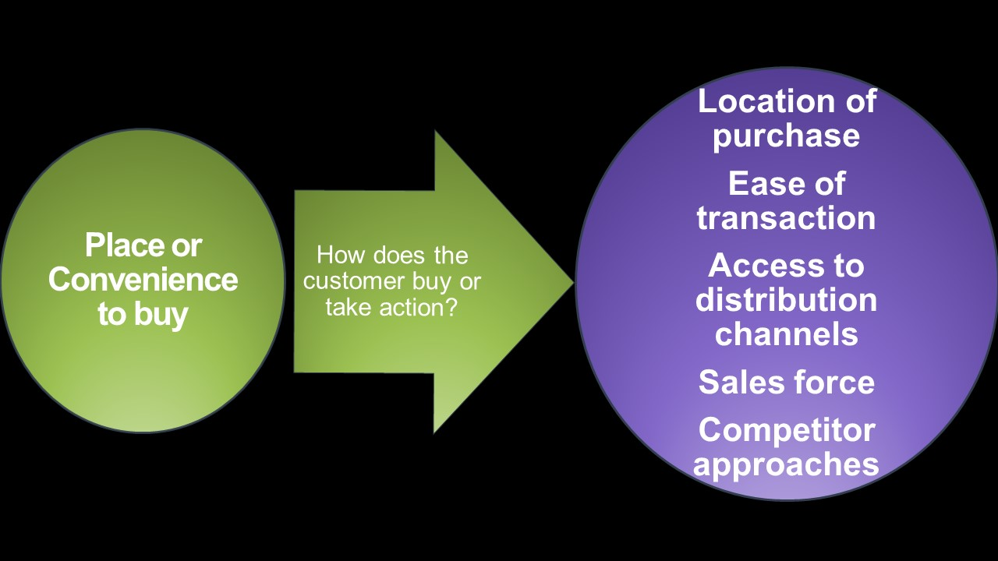
Place
Four sets of considerations come into play:
  Market potential
  Entry costs
  Strategic motives
  Distribution channels
Notes:
The last element of the traditional marketing mix is Place. “Place” refers to the distribution of the good or service to consumers in the MNEs host and parent countries. They might use traditional brick-and-mortar stores (hotels, for instance), or the virtual marketplace using online intermediaries (like Takealot). Therefore, decisions about whether to sell directly to the consumer or via a distributor or partner also come into play here. The question is, how easy (or difficult) is it for the consumer to purchase from the MNE?
Four sets of considerations come into play for the Place element of the mix (see page 481): (1) market potential, (2) costs, (3) strategic motives and (4) distribution channels. First, the potential of a market is usually estimated based on the size and growth of the market for the specific products, taking into consideration trends that may affect potential customers’ buying behavior ( do you recall Assignment 1? Netflix had a definite market-seeking motive and Africa represented a huge and untapped market with massive growth potential and a thirst for local content). The initial analysis of market potential makes use of industry-level market statistics, but usually entrants will also employ additional customer surveys to assess the likely consumer behaviour. Linking back to the first assignment – additional consumer research would have identified the four key content genres that resonate in Africa as drama, natural history, and factual and light entertainment. And also the appeal of storytelling and a growing appetite for local content. Based on this, you could have made a location recommendation of Nigeria and South Africa for good points of entry as the biggest content producers on the continent.
Second, costs in the form of expected revenues need to be converted to estimates of net revenues, taking into account both cost of the initial entry and the unit costs that may be higher due to the adaptation of products and marketing programmes. South Africa and Nigeria are major content producers, which would help to lower the costs of adaptation as Netflix would not need to learn how to adapt their programming from scratch. As a result of trying to bypass this learning curve on African content, we also saw a lot of partnering happening in the case study.
The third consideration is the strategic motives. Don’t get confused with the strategic objectives of natural resource seeking, market seeking etc. In this context, focused on place, marketers will have strategic motives for the choice of market in a region, for example. These include test markets, which are markets where trials are rolled out before a wider regional/continental roll out introduction of new products. You also have bridge markets – those locations that may offer avenues to enter broader markets. Question 2 in assignment 1 was a good example of how you needed to think strategically on the best countries to enter a market. South Africa is very commonly used as a point of entry for African markets, but the case study also introduced Nigeria as having equal offerings. Therefore, one could argue that South Africa makes a good bridge market for Southern Africa and Nigeria for West Africa.
Fourth, the question of place is closely related to the question of distribution channel – how to bring the products to the customer. In global business, the place element takes on even more importance. Location is key as managers need to leverage locational advantages to access markets (Peng & Meyer, 2019: 156–160). Remember also, in Lesson 2, the strategic decision of WHERE to enter when considering making FDI in a foreign country (Peng & Meyer, 2019: 338–342)? The availability of infrastructure is going to be an influence on any location or place decision. Netflix has had to make massive investments in infrastructure in order to enter African markets. Therefore, it would have made sense for Netflix to offset the size of a market in an African country against the availability of telecommunications and mobile penetration to carry their digital service to the customer. Again, the case study recognized Nigeria and South Africa as already having established infrastructure – and this would make them good recommendations for points of entry as distribution channels were in place.
The choice of location (for production sites) to access the target market and the choice of logistics system – discussed in the next section – are inseparable. Which brings us to the topic of supply chain management.

Slide 11
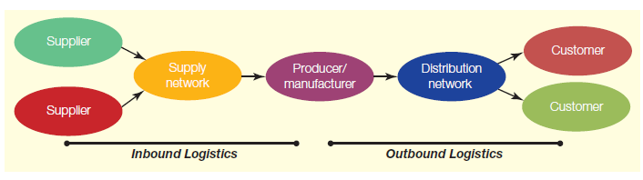
Supply chain management
DEMAND
Figure 17.2 Supply chain management
Source: Peng & Meyer (2019: 482)
Inbound logistics
  Purchasing and the coordination of intermediaries on the supply side.
Outbound logistics
  Sales and the coordination of intermediaries on the customer side
  Watch: https://youtu.be/UBSOiHUctrY
Notes:
Going “global” through global supply chains facilitates entry into new markets, enables business growth and provides organisations with access to new technologies through partnerships with foreign organisations. Since 2001, when the internet became pervasive, the “pull system” or demand-pull approach has become increasingly dominant in global business. In a pull system, the entire supply chain is driven by (CLICK) demand instead of forecasting. This is in line with the supermarket approach according to which limited inventory is kept and the system operates when the customer wants it to. Another aspect of the pull system in the supply chain is that because the customer initiates the purchase, there is a requirement for real-time information through a network. Moreover, technologies such as Internet-of-Things devices, provide an effective means to track and authenticate products and shipments by using GPS and other technologies. They can also monitor the storage conditions of products, which enhances quality management throughout the supply chain.
The goal of supply chain management is to satisfy customers by seamlessly coordinating all the activities of supply-chain members. The driving element is the consumer, who expects customised goods and services suited to his or her unique wants and needs. All role players in the supply chain, including suppliers, manufacturers, wholesalers and retailers, pursue the common goal of creating value for the consumer. An effectively managed supply chain not only moves goods and services in a timely and cost-effective manner through the entire supply pipeline, but also communicates customer demand from the point of sale all the way back to the supplier. When a supply chain includes member organisations that are located in different countries, the term global supply chain is used.
Let’s watch the following video to see how Coca Cola’s global supply chain works https://youtu.be/UBSOiHUctrY

Slide 12
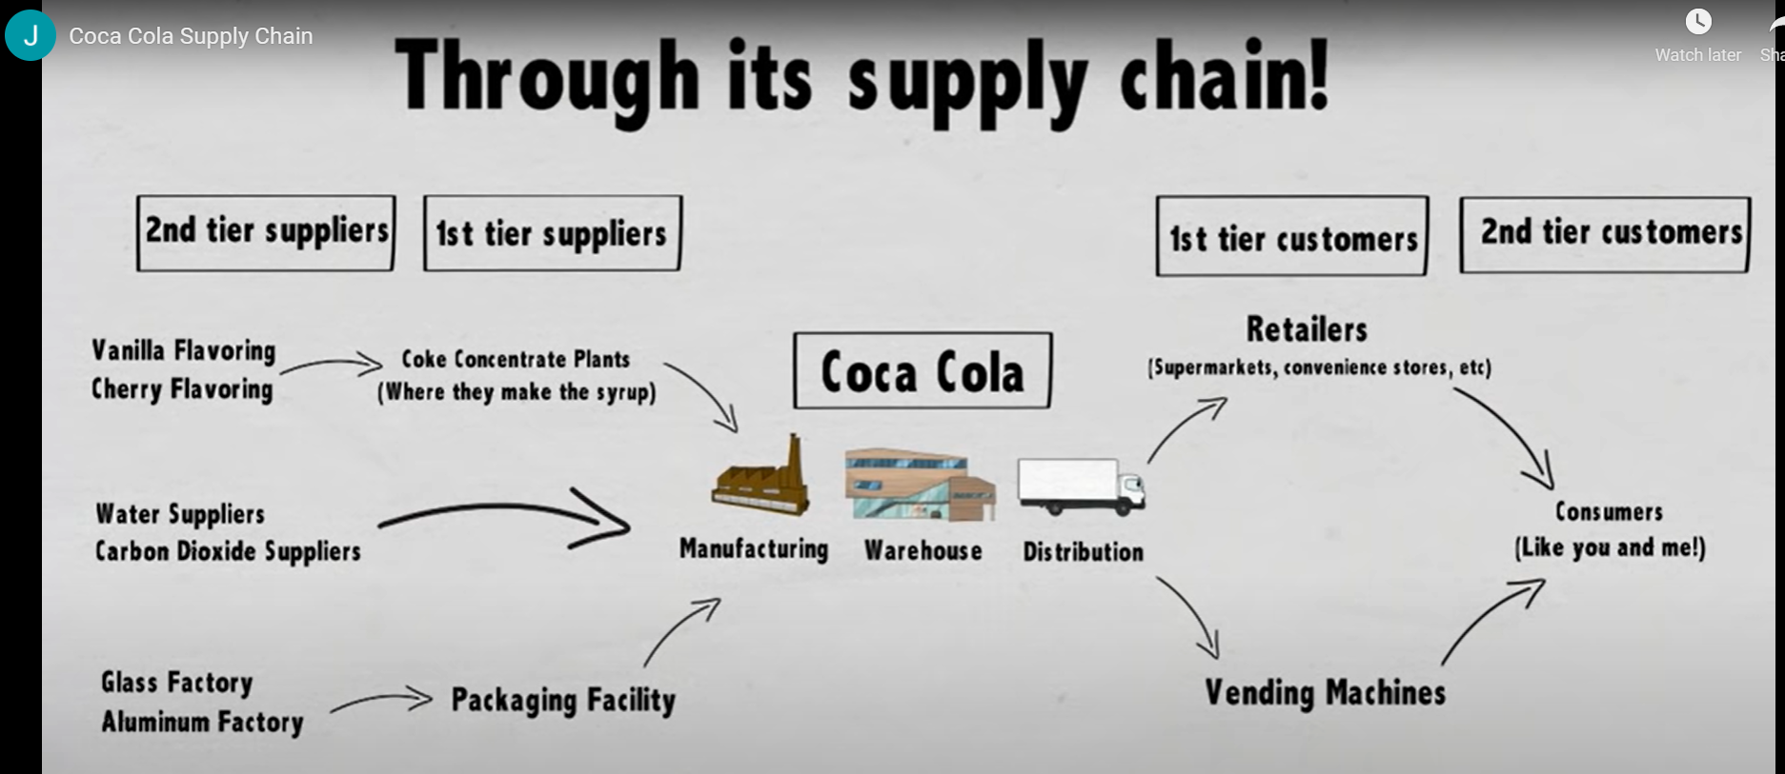
Source: Jonathan Hu. (2016). Coca Cola Supply Chain. [Online Video]. 23 February 2016. Available from: https://youtu.be/UBSOiHUctrY. [Accessed: 4 May 2021].
Notes:
So, if we compare Figure 17.2 (page 482) to the example of Coca Cola’s global supply chain, what can we see? All the first and second tier suppliers form part of the supply network that must move supplies towards coca cola’s manufacturing facility through (CLICK) inbound logistics. The movement and combination of these supplies to create that final bottle or can of Fanta within Coca Cola is the (CLICK) intra-logistics, and the transport of the pallets of Fanta, Coke and so on from the trucks to retailers and vending machines to the final consumer are the (CLICK) outbound logistics.
Coordinating and managing a global supply chain is a fairly complex task. Channel strategy decisions need to be made; the sourcing and procurement of raw materials have to be coordinated; production across different time zones needs to be scheduled; orders from around the globe have to be processed; inventory and warehousing in different countries must be managed; supplies and finished goods must be transported across borders; and customer-service activities have to be coordinated to accommodate diverse people. Information that flows through the global supply chain also requires management and rising digitalisation has a notable influence. The relationship between the MNE and its international partners such as vendors, carriers, and third-party companies, is another critical function of supply-chain management. Because supply-chain managers play such a major role in both cost control and customer satisfaction, they are more valuable than ever

Slide 13
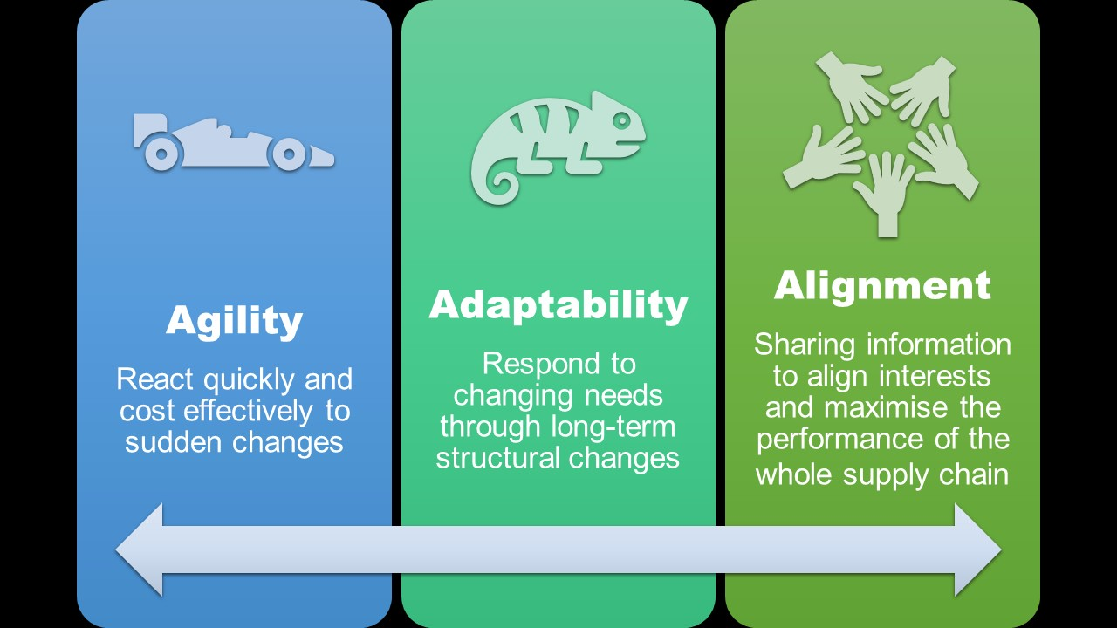
Agility, adaptability and alignment
Notes:
Because of the many crucial value-adding activities in the global supply chain, companies look at ways to strengthen their logistical network. For competitive advantage, MNEs need to work together and coordinate their activities to develop agility and adaptability, allowing for a quick and enduring response to sudden changes in demand or supply or growing with evolving market structures and environmental conditions. Furthermore, they need to align their supply chains, including tiers of suppliers and customers, to optimise performance. In doing so, they can compete effectively in the global arena and create more value for the consumer
Agility – the ability to react quickly and cost-effectively to sudden changes in supply, demand and technology – is critical for supply chains because. Agility will have an impact on organisational efficiency, effectiveness and financial performance. Sudden shocks to supply chains have increased in frequency and an agile and resilient supply chain will help the MNE to recover more quickly from such sudden setbacks. Such agility and resilience can differentiate the MNE from its competitors, assuming that the ability to manage risk means being better positioned than competitors to deal with disruptions. Key to increasing agility and resilience is building flexibility into the supply-chain structure, processes and management. Since sudden shocks to supply chains have become frequent, an agile and resilient supply chain will help the MNE to recover more quickly. Just think on how COVID-19 has disrupted many companies’ supply chains! By building an agile supply chain, companies can recover much more quickly from sudden setbacks. For example, the pandemic saw sales of vehicles declining 90% in the China market. With the massive pressure to respond quickly, automotive manufacturer BYD Co. started making surgical masks, while Ford and General Motors quickly adapted to making ventilators.
Where agility refers to the ability of the organisation to respond to quick, short-term operational changes, adaptability refers to the ability to respond to long-term structural changes. A supply chain needs adaptability in order to adjust to changing business strategies and a changing market place. Adaptable MNEs are able to learn how to do new things, requiring that they are able to: read and react to signals of change, experiment frequently and rapidly, manage complex multi-organisation systems with numerous stakeholders, and motivate employees and partners. Virtual technologies have enhanced integration across supply chain partners and supply chain intermediaries can assist in creating a flexible supply chain network, improving MNE’s adaptability capabilities. The importance of an adaptable supply chain in this industry also came to the fore during the pandemic. Online grocery shopping had been presenting issues for food retailers for many years. Consumers had been slow to adopt the new model of online shopping as grocers tried a range of solutions to balance profit margins with consumer needs such as store pickups, third-part and peer-to-peer delivery, and third-party delivery stores for central delivery (eg, Pargo). COVID-19 prompted consumers to adopt online grocery shopping and forced food retailers to adapt their business models and delivery methods at a rapid pace. Testing was not an option and stores needed to solve the problem of online delivery by trial and error in real time
Alignment in the global supply chain works to optimise the performance of the entire supply chain and deliver on customer value propositions. There must be a fit between the global supply chain partners’ objectives, interests, values, risks, rewards and commitments. If any organisation’s interests differ from those of the other organisations in the supply chain, its actions will not maximise the chain’s performance. Alignment requires the sharing of information so that all the companies in a supply chain have equal access to forecasts, sales data, and plans. Partner roles and responsibilities must then be carefully defined so that there is no space for conflict to form. Finally, companies must align incentives so that, when companies do try to maximise returns, they also maximise the entire supply chain’s performance. Misaligned incentives can lead to excess inventory, incorrect forecasts and also poor customer service. New technologies and the digitalisation of the supply chain have supported the alignment of supply chains through enhancing communication and collaboration among supply chain stakeholders – information sharing has been improved and deeper relationships formed. An example of alignment is when a retailer that focuses on quality works with its upstream suppliers to improve their processes and quality output (rather than, for example, applying pricing pressure which can cause suppliers to take cost-cutting measures and reduce quality).
With COVID-19, we are seeing unprecedented collaboration among companies, to an extent typically reserved for states of dire need such as times of war. Collaboration in supply chains is not something that comes easily, nor can companies turn it on like flipping a switch. It takes time to build trust and working relationships with upstream suppliers. While the current crisis is pushing stakeholders in supply chains to work together (see, for example, medical device supply chains), the collaborations that will be most successful in reacting to the crisis are the ones where cooperative, working relationships already exist. This is because the means for information and knowledge sharing is already established, and the objectives between upstream suppliers and downstream businesses in the supply chain are already aligned.
https://phys.org/news/2020-04-covid-highlights-importance-agility-chains.html

Slide 14
Institutions, marketing and supply chain management
Marketing
  Companies marketing controversial products, e.g. tobacco must be particularly adept at interpreting local rules and customs
  Other marketing constraints include standards in advertising, personal information and ownership restrictions (FDI vs online marketing).
Supply chain
  Ownership – some countries do not allow a WOS
  Create interdependencies between firms, they themselves can become a channel for the diffusion of practices and norms.
Notes:
Formal and informal institutions in the countries where an MNE has operations will have an influence on marketing and supply chain activities. The prescribed book presents standards in advertising as an example of marketing constraints (Peng & Meyer, 2019: 487). Regions have different regulations in place to protect personal information and MNEs must be careful to check that they are compliant with these regulations.
The Protection of Personal Information (PoPI) Act (2013) in South Africa provides that companies protect individuals’ personal information. In a digitised world, this Act prevents the selling or use of personal information without consent. It includes a section related to unsolicited marketing which prevents any MNE operating in South Africa from contacting individuals or sharing their information with third parties without the individual’s consent (Act No. 4 of 2013: Protection of Personal Information Act, 2013). In effect, this Act prevents MNEs from obtaining a competitive advantage in South Africa by gathering and analysing consumer preferences.
Similarly, the European Union (EU) adopted the General Data Protection Regulation (GDPR). This regulation is one of the strictest privacy and security laws in the world and imposes obligations on organisations worldwide that target or collect data of people in the EU. It protects the rights and freedoms of individuals, particularly their right to protect their own personal data (Regulation (EU) 2016/679, 2016).
Peng and Meyer (2019: 487) identify formal institutional constraints on ownership as having an impact on the global supply chain of a company. Remember from Lesson 2 (Learning objective: Apply the institution-based view to explain the constraints of foreign-entry strategies) that some countries have laws that prevent MNEs from using certain equity entry modes. Just as the MNE might not be able to establish a WOS in China, for example, the same laws would prevent them from setting up a manufacturing plant in the country, impacting on their supply chain.
Supply chains themselves are channels for the diffusion of norms and practices because of the interdependencies between the organisations in the chain (Peng & Meyer, 2019: 488). Institutions governing supply chains are particularly concerned with governing the environmental and societal impacts of these operations in the global economy. Pressure is put on global supply chains to be responsible and sustainable by addressing economic, political, societal, legal, human rights, ethical and environmental concerns. Innovative technologies such as big data and blockchain, offer potential solutions to enhance supply chain management and reduce its societal and environmental consequences (Gurzawska, 2019). The prescribed book describes the International Organisation for Standardisation (ISO) as an international organisation with a membership of 165 national standards bodies that work together to develop consensual standards by which multiple industries operate (“ISO - About us”, nd).

Slide 15
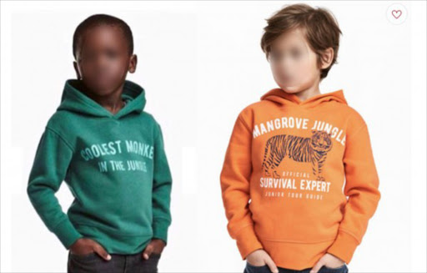
MARKETING BLUNDER: H&M hoodie advertisement
Source: DispatchLIVE (2018)
Notes:
Informal institutional rules and norms also have an impact on marketing and supply chain operations for the MNE. You might recall the below advert by Swedish clothing MNE, H&M, that made the news in South Africa and worldwide. In marketing, it is crucial for managers to research religions and cultures, for example, to ensure cultural brand blunders, like this one, are prevented.

Slide 16
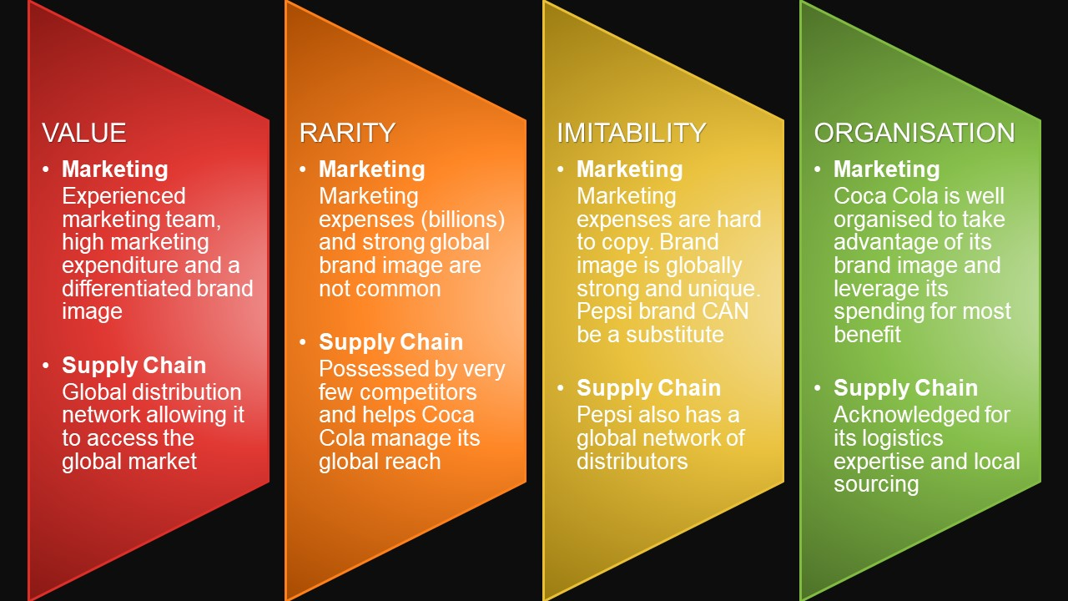
Resource-based view
VRIO for Coca Cola’s marketing and supply chain
Source: Adapted from Pratap (2017) and "VRIO Analysis" by John Morris
Notes:
The prescribed book uses the VRIO framework to assess the contribution of marketing and supply chain resources towards an MNEs competitiveness in the long term.
In this figure, I’ll take you through an example of resources for sustained competitive advantage from the perspective of these two operations.
In this figure, we can see an example of how either the marketing or the supply chain function of an MNE may contribute resources that are valuable, rare, inimitable, and organisable. A resource or capability is said to be valuable if it allows the MNE to exploit opportunities or negate threats in the environment. If a resource does not allow an MNE to minimise threats or exploit opportunities, it does not enhance the competitive position of the MNE. So, how does marketing create value? By increasing revenues for the MNE – bringing in sales through higher volumes or increased price premiums. It also creates value for the customer by providing them with a product they need. Let’s look at Coca Cola. The MNE spends billions on its marketing annually and has an experienced marketing team – this allows value to be added by creating a differentiated brand image. The supply chain, when efficient, provides value to the customer by lowering inventory costs. To the MNE, it provides access to markets. Coca Cola’s distribution network allows the company to service the global market and has played a major part in giving the brand a global presence. In both cases, value is only added if these operations are running smoothly. Both marketers and supply chain managers should constantly evaluate the tools and channels at their disposal to ensure they continue to add value. What about rarity? A resource is rare simply if it is not widely possessed by other competitors. Of all of the VRIO criteria this is probably the easiest to judge. An MNE that possesses valuable resources that are not rare is not in a position of advantage relative to competitors. Rather, valuable resources that are commonly held by many competitors simply allow MNEs to be at par with competitors. However, when an MNE maintains possession of valuable resources that are rare in the industry they are in a position of competitive advantage over MNEs that do not possess the resource. They may be able to exploit opportunities or negate threats in ways that those lacking the resource will not be able to do. Coca Cola’s marketing skills are not necessarily rare, but with marketing expenses at around $4 billion a year, competitors will have a hard time matching them. Similarly, their strong global brand image is not an easy one to build. Still, Pepsi – their nearest competitor – has a formidable one too. The supply chain of Coca Cola can be matched by very few competitors, Pepsi being a notable exception, helping the MNE to reach its global market. So, we have the advertising ability, brand name and global supply chain of Coca Cola as being both valuable and rare resources. What about imitability? An inimitable (the opposite of imitable) resource is difficult to imitate or to create ready substitutes for. A resource is inimitable and non-substitutable if it is difficult for another MNE to acquire it or to substitute something else in its place. A valuable and rare resource or capability will grant a competitive advantage as long as other MNEs do not gain subsequent possession of the resource or a close substitute. If a resource is valuable and rare and responsible for a market leader competitive advantage, it is likely that competitors lacking the resource or capability will do all that they can to obtain the resource or capability themselves. This leads us to the third criterion—inimitability. The concept of imitation includes any form of acquiring the lacking resource or substituting a similar resource that provides equivalent benefits. The criterion important to be addressed is whether competitors face a cost disadvantage in acquiring or substituting the resource that is lacking. There are numerous ways that MNEs may acquire resources or capabilities that they lack. Generally, intangible (also called tacit) resources or capabilities, like corporate culture or brand image and reputation, are very hard to imitate and therefore inimitable. Think of Coca Cola’s brand image, which is intangible and very unique to the company. However, Pepsi’s brand image can be considered an acceptable substitute – meaning that Coca Cola and Pepsi have competitive parity there. In the same way, the average of $4 billion spent on advertisements by Coca Cola is a resource that is not easy to imitate. Pepsi has its own financial strength, spending between $2.3 and $3 billion itself, meaning that the potential to match Coca Cola is there and this marketing resource is not necessarily sustainable. We see a similar situation with Coca Cola’s global distribution network. It is a source of temporary, not sustainable, competitive advantage when one considers the resources of Pepsi, who have their own global distribution network. However, any other competitor, but Pepsi, would find this global network exceptionally hard to copy!
The fourth and final VRIO criterion that determines whether a resource or capability is the source of competitive advantage recognises that mere possession or control is necessary, but not sufficient, to gain an advantage. The MNE must likewise have the organisational capability to exploit the resources. Think of it in terms of whether the organisation owns the capability. Alternatively, think of organisation ownership in terms of how much it would cost to copy the capability in terms of time or money or both. We can conclude that Coca Cola is well organised and possesses the capabilities to take advantage of its brand image and leverage its spending. Coca Cola is also widely acknowledged as one of the most wide-reaching and seamless distribution operations in the world!

Slide 17
Debates and extensions
B-2-B marketing
In B2B markets, the customer uses the product for goods, which may go through several transformations before reaching the consumer.
First challenge is to understand the value chain that the product feeds into and how to influence the key decision-makers in the value chain, without being their direct supplier.
Three ideas that can influence decision makers:
  Relationship marketing: A focus to establish, maintain and enhance relationships with customers.
  Ingredients branding: Creating a brand identity for a component of a product.
  Lobbying regulatory authorities: Aim to influence regulatory standards.
Notes:
The prescribed book presents two debates in the global marketing and supply chain fields. We start with business-to-business (B2B) marketing, and then review the country-of-origin effect.
To aid understanding, most students are introduced to the concept of business from the “business-to-consumer,” or B2C, perspective, with the idea that the MNE’s customer is the end-consumer. However, when we consider the global supply chain network, we can see multiple organisations that serve other organisations as their customers – think of Li & Fung servicing small business suppliers and large MNE buyers. These are business-to-business (or B2B) organisations. The challenge for a materials provider is how to influence the key decision-makers in the value chain, without being their direct supplier (see Figure 17.3).
In relationship marketing, the supplier can get involved with the innovation teams of the brand manufacturer, or with design companies that develop new products. Such relationship marketing, defined as a focus to establish, maintain and enhance relationships, helps to lock in customers. The design of the product/service is customized for the company and the supplier becomes a critical supplier.
suppliers can try to build an ingredients brand for their component. Intel inside, Rolls Royce engine
The prescribed book introduces the concept of organisations influencing the market demand of their value chains through lobbying government regulators (as formal institutions) (see figure 17.3 in Peng & Meyer, 2019: 491). An example of this is the case of the De Beers Group (a South African MNE) lobbying the Federal Trade Commission (FTC) in the USA.
The De Beers Group wanted the FTC to label only natural diamonds as “diamonds” and to label diamonds developed in laboratories as laboratory-grown (lab-grown) diamonds in their jewellery guides (Payne, 2018). These man-made diamonds are a substitute product and, in an increasingly environment conscious society, pose a threat to De Beer’s market dominance. Despite the De Beers Group’s lobbying, the FTC changed the original definition of a diamond from “… a NATURAL mineral consisting essentially of pure carbon crystallized in the isometric system” to “… a mineral consisting essentially of pure carbon crystallized in the isometric system” (FTC, 2018: 114). The new definition has implications for De Beers’ marketers, who can no longer claim that mined, natural diamonds are the only real diamonds.
Can you think of other implications that the change in the FTC definition has for marketers of natural and lab-grown diamonds?

Slide 18
Debates and extensions
Country of origin
The positive or negative perception of firms and products from a certain country.
Being an outsider (especially a foreigner) is often seen as a disadvantage, however sometimes this can be the opposite.
Marketers have to decide whether to enhance or downplay such country-of-origin effects
Some deliberately associate with a different country
CAN YOU THINK OF SOME EXAMPLES?
Notes:
The concept of a country-of-origin effect refers to the negative or positive response that a consumer has towards an MNE’s offering when they become aware of where it comes from (Ramadania, Gunawan & Jamaliah, 2013). If a consumer has animosity towards the country (views the country negatively), then their attitude towards a brand or product of that country may also be negative and they are less likely to purchase from the MNE. Similarly, the consumer may view the country of origin in a favourable way and are therefore more likely to purchase from the MNE. In the European Union, a product’s geographic status (and therefore, its country-of-origin) can be recognised through a distinct form of intellectual property right, known as a Geographic Indication (GI). This GI is recognised by the World Trade Organisation (WTO) and is typically given to products that are produced in a specific way and whose quality and reputation are attributed specifically to their place of origin (Duvenage, 2015).
Rooibos (or Red Bush), a tea that is produced from the fynbos shrub Aspalathus linearis, obtained its GI status as being from the winter rainfall areas of the Western and Northern Cape of South Africa. The Rooibos industry has applied for its own Harmonised Systems (HS) code with the WTO which will allow Rooibos producers to accurately track and enforce the geographic indication of all Rooibos derivatives (such as extracts and cosmetics) across the globe. As the Rooibos industry, the National Khoi-San Council (NKC) and the South African San Council (SASC) are part of an agreement to benefit the Khoi and San communities from the sale of Rooibos, an international HS code will fairly and equitably share the benefits of the global trade in Rooibos with traditional knowledge holders

Slide 19
Summary Lesson 7
Consumers come first!
To avoid marketing blunders, managers should study consumer behaviour before deploying their marketing mix.
Managers can enhance supply chain management by focusing on agility, adaptability and alignment (triple A).
Don’t only focus on B-2-C markets – B-2-B can be very profitable if you can influence the value chain.
Notes:
Consumers and their needs are behind all international marketing and supply chain activities. The overarching need of the consumer is to live in a world where the environment is protected and communities are developed and RESPECTED – it is only through research into these needs that the MNE can respect and prevent blunders in their marketing. Using an agile, adaptable and aligned global supply chain, MNEs must satisfy this need through sustainable business practices that consider not only their financial profit and longevity, but also the environmental impact of their entire supply chain network by ensuring ISO compliant distribution of norms, for example. Lastly, the customer is not always the end consumer. B-2-B markets are very profitable – especially if you think back on the advantage of global key accounts that we discussed in Lesson 14?

Slide 20
Test yourself
GO READ “LI & FUNG: FROM TRADING COMPANY TO SUPPLY CHAIN MANAGER”, IN YOUR PRESCRIBED BOOK (PENG & MEYER, 2019:494–495) AND ANSWER THE FOLLOWING QUESTION:
Apply the VRIO framework to identify and assess the marketing and supply chain resources of Li & Fung as contributing towards sustainable competitive advantage.
ASSESSMENT CRITERIA
Identification (1/2 mark each) of the resources of Li & Fung (2 marks)
Evaluate how Li & Fung’s resources contribute to the sustainable competitive advantage of the company (8 marks)
POST YOUR ANSWER ON THE DISCUSSION FORUM

Slide 21


