Slide 1

MNB3702 Discussion Class
Theme 3: Management and implementation
Chapter 15 / Lesson 5
By Jessica Nel

Slide 2
Theme 3 – Management and implementation
How the various types of MNEs are organised (refer back to Figure 1 in Discussion Class 1 for an overview) for knowledge and innovation.
Managing people, including expatriates and international assignments.
Implementing the marketing mix and structuring the supply chain in a global environment
Notes:
In Theme 2, Chapters 13 and 14, we learned about the unique considerations that come with competing internationally as an MNE. Global oligopolies and the rules for international competition were explored. We were also made aware of the competitive advantages that come with global operations, and we explored mergers, acquisitions and alliances as a means to build these operations.
In Theme 3, covering Chapters 15 to 17, we will learn about the management of the MNE in the global sphere, including how the various types of MNEs are organised (refer back to Figure 1 in from the first discussion class for an overview) to ensure that people within it work together constructively (Chapter 15). The building blocks of an entry strategy from Discussion class 2 are echoed in more detail as we delve into the implementation of the MNE’s operational areas of human resources and marketing and supply chain management in Lessons 6 and 7 (Chapters 16 and 17).
But for now, let’s start with Chapter 15 – Lesson 5

Slide 3
Lesson 5 – Organisation and innovation in international business (Chapter 15)
International business is about firms engaging in cross-border economic activities and/or the activity of doing business through transactions that are “devised and carried out across national borders to satisfy the objectives of individuals, companies, and organisations”. (Peng & Meyer, 2019).
Notes:
In Lesson 4 and Chapter 14 of the prescribed book, we discussed how crucial it is for MNE to achieve competitive advantage in global strategies. However, realising such competitive advantages requires complex organisational structures and processes. As the world becomes more globalised and organisations mature, hierarchical structures tend to become less important. Instead, individual cross-cultural skills, global project teams and decision processes become more imperative. MNE’s have realised that central decision making kills creativity and initiative in the organisation and can undermine many of the firm’s capabilities (Meyer & Peng, 2019).
So, in Lesson 5, we address key questions of how MNEs can organise their operations to be successful both locally and internationally. This chapter considers how best to structure the organisation to ensure that the people within it work together constructively, knowledge is exchanged freely, and innovative practices are encouraged.

Slide 4
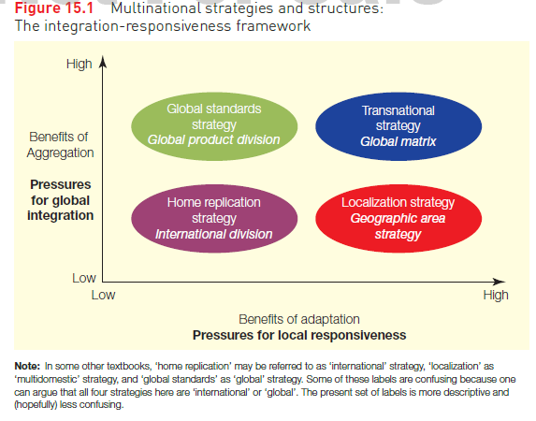
Organisational structures of the global business
Figure 15.1
Multinational strategies and structures:
the integration-responsiveness framework on page 418
Notes:
This section introduces the four types of strategies, distinguished based on the organisations need to be responsive to local markets versus their need to integrate operations on a global scale. These four strategies therefore influence where the node of control over the organisation’s operations rests. The choice of strategy results in one of four organisational structures for businesses operating across borders.
The integration-responsiveness framework (see Figure 15.1 in Peng & Meyer, 2019: 418) provides a tool to analyse multinational strategy and structure. The main concern when deciding on a global business strategy is the trade-off between global integration and local responsiveness. Global integration is a strategy of focusing benefits of aggregating operations above the national level. It helps in realising aggregation benefits, such as economies of scale, global innovation and global sourcing. Local responsiveness, on the other hand, is a strategy that focuses on the accommodation of local consumer demand and institutions. The two dimensions result in four global business strategies: (1) home replication, (2) localisation, (3) global standards and (4) transnational strategy. These strategies vary in responding to local needs and their emphasis on achieving efficiency around the world.
Do you see how we can link our discussion of the triple A framework to this figure? In our last discussion class, on Chapter 14/Lesson 4, we took you through the this framework. Note how the pressures for global integration versus the pressures to be locally responsive link to the two levers of aggregation and adaptation? Even more, we have been familiarizing you with these four global business strategies from the very beginning of this module…[next slide]

Slide 5
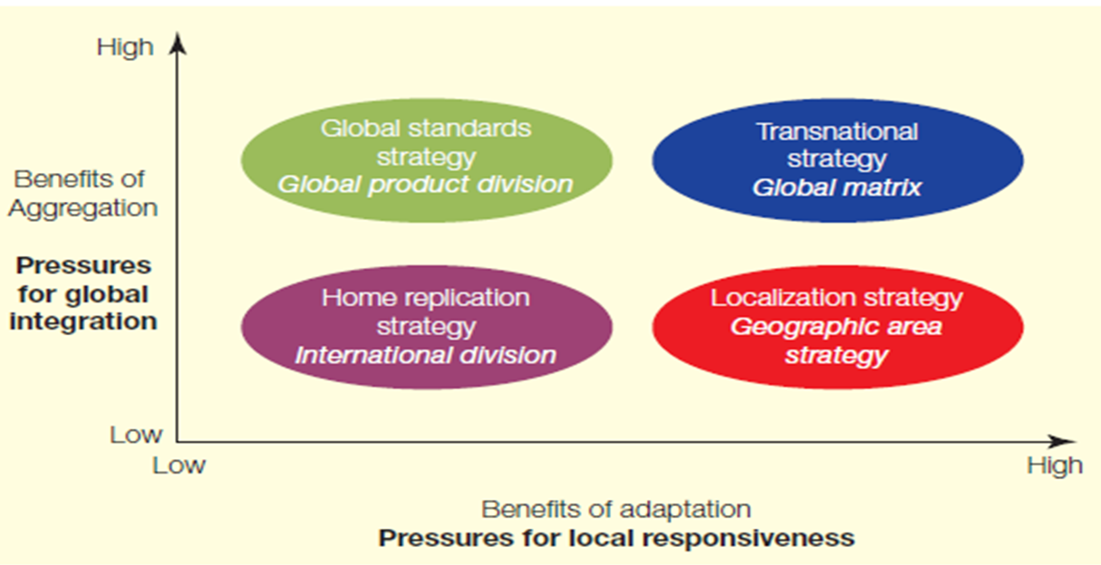
Organisational structures of the global business
GLOBAL
Centrally controlled operations
No need for home office integration, since home office makes all decisions
Views the world as its market
Low market responsiveness, since it is centrally controlled
(Global standards/standardisation strategy)
TRANSNATIONAL
Foreign offices have control over production, markets
Integration with home office
High local responsiveness
(Transnational strategy)
INTERNATIONAL
Centrally controlled
No need for home office integration, as home office makes all decisions
Uses existing production to sell products overseas
Low market responsiveness
(Home replication/export strategy)
MULTINATIONAL
Foreign offices are viewed as subsidiaries
Home office still has much control
High local responsiveness
(Multi-domestic/localisation strategy)
Source: Adapted from Edwards (2014); Peng & Meyer (2019: 418)
Attribution: "Effective training for international assignments" by Bruton, J & Bruton, L, Lumen Learning is licensed under CC BY 4.0
"International HRM", eLearning Support Initiative, University of Minnesota is licensed under CC BY-SA 4.0
Notes:
Remember this Figure 1 from Lesson 1? International organisations follow a Home replication strategy, often known as the ‘International’ strategy. This based on replication of home country-based competencies, such as production scales, distribution efficiencies and brand positioning. Essentially, the operation abroad is built to resemble the home operation in the belief that this is the best way to transfer competences of the firm. This strategy is relatively easy to implement and may be used by firms venturing abroad for the first time (Meyer & Peng, 2019). One will frequently see the home replication strategy in those organisations that expand through franchising – such as Ocean Basket. These companies use the International Division structure as they experience low pressures for global integration (they don’t need to aggregate as all the decisions are made at home and they do not have to coordinate operations like supply chains, HR and marketing globally). They also experience little pressure for local responsiveness – reproducing their business model overseas.
The Multinational company follows a localisation, also known as the multi domestic strategy. These MNEs customise products or processes to the specific conditions in each country in response to pressures for local responsiveness. Each country or region is considered as a stand-alone ‘local’ market worthy of significant attention and adaptation. An MNE using a localisation strategy, therefore sacrifices a lot of the benefits of aggregation in order to embrace the benefits of adaptation, responding to local requirements within each of its markets and giving their foreign subsidiaries/branches a lot more control. They use a structure based on geographic area, with overall management centralised in the home country but country managers having latitude to make adaptations. Why would a company sacrifice scale efficiencies of global integration for responsiveness to local conditions? Mainly because country managers have a deep understanding of local laws, customs, and tastes and can decide how to best meet them, enhancing success in that market.
The global MNE follows a global standards strategy, also known as the standardisation strategy, involves sacrificing responsiveness to local requirements within each of its markets in favour of emphasising efficiency. This strategy is the complete opposite of a localisation or multi domestic strategy (Peng & Meyer, 2019). Some minor modifications to products and services may be made in various markets, but a global strategy stresses the need to gain economies of scale by offering essentially the same products or services in each market and so they follow a global product division structure. However, according to Meyer and Peng (2019), global standards do not imply that all core operations are based at home. In a number of countries, the MNE may designate centres of excellence, defined as subsidiaries explicitly recognised as a source of important capabilities utilised by other subsidiaries. Apple is a good example of a company that applies this strategy to its iPhones. The design, manufacturing and promotion of these products are managed by a single unit globally.
Lastly, Transnational MNEs use a transnational strategy seek to find a middle ground between the home replication strategy and localisation strategy. They aim to capture the best of both worlds by endeavouring to be locally responsive and cost-efficient. The transnational strategy customises processes or products to the particular conditions found in each country. A hallmark of this strategy is to promote global learning and diffusion of innovations. Knowledge flows in both directions, from the home country to host countries as well as from host countries to the home country and among subsidiaries in multiple host countries (Peng & Meyer, 2019). They therefore use a rather complicated global matrix structure to enable this knowledge flow and to maximise both aggregation and adaptation.
Study pages 417-420 in Chapter 15 of Peng and Meyer (2019). Pay special attention to Table 15.1 which discusses the advantages and disadvantages of the four strategic choices for MNEs .

Slide 6
Four structures
Head Quarters
International division structure
(home replication strategy)
Global product division structure
(global standards strategy)
Geographic area structure
(localisation/multi-domestic strategy)
Global matrix structure
(transnational strategy)
Notes:
Let’s look at the structures that accompany each strategy more closely. Every organisation is different and thus requires a particular organisational structure, which will lead to its future success. At the top of every MNE are corporate headquarters which host the corporate executives and central staff functions and are normally found in the home country of an MNE. It is below these headquarters that we find the four organisational structures that are informed by the four strategic choices that were discussed above, namely: (1) international division structure, (2) geographic area structure, (3) global product division structure and (4) global matrix structure (Meyer & Peng, 2019).
An international division is typically set up when firms initially expand abroad, often engaging in a home replication or export strategy. Two problems. First, foreign subsidiary managers, whose input may be channelled through the international division, are not given sufficient voice relative to the heads of domestic divisions. Second, by design, the international division is not well integrated with the rest of the firm. Consequently, such an organizational structure is mainly used by firms where international sales contribute only a small share of their revenues. Restaurant franchises often embark on internationalization and structure themselves by international divisions.
A geographic area structure organizes the MNE according to different geographic areas (continent or region). It is the most appropriate structure for a localization strategy used by multinational organisations. The leadership team is often based in a regional HQ, which is in the region itself, for example in Johannesburg for Southern Africa, and is led by a regional manager. Each area is largely stand-alone. Country and regional managers carry a great deal of weight in a geographic area structure, in contrast with what we see in the international division structure. However, both the strengths and weaknesses of this structure lie in its local responsiveness. Although being locally responsive can be a virtue, it also encourages the fragmentation of the MNE into autonomous, hard-to-control units. Regional managers might make decisions without consideration of the overall impact on the rest of the company.
The complete opposite of this geographic area structure, is the global product division structure, which supports the global standards strategy of the Global MNE. Each product division can be considered a stand-alone, or autonomous, unit with full worldwide – as opposed to domestic – responsibilities. This structure greatly facilitates attention to pressures for cost efficiencies because it allows for consolidation on a worldwide (or at least regional) basis and reduces inefficient duplication in multiple countries. Most MNEs operating in more than one line of business have adopted a product division structure, some supplementing it by a regional structure within each product division. So, we might see businesses with very standardised products, like washing machines, cellphones, laptops etc, making use of this structure as there is very little need to adapt (though there might be some minor product adaptations based on regions).
A global matrix takes away the disadvantages associated with both geographic area and global product division structures, and is typically found in the transnational strategy. The key characteristic is the sharing and coordination of responsibilities between product divisions and geographic areas, to be both cost efficient and locally responsive. A manager of a country (area) in charge of a product line would report to two offices – the GLOBAL head of that product line AND the REGIONAL headquarters - both of which have equal power. The textbook mentions Unilever and Proctor & Gamble as consumer brand companies that use this type of structure. This is because companies like these, which manufacture items frequently purchased by individual consumers for personal care and use, have to balance a definite need for adaptation (shampoo that appeals to Europeans won’t appeal to consumers in West Africa for example – there are very different hair care needs) against high output needs which require aggregation. So, we will see the brand manager of Head and shoulders in Nigeria, reporting to both the West African regional HQ AND the personal care product division unit, both units reporting to corporate headquarters. It is VERY challenging to implement because of conflict that may arise between the product division and regional offices, who have equal say and leads to complicated decision-making. Consequently, the global matrix structure, despite its merits on paper, often slows down decision speed.

Slide 7
Managing knowledge
Knowledge management: the structures, processes and systems that actively develop, leverage and transfer knowledge. It is a broad concept that includes not only factual information but the know-how and know-why held by individuals and by the firm.
Explicit knowledge is codifiable (that is, can be written down and transferred with little loss of its richness). Virtually all the knowledge captured, stored and transmitted by IT is explicit.
Tacit knowledge is non-codifiable and its acquisition and transfer require hands-on practice. This knowledge is more important and harder to transfer and learn; it can only be acquired through learning by doing.
Notes:
This section outlines the challenges for MNEs to manage knowledge creation and sharing within their global operations. Every point of business throughout an MNE’s global operations is a point where knowledge is generated. Further knowledge is generated through these points interacting – for example. A subsidiary in Ghana will generate knowledge itself, but it will also generate knowledge by interacting with the local people and organisations, by interacting with other units of the MNE in other countries in the region, and by interacting with headquarters in the UK, for example. Remember organisations with capability-enhancing motives for FDI? In particular, these organisations are seeking knowledge that they can tap into in an innovation hub and then disseminate that knowledge across the global operations. The aim of knowledge management is to generate competitive advantages. The process of distributing and embedding this knowledge can get quite complex, however. Knowledge management is about the structures, processes and systems that actively develop, leverage and transfer knowledge. It is a broad concept that includes not only factual information (explicit knowledge) but the know-how and know-why held by individuals and by the firm (tacit knowledge). Tacit knowledge, in particular, is a great source of competitive advantage as it is not easily imitable. But it is also difficult to transfer across the organisation as it rests in the individual AND in teams or units of the organisation.
In the book

Slide 8
Managing knowledge
HOME CONTEXT
Knowledge flow (explicit and tacit)
HQ
Subsidiary A
MNE
Subsidiary B
Resources and insitutions
HOST CONTEXT
HOST CONTEXT
Resources and insitutions
Resources and insitutions
Peng and Meyer (2019:423)
Notes:
In the book (page 423) you will come across Figure 15.6 which shows the process of knowledge generation through interacting with local contexts (resources and institutions) and between organisational units. In each of these knowledge generating units (HQ, Sub a and sub b), we have both tacit and explicit knowledge. This is a very basic figure – it doesn’t, for example, show how centres of excellence (commonly used by global MNEs) come into play. What about international organisations with home replication strategies? Do you think knowledge flows freely back to HQ? I would advise that, as you study this chapter, you make drawings to show how each type of MNE, with its strategy and its structure, would handle knowledge flow. In an ideal situation, knowledge should be flowing freely between all the units of the MNE, but is this really the case? Explicit knowledge is easy enough to communicate – its procedures and policies that are written down. But what about that inherent tacit knowledge? How are you, as a manager of a global business, going to access that tacit knowledge about local institutions and resources?

Slide 9
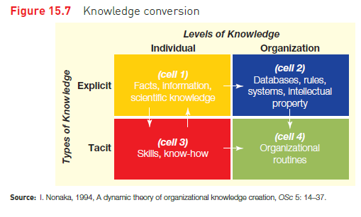
Knowledge conversion
Source: Peng and Meyer (2019: 424)
Notes:
That’s where figure 15.7 comes in (page 424). Nonaka identified four types of knowledge that organizations have to manage.
Knowledge management involves transforming these different forms of knowledge into knowledge that can be shared and used across people and teams in the MNE. Remember, tacit knowledge is the unwritten “know-how”. It needs to be turned into written knowledge (from cell 3 to cell 1) by writing manuals or by entering it into databases. At the same time, people throughout the MNE have to learn and integrate the explicit knowledge (say, cell 1) of others with their personal, tacit knowledge. At the organisational level of knowledge (cell 2 and 4), knowledge that is explicit (written/recorded) can easily be transferred into formal rules and IP for the company. Company routines (cell 4) on the other hand, can evolve through these formal explicit rules, but also through the tacit know how of its people (an employee might know the best person to go to regarding IT issues). Can you imagine how much more complicated this gets when you are dealing with a global operation with thousands of people? This knowledge conversion has to take place within every unit of the organizational structure!

Slide 10
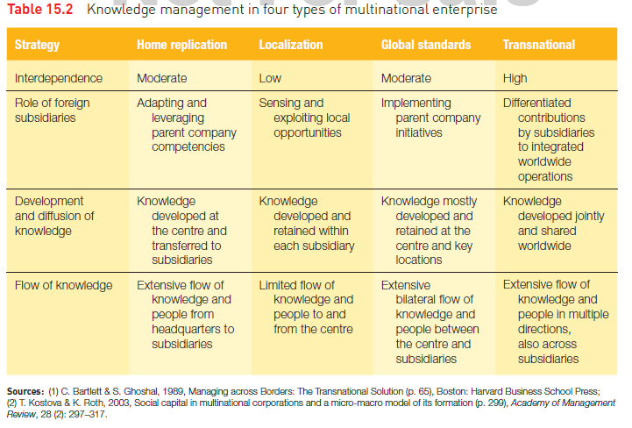
Knowledge management and the MNE structure/strategy
Source: Peng & Meyer (2019: 426)
Notes:
The figure where we introduced you to the four types of MNE comes into play again. Each type of MNE structure will have an effect on the flow of knowledge and its management. An organisation following a home replication strategy will have knowledge flowing from the centre to the border. The parent company develops knowledge about new technologies and products and then transfers it to subsidiaries in a traditional one-way flow (Peng & Meyer, 2019). Multinational enterprises implementing a localisation strategy develop knowledge that can best deal with their local markets. Most knowledge transfer takes place within the subsidiaries. Those MNEs adopting a global standards strategy develop and retain knowledge at the headquarters and a few centres of excellence at other locations. This strategy therefore leads to an extensive flow of information within the organisation. Lastly, transnational MNEs are built on extensive and multi-directional flows of knowledge. Reverse knowledge transfer – new knowledge created in a subsidiary being transferred from the subsidiary to a parent organization – is of increasing importance in a global interconnected world Table 15.2 in the prescribed textbook outlines how knowledge is managed in these four types of MNE. When encountering a case study, besides looking at how the company adapts versus aggregates, how how the organisation is structures across countries, you can also look at how knowledge management is handled in the case study. Do we see key centres of excellence responsible for creating and distributing knowledge? Then you are most likely dealing with a GLOBAL MNE, following a global standards strategy with a product division structure.

Slide 11
Question – Which type of organisation do you think this figure best represents?
HOME CONTEXT
Knowledge flow (explicit and tacit)
HQ
Subsidiary A
MNE
Subsidiary B
Resources and insitutions
HOST CONTEXT
HOST CONTEXT
Resources and insitutions
Resources and insitutions
Peng and Meyer (2019:423)
Notes:
Which type of MNE do you think would have a knowledge flow like that shown in the book? Transnational
What about this one?

Slide 12
Question – Which type of organisation do you think this figure best represents?
CoE
HOME CONTEXT
Knowledge flow (explicit and tacit)
HQ
Subsidiary A
MNE
Subsidiary B
Resources and insitutions
HOST CONTEXT
HOST CONTEXT
Resources and insitutions
Resources and insitutions
CoE
Peng and Meyer (2019:423)
Notes:
What about this one? Global

Slide 13
Communities of practice (CoP)
Groups of people doing similar or related tasks
Tacit knowledge is shared within the group and the group can be tapped into when and as needed.
International CoPs are difficult to organise – different cultures, different countries, different languages, different time zones etc
Rise of the virtual CoP
Notes:
The book also speaks about Communities of practice (CoPs) as an important means to share knowledge in MNEs. Most knowledge that is created occurs in groups of people doing related or similar tasks (Peng & Meyer, 2019). The prescribed book outlines ways in which these CoPs can be encouraged and the influence of digitalisation on the interaction of CoP members across borders.
CoPs organise around the need to tap into tacit knowledge. Creating these groups is a quicker option that codifying the knowledge and distributing it as explicit knowledge.

Slide 14
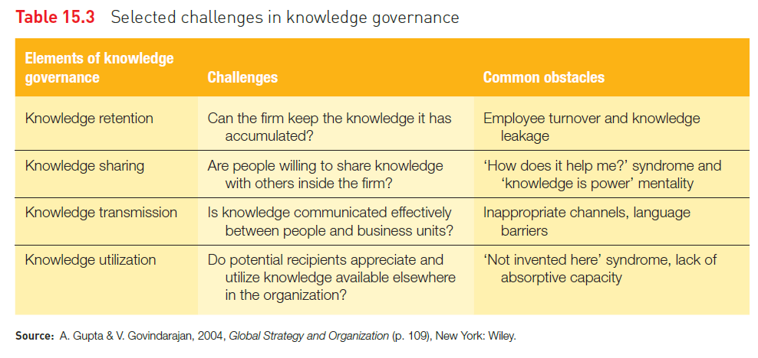
Knowledge governance
Source: Peng & Meyer (2019: 429)
Notes:
Knowledge governance refers to selecting mechanisms and organisational structures that can facilitate the creation, integration, sharing and utilisation of knowledge. The prescribed book highlights the challenges that need to be addressed in knowledge governance in the MNE. You can see a summary of these challenges in Table 15.3 (Peng & Meyer, 2019: 429). You might see a link between knowledge retention and human resources – If you have employees with tacit knowledge and they leave the company, you are going to lose that valuable knowledge. Making that knowledge explicit or sharing tacit knowledge through communities of practice will help the company to retain it. Intellectual property is also a valuable resource – what if an employee leaves with that knowledge and goes to a competitor? Then that knowledge is no longer rare and it can be imitated – you will lose your sustainable competitive advantage unless you can protect it through contracts, for example.
CoPs come into play again with knowledge SHARING: HQ can manipulate the formal rules of the game, such as (1) tying bonuses to measurable knowledge outflows and inflows, (2) using high-powered, corporate-or business-unit-based incentives (as opposed to individual-and team-based incentives) and (3) codifying tacit knowledge. However, the most challenging (if not impossible) task is to accurately measure inflows and outflows of tacit knowledge. The nature of tacit knowledge simply resists such formal processes. Moreover, high powered incentives may undermine a corporate culture of sharing knowledge, as individuals focus on initiatives that are measured and rewarded, while reducing informal means of sharing that can be more timely and effective. In other words, large bonuses can undermine a cooperative culture.
With knowledge transmission, you can think back on the figures highlighting knowledge flow. The organizational structure needs to allow knowledge to be communicated. However, you will see issues in an international division structure for example, where business units are not communicating between countries. Even if you have the structure of a global matrix, we might still encounter language or cultural barriers as well.
Lastly even if knowledge is retained, transmitted and shared, is it being USED? A subsidiary manager in India might not take knowledge shared by another subsidiary in China – shrugging it off as not applicable. How does the MNE get around this and the other challenges of sharing?
Through informal social capital, in which individuals and subsidiaries can be encourages to benefit informally from this knowledge through their social structures and networks. Social capital helps in motivating individuals to go out of their way to help friends and acquaintances. MNEs thus organize major events for participants from across their global network, not only to learn from each other but to develop personal relationships. Then, managers of the China subsidiary are more likely to help managers of the India subsidiary if they know each other and have some social relationship. Thus, informal interpersonal relationships between managers of different units may greatly faciltate inter-subsidiary cooperation among units.

Slide 15
Subsidiary strategies
Increasing importance of a global MNE network means that subsidiaries have more decision influences.
Worldwide (or global) mandate
The charter to be responsible for one MNE function throughout the world – created as centres of excellence.
Subsidiary initiative
The proactive and deliberate pursuit of new opportunities by a subsidiary to expand its scope of responsibility.
Notes:
Subsidiaries develop over time and that through their own initiatives and actions have the potential to modify the power structures of the MNE and influence strategy from below. If we are to say that MNEs are no longer massive, hierarchical organisations, with knowledge flowing in one direction, and if knowledge originates throughout the global network of the MNE, then subsidiaries have vital roles in all aspects of knowledge management. As a result, subsidiaries have the potential to attain considerable independence within the MNE. A subsidiary might evolve into a centre of excellence because of their strategic location for the region, for example.
Also, providing subsidiary managers with the freedom to act entrepreneurially in their own markets is a powerful way to bring about their best ideas and initiatives. Yet subsidiary autonomy also makes it more difficult to realize the benefits of integration, in particular economies of scale and shared standards and practices. We saw this with one of the downfalls of the multinational MNE with a localization strategy and a geographic area structure. When HQ wants to introduce common practices throughout the organization (such as quality procedures), some subsidiaries may be happy to comply, others may pay lip service, and still others may object, citing local differences. Subsidiary employees often feel
that corporate HQ, especially those staffed by parent country nationals only, take decisions in more or less ignorance of their local context, and that imported practices from HQ are insufficient to beat local competitors.

Slide 16
Institutions affecting organisational structure
Home country
MNEs comply with the institutional frameworks in their home countries, and each country has a “tradition” of favouring certain strategies and structures – US = home replication strategy/international division, but Japan = product division/ global standards
Host country
Governments often attract or encourage MNEs into undertaking activities e.g. investment in advanced manufacturing, R&D etc.
Notes:
So, how do institutions come into play for structures in the MNE? Each country has a “tradition” of favouring certain strategies and structures because of their home institutions – US = home replication strategy/international division because of the sheer size of the country, bringing in most sales, they chose this strategy but did allow some localization of their subsidiaries. These institutional variances influence organisational forms in numerous ways. In the past, majority of the firms were organised either as holding companies (if they operated in multiple businesses), or by functions along the value chain, separating purchasing, manufacturing and sales units. However, with increasing diversity of markets and products, such organisational structures were no longer relevant. In the latter years, ‘multi-divisional’ forms started to be preferred.
The external environment can change this – new trade agreements, for example, open borders and do away with geographic structures in favour of matrix structures
Therefore, host country governments use incentive schemes and the national innovation system, for example, may affect the types of activities MNEs locate in a country. BMW opened a car manufacturing centre in SA
MNEs tend to look more broadly at the institutional framework for innovation, also known as national innovation systems. Thus MNEs locate their
R&D units near quality universities and research laboratories and where networks between business and academia facilitate knowledge flows (CAPABILITY ENHANCING)
The MNE’s relationship with host governments has also come to the fore as large organisations have gained the ability to extract a favourable outcome from negotiations with local politicians (bargaining power)

Slide 17
Resource-based considerations
Organisational structures and knowledge management practices support value creation and exploitation
VALUE: Does the structure and the innovations arising from knowledge management add value? Does the structure help or work against valuable innovations?
RARITY: Structure is not rare, but the coordination of the global network of the structure can be.
IMITABILITY: Structure is imitable, but the intangible knowledge (remember Cell 4?) is not!
ORGANISATION: Resources and capabilities to take advantage of the innovations
Notes:
This section discusses how organisational structures and knowledge management practices support value creation and exploitation.
The structure of an organisation can contribute or detract from the sustainable competitive advantage of the MNE. You will read how organisational structure can do this by analysing it against the VRIO framework in the prescribed book
VALUE: Does the structure and the innovations arising from knowledge management add value? Does the structure help or work against valuable innovations?
RARITY: Structures are not typically rare, but the technology and tacit knowledge to mange the structures can be. Seamless conection is difficult.
IMITABILITY: Structure is imitable, but the intangible knowledge (remember Cell 4?) is not! The less formal network structure provides an organizational concept or philosophy which, supported by a collaborative organizational culture, enables organizational capabilities. It is obviously a lot harder, if not impossible, to imitate an intangible mentality than to imitate a tangible structure. Tacit knowledge is harder to copy than explicit – which is why you don’t want to do away with it!
ORGANISATION: Resources and capabilities to take advantage of the innovations. Are MNEs organized, both formally and informally, to exploit the values they are creating? A crucial difference exists between an innovator and a profitable innovator. The latter not only has plenty of good ideas but also lots of complementary assets (such as organizational structures and marketing muscle) to add value to innovation (see Chapter 4).

Slide 18
Debates and extensions
MNEs have three choices when appointing head of subsidiary:
A parent country national as the head of subsidiary (such as a French person for a subsidiary of a French MNE in India).
A host country national (such as an Indian for the same subsidiary).
A third country national (such as a Briton for the same subsidiary).
Notes:
In the last section, The prescribed book presents two debates on organising and managing knowledge. The first debate concerns the nationality of top management teams, and the implications for the management of the corporation.
Home country nationals are more likely to have a thorough understanding of the informal, social norms and values of a firm.
Foreign-born bosses bring substantial diversity to an organization, especially valuable with high share foreign owners or sales.
Diversity of top management teams affects the global survival and success of the MNEs. Furthermore, Peng and Meyer (2019) noted that a crucial element in the structure of an MNE is the leadership of subsidiaries and the composition of the top management team. You will learn more about the managerial mindset of the MNE and how it influences HR practices in Study Unit 6.

Slide 19
Debates and extensions
Some MNEs aggregate operations by locating business unit headquarters (HQ) away from home, while some are even moving their corporate HQ away from their country of origin.
‘Centre of gravity’ around business activities may pull its HQ towards a host country e.g. IBM moved its global procurement office to Shenzhen, China in 2005.
HQ are a clear signal to various stakeholders that a firm is global.
Facilitates access to capital markets e.g. New York or London.
Indicates commitment to that country’s market.
Some firms can reduce their tax burdens by moving their HQ.
Notes:
The second debate concerns the relocation of headquarters and business-unit-headquarters away from the country of origin.
Some MNEs aggregate operations by locating business unit headquarters (HQ), the central coordinating unit for an entire business, away from their home country. Some are even moving their corporate HQ away from their country of origin. At the business unit level, the answer is straightforward: the ‘centre of gravity’ of the activities of a business unit may pull its HQ towards a host country.
They might move their operational HQ because most of their markets are in that area. Others move key functions overseas to be closer to their business partners. For example, IBM moved its global procurement office to Shenzhen, China, in 2006.
At the corporate level, there are at least four strategic rationales. First, HQ location is a clear signal to various stakeholders that the firm is a global – rather than domestic or local – player.
Second, it may facilitate access to capital markets. A corporate HQ in a major financial centre such as New York or London facilitates direct communication with institutional shareholders, financial analysts and investment banks. The MNE also increases its visibility in a financial market as a result.
Third, moving corporate HQ to a new country clearly indicates a commitment to that country’s market.
Finally, as discussed in Chapter 6 from MNB3701, some firms may be able to reduce their tax burden by moving the place of their incorporations.

Slide 20
Summary Lesson 5
MNEs are big, complex and geographically spread businesses
Structure calls for MNEs to have a thorough understanding of the rules of the game, both locally and abroad
Need to understand external and internal rules governing managerial action, along with the need to develop capabilities to manage innovation while ‘thinking global, acting local’
Notes:
In summary, MNEs are big, complex and geographically spread businesses. Different strategies and structures call for different rules. Excessive centralization kills local initiative and innovation, and undermines context-sensitive adaptation. Complete decentralization, on the other hand, under-mines the MNE’s ability to create synergies and exploit economies of scale, We need to emphasise the need to understand external and internal rules governing managerial action, along with the need to develop capabilities to manage innovation while ‘thinking global, acting local’ Subsidiaries of MNEs thus need to engage not only in local CoPs to access local knowledge but with internal CoPs within the MNE to share such knowledge throughout the company. However, it requires rare managerial skills to implement the ‘act local, think global’ management philosophy.

Slide 21
Test yourself
GO READ THE SHORT CASE ON MYUNISA AND ANSWER THE FOLLOWING QUESTION:
MNEs need to make decisions on how to organise their people and subunits in distinct local contexts. Which organisational strategy and structure has Standard Bank adopted? Motivate your answer with evidence from the case study and outline the impact their choice will have on knowledge flow.
BREAK DOWN YOUR ANSWER AS FOLLOWS:
Identify Standard Bank’s strategy and structure according to the integration-responsiveness framework (2 marks)
Motivate your choice using evidence from the case study (2 marks)
Analyse the impact of their structure on knowledge flow (4 marks)
POST YOUR ANSWER ON THE DISCUSSION FORUM

Slide 22


