Slide 1

MNB3702 Discussion Class
Theme 3: Management and implementation
Chapter 16 / Lesson 6
By
Jessica Nel

Slide 2
Lesson 6 – People in the international business (Chapter 16)
Organisational structure and strategy impacts on staffing policies and managerial mind-sets (central operational efficiency vs local responsiveness)
Managerial mind-set affects the use of expatriates and how the MNE manages its employees
HR policies and practices are varied across countries – NB to research and understand them
People provide a source of sustainable completive advantage (RBV)
MNEs have the unique consideration of diverse multicultural teams
Notes:
In Lesson 2, you were introduced to the building blocks for an entry strategy, including decisions such as location, timing, ownership forms and global operations. One of the key considerations in organising the MNE’s operations included the management of its people across the host and local markets. A highlight of that discussion was the management of the cultural differences.
We begin Lesson 6 by recapping how organisational strategy and structure balance the need for centrally controlled and organised global operations against the need for local responsiveness (remember the integration-responsiveness framework from lesson 5?). Organisational structure and strategy impacts on staffing policies and managerial mind-sets and we briefly touched on this in the debates and extensions of chapter 15. You are now going to learn how these mind-sets affect the use of expatriates and the management of employees across the MNE. We also emphasise the importance of researching and understanding HR policies and practices in each country of operation and explore the contribution of people as resources that can provide sustainable competitive advantage. Finally, the need to manage diverse multicultural teams in a variety of circumstances is highlighted.

Slide 3
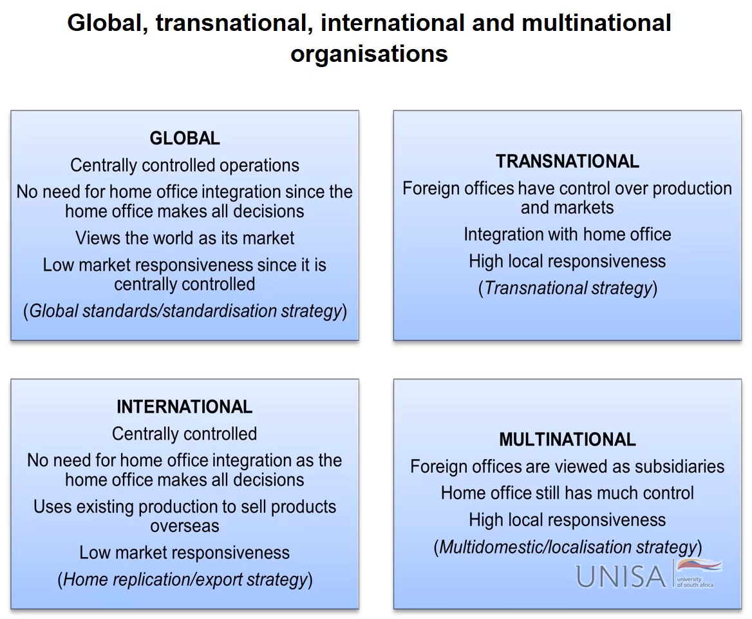
Strategy, structure and managerial mindset
Notes:
https://vimeo.com/552789123
Note the relationship between the different types of organisations in this figure and how they are linked to the integration-responsiveness framework that you learned about in Lesson 5 and pages 417 to 423 of Peng and Meyer. Pressures for aggregation and pressures for local responsiveness will lead the MNE to choose different strategies and accompanying structures. In turn, these strategies and structures influence the mindset of the decision-makers of the organisation as they measure the pressures of globally integrated management policies and practices against the need to adapt and respond to local pressures.
The global organisation, using a global-standards, or standardisation, strategy and following a global product division structure, has a strong product orientation which benefits from aggregation. These MNEs are more likely to have management that thinks globally because the entire information infrastructure is geared toward collecting and processing product data on a worldwide basis.
An organisation with a focus on countries, areas, or regions, reflecting high pressures for local responsiveness, is more likely to reflect a local mindset. The information infrastructure in these organisations is primarily geared toward local and regional needs. These are typically multinational organisations, using a multidomestic or localisation strategy and a geographic area structure.
The transnational MNE has managers of organisations that follow a matrix structure – based on product as well as geographic dimensions – and who have both a global and a local perspective.
The type of organisational strategy, structure and managerial mindset will also influence the staffing-policy approach and mix of the MNE’s management team. The staffing-policy approach determines if MNE teams are composed of predominantly home-country nationals, host-country nationals or a blend of both, or third-country nationals. This mix goes hand in hand with staffing issues such as when to expatriate, how to compensate, and repatriation. Have a look at the advantages and disadvantages of home-country, host-country and third-country national management teams in the pictures after this video. Please note that selecting third-country nationals for your team would form part of a geocentric, or supranational approach. However, the geocentric approach is not ONLY third-country nationals. It ALSO includes selecting home and host-country nationals. The key characteristic of the geocentric approach is that the person chosen is considered the best for the job – irrespective of their nationality.

Slide 4
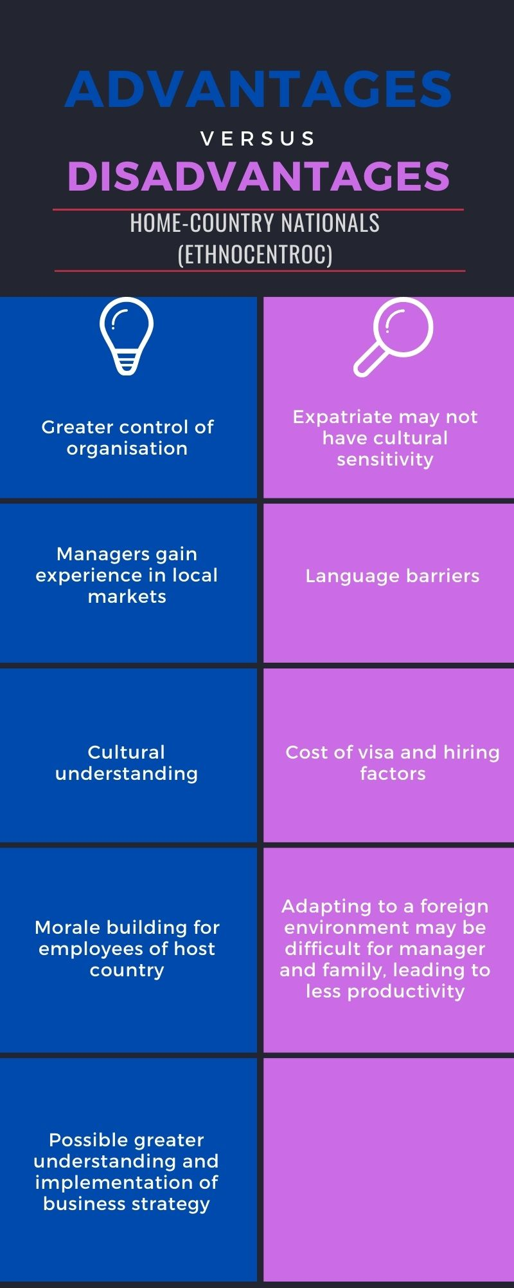
Approaches to managing people
Ethnocentric
  Home-country mentality
  Norms, practices, procedures and practices originate in the home country and spread across the global operations
  Subsidiaries led by expatriates from the parent company

Slide 5
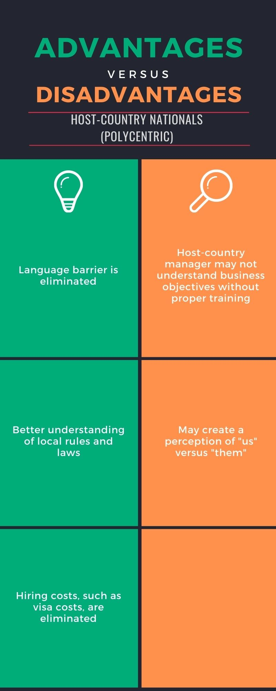
Approaches to managing people
Polycentric
  Host-country mentality
  Adapts locally using local knowledge
  Language and cultural barriers overcome

Slide 6
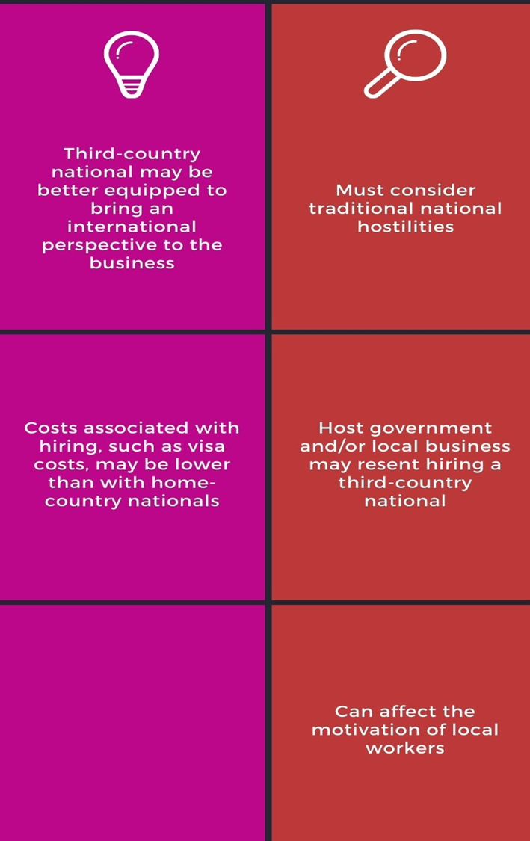
Approaches to managing people
Geocentric
  Supranational mentality
  Think global act local
  No dominant nationalities (positions filled based on ability)
Notes:
Two simultaneous demands on global organisations have given rise to geocentric organisations. On the one hand, they are expected to be locally responsive and, on the other, maintaining worldwide competitiveness requires a higher degree of efficiency that is only possible with a globally integrated operation. Geocentric organisations think globally and act locally, prefer to have no dominant nationalities within the organisation, and fill positions based on applicants’ ability (Conrad & Meyer-Ohle, 2019). Successful geocentric organisations integrate business activities, operations, processes, people, values, and practical cultural attributes (Fatehi & Ghadar, 2014).

Slide 7
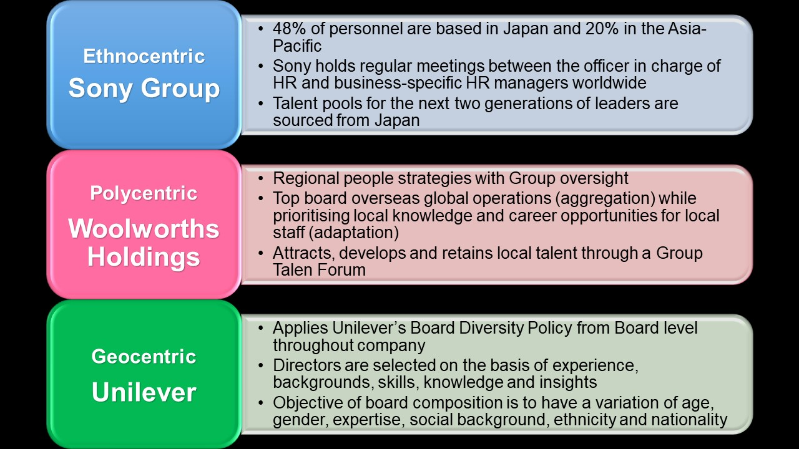
Examples of ethnocentric, polycentric and geocentric organisations
Notes:
Review the figure below for some examples of MNEs using each of the staffing approaches. Note that, while Sony has historically shown an ethnocentric approach, the company is moving towards a polycentric approach as they grow.

Slide 8
Question
Can you link the organisational structures and strategies outlined in Lesson 5 to the typology of managerial mentalities described here and in the prescribed book?
Which mentality will be common in a Global MNE?
Which mentality will be common in a Multinational MNE?
Which mentality will be common in a Transnational MNE?
Which mentality will be common in an International MNE?
Notes:
An MNE that uses the global standards or standardisation strategy and follows a global structure (or global product division structure), treats the whole world as one market with little meaningful variation between each product division ("Introduction to current trends in global business" by Bruton & Bruton; Peng & Meyer, 2019: 421). The assumption is that one product meets the needs of people everywhere and such a strategy is therefore not responsive to local markets. This organisation has centrally controlled operations and its home office makes all the decisions ("International HRM" by eLearning Support Initiative). A strongly product-oriented structure, on the other hand, implies that management thinks globally. Therefore, one can argue that this organisation follows an ethnocentric approach (home-country mentality) and that its subsidiaries are run by parent-country nationals (non-native expatriates) who have to ensure that home-country structures and processes are consistently applied ("Globalizing the management model" by De Kluyver; Peng & Meyer, 2019: 447–448).
International divisions are set up when organisations initially expand abroad, often engaging in a home-replication strategy (sometimes called an export strategy). The downside of this structure and strategy is that foreign subsidiary managers, whose input may be channelled through the international division, have a smaller say than the heads of domestic divisions ("Introduction to current trends in global business" by Bruton & Bruton; Peng & Meyer, 2019:420). Because it is not interested in responding locally to the unique conditions in other countries, it can be argued that this structure advocates an ethnocentric approach. This approach ensures that the comprehensive procedures and standards developed by the parent organisation are complied with in the foreign country using a home-trained expatriate ("Introduction to current trends in global business" by Bruton & Bruton; Peng & Meyer, 2019: 447–448).
A geographic area structure organises the MNE according to different geographic areas (continents or regions). It is the most appropriate structure for a multidomestic or localisation strategy. The leadership team is often based at a HQ in the region itself, for example, Singapore for Asia, and it is led by a regional manager. Each area is largely independent and products or processes are customised to suit the specific conditions in that country. In contrast to the limited voice of subsidiary managers in the international division structure, country and regional managers carry a great deal of weight in a geographic area structure ("Introduction to current trends in global business" by Bruton & Bruton; Peng & Meyer, 2019: 420–421). This type of organisation tends to follow a polycentric approach (host-country mentality) and focuses on countries, areas or regions (Fatehi & Ghadar, 2014). The top managers of these subsidiaries have a local mindset. They are host-country nationals who speak the local language and know the local culture and who are better equipped for engaging with local customers, suppliers and government officials (Fatehi & Ghadar, 2014; Peng & Meyer, 2019:448).
A transnational MNE that follows a transnational strategy and a global matrix structure has a geocentric managerial mentality (a supranational mentality) (Fatehi & Ghadar, 2014; Peng & Meyer, 2019: 448). The delegation and coordination of responsibilities between product divisions and geographic areas are the hallmark of this mentality. A transnational strategy and a global matrix structure must be both cost-efficient and locally responsive (Peng & Meyer, 2019:422). The need to be locally responsive while globally integrated has led geocentric organisations to treat all employees the same (Fatehi & Ghadar, 2014; Peng & Meyer, 2019:448). Their management team, therefore, consists of home-country, host-country, or even third-country nationals, which facilitates the emergence of a corporate culture and identity (Peng & Meyer, 2019:448).

Slide 9
Watch this video, which explains key global staffing considerations when selecting expatriates.
https://youtu.be/11irCzsdip4

Slide 10
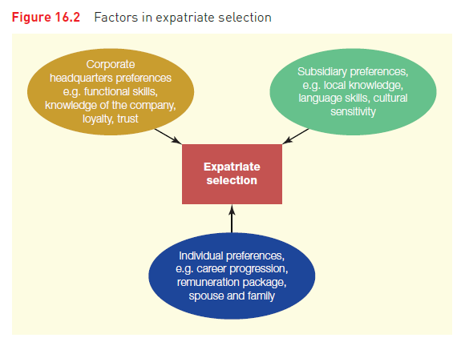
Expatriates - selection
Source: Peng & Meyer (2019: 450)
Notes:
The textbook takes a similar stance to the video. Expatriates facilitate communications across the different units in the MNE’s organisational structure and play a critical role, acting as strategists, monitors, ambassadors, daily managers, and also trainers (Peng & Meyer, 2019: 449). As expatriates are home- or third-country nationals, their management will be especially important to those MNEs with an ethnocentric and geocentric approach. The prescribed book presents the various influences in selecting expatriates to go on assignment. Figure 16.2 provides a visual summary of those influencing forces as parent-organisation preferences, host-organisation preferences, and individual preferences (Peng & Meyer, 2019: 450).
HQ seeks expats that have functional skills, knowledge of the company and loyalty and trust in it. Subsidiaries may be more concerned about sensitivity to local culture and in filling specific capability gaps. It is ideal if the expat has good knowledge of the local language. On an individual level, an expat that is likely to be successful should have intellectual (knowledge of IB and capacity to learn), Psychological (openness to new cultures, ideas and experiences) and social (networking/relationship building in diverse cultural backgrounds) capabilities.
Sending someone on an international assignment is resource intensive, so there should be a clear organisational need and valid reason why the need cannot be met through hiring a local candidate. Ultimately, they should make a contribution to the organisation as a result of the skills they have and will develop on assignment.
Also important is the needs of the expat’s family and spouse – if they are unhappy, that will influence the effectiveness of the expat and the chance of success. So, companies may offset choosing an expat who has experience, but strong family ties, against a young expat with limited experience, but an eagerness to learn, ambition and fewer family ties (making it less costly to relocate).

Slide 11
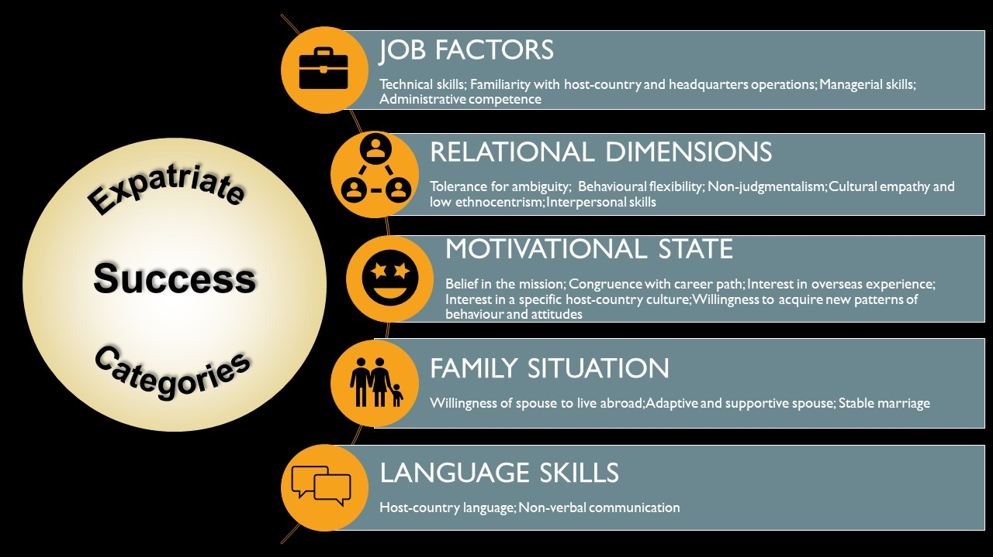
Expatriates - selection
Source: "International HRM", eLearning Support Initiative, University of Minnesota is licensed under CC BY-SA 4.0
Notes:
In addition to the above preferences and the capabilities discussed in the prescribed book, the selection of expatriates should also be based on the likelihood of success in the expatriate assignment. You will see a link between the HQ and subsidiary needs reflected in the Job factors, relational dimensions, and language skills. The expatriates needs are reflected in their motivational state and family situation.
Expatriate staffing decisions should never be based on gender; women both desire to become expatriates and perform equally well in these positions as their male counterparts. Depending on the categories of job factors, relational dimensions, motivational state, family situation, and language skills as determinants of expatriate success (developed by Simcha Ronen, 1989), appropriate selection processes and training can prevent expatriate failure ("International HRM" by eLearning Support Initiative).

Slide 12
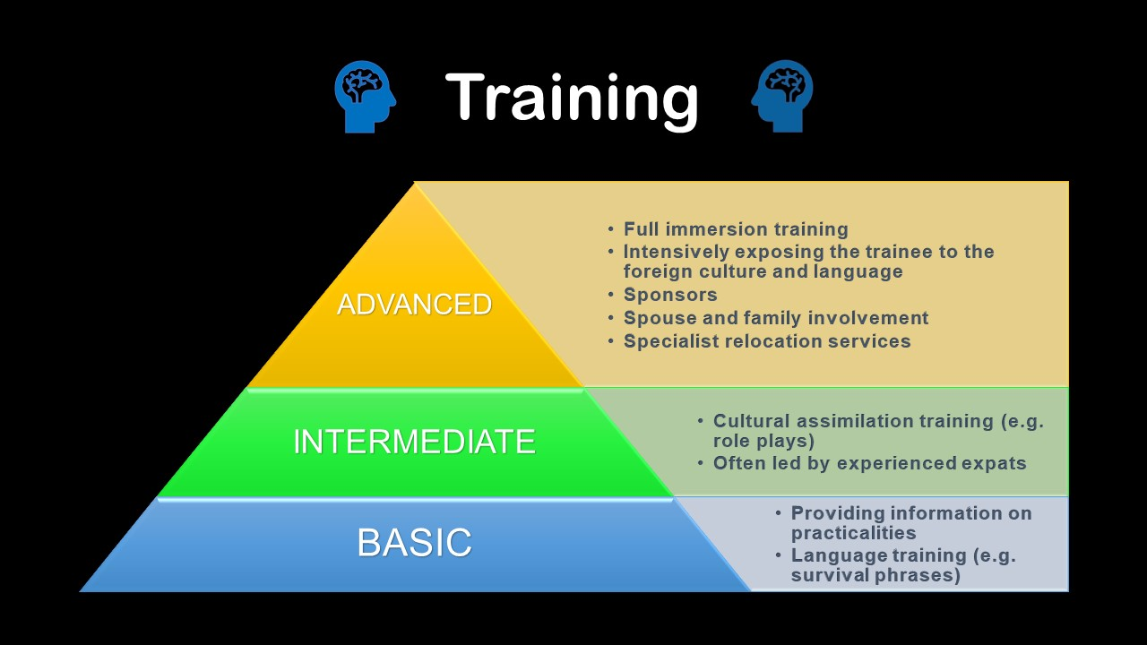
Source: Adapted from Peng & Meyer (2019: 452)
Notes:
A long assignment can mean a significant investment for the MNE. Two key reasons for expatriates failing are the inability of the spouse, or of the employee, to adjust to the new environment – physically or culturally. Common complaints include a lack of appropriate cross-cultural training to prepare expatriates and their families, lack of long-term career planning, and difficulties in adjusting to the demands of an expatriate assignment. Therefore, assessing an expatriate’s likelihood of success in his or her international assignment will allow the MNE to identify training needs and prevent the assignment from failing. It is recommended that training in host-country experiences and activities be given to every person selected for expatriation.
The prescribed book, on page 452, makes the following recommendations on training, based on the length of the expatriate assignment: First, basic level training which focuses on providing information on practicalities in socalled area briefings, cultural briefings, and the use of interpreters. It often includes language training, which may focus on survival phrases (such as ‘good morning’, ‘thank you’ and ‘please take me to this address’).
Second, intermediate training. This type of training would include cultural assimilation training such as role plays and discussion of cases and critical incidences. Experienced expatriates will lead these groups.
Third, advanced training – also known as full immersion training. Advanced training has the aim of intensively exposing the trainee to the foreign culture and language. Expats may spend a few days at the new location, guided by a sponsor, in a situation resembling the future role. Sponsors from the home and host organisations should be identified to mentor expatriates and to help them manage the challenges they will experience during their assignment. These sponsors help the employee maintain and enhance the connection between headquarters and the subsidiary. Ideally, those chosen as sponsors should have experience in international assignments (having been abroad themselves) and should be empathetic and understanding about the experience as it can be extremely stressful (Molinsky & Hahn, 2016). Involving the spouse and children in expatriate training is advisable, as they will be sharing the expat experience and can be an important source of personal support. If the MNE has the resources, it can also offer specialist relocation services firms to find a suitable place for the expat to live, the removal of furniture, identification of suitable schools for the children, and organisation of visa and work permits.
In addition to training, Molinsky and Hahn (2016) make recommendations for preparing successful overseas assignments. They advise selecting the right person for the right reasons. Sending someone on an international assignment is resource intensive, so there should be an urgent organisational need and valid reason why the need cannot be met through hiring a local candidate. Furthermore, the person who is selected for the assignment should be open-minded and committed to adapt to the local culture, should develop specific skills because of the assignment, and should ultimately contribute to the organisation as a result of these skills. Kraimer, Bolino and Mead (2016) recommend that expatriates be guaranteed positions within the MNE on their completion of the international assignment to reassure them of their future employment within the organisation. These positions should effectively use expatriates’ skills and knowledge acquired while overseas. Furthermore, MNEs should show that they value the international experience of their expatriates through pay and promotional opportunities.

Slide 13
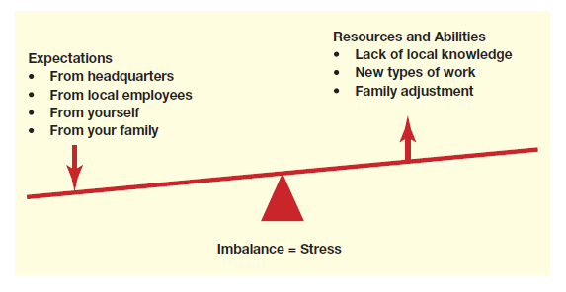
Culture shock and stress
Arrival
  practicalities and getting settled
Time passes
  Culture shock (reaction to a new, unpredictable and uncertain environment)
  Stress (expectations, resources and abilities)
Source: Peng & Meyer (2019: 454)
Notes:
Moving to a new country is stressful, so MNEs must train expatriates to deal with stress, homesickness and culture shock. Because the expatriate’s family also experiences a great deal of stress, the MNE should put in place measures to ease the transition for them (Kraimer et al, 2016). If the expatriate adjusts well but his or her family does not, this can increase the expatriate’s stress and result in a failed assignment ("International HRM" by eLearning Support Initiative).
A spouse may have to sacrifice his or her own career goals, children must go to new schools, and social networks have to be left behind. These considerations can spoil an assignment. As a result, many companies offer training and support for the entire family to prepare them for an overseas assignment. The development of an overseas network to provide social outlets, activities, schooling and housing options, the assignment of mentors to the spouse, and other methods can help ease the transition ("International HRM" by eLearning Support Initiative).
If an MNE is able to provide these resources to support and effectively train the expatriate, then they will be able to reduce stress for the expatriate. Review the figure on expatriate stress below: if an expatriate is under high expectations to perform, but is not receiving the resources and training they need, they will experience high levels of stress (Peng & Meyer, 2019).

Slide 14

Progressing through culture shock
Source: Peng & Meyer (2019: 455)
Notes:
Figure 16.4 on page 455 in the prescribed book depicts the various stages of culture shock an expatriate experiences in an unfamiliar culture.
Similarly, this figure depicts four phases of adjustment that expatriates on an international assignment go through: elation/honeymoon, resistance, adaptation and biculturalism.
Expatriates will often begin to experience culture shock a few weeks after moving. The elation phase (or honeymoon period as described in the prescribed book) is characterised by feelings of excitement for the expatriate, who finds the new surroundings and culture to be exotic and stimulating. However, after a while, the pressures of work become a reality and the expatriate begins to miss home. This is the resistance phase, in which the employee makes frequent comparisons between the home and the host country and seeks out reminders of home. The expatriate may be frustrated by the differences in language, culture and routine. Once this period passes, and the expatriate becomes more familiar with the local culture, gains language skills and a new social life, they enter the adaptation phase. Some expatriates may even reject their own culture and embrace life overseas. In the final phase, biculturalism, expatriates embrace the new culture and appreciate their former life at home as much as their new life overseas. Many of the problems associated with expatriate failures such as family life and cultural stress, have diminished and the employee may even wish to stay longer when the assignment ends. The prescribed book recommends some dos and don’ts for the expatriate moving through the phases of adjustment. Importantly, in Table 16.2 on page 456, Peng and Meyer (2019) stress that the employee should not blame their spouse or family, the company, or the host nationals for their stress. Instead, employees are encouraged to engage in physical exercise or meditation, find ‘stability zones’ and become part of local expat groups, reflect and modify expectations on the job, and to decorate their new home with items that reinforce their own culture or heritage.

Slide 15
Watch the videos by Ofentse Tsipa, a South African expat living in India, who describes what it’s like living in a new country.
What phase is she going through in the first video? What about the second video?
https://youtu.be/-9s4PgeYVUU
https://youtu.be/rhbDTFG4mUk

Slide 16
Returning expats
Professional re-entry
  Career anxiety
  Work adjustment – responsibilities high at subsidiary versus lower at HQ.
  Status (authority loss, lower pay and perks)
Value of the experience
  Psychological or formal contract – is the international experience valued?
  Accelerated performance improvements and promotion
Private life
  Reverse culture shock (getting used to the “old way” or maybe the company, country or even themselves have changed - a disconnect)
  Disconnect with friends and family
Notes:
MNEs must prepare employees and their families not only for the expatriate experience, but also for their return. Molinsky and Hahn (2016) advise that communication about reintegration begins six months before the return of the employee. These communications can include reflections on the top skills, qualifications and insights achieved during the international assignment together with what the expatriate expects when he or she is reincorporated in the home office. In return, the sponsors should explain how they would like to see the employee leveraging their experience and they should also outline, with honesty, what opportunities may be available when they return (if any). These conversations serve to keep expectations about the return realistic (Molinsky & Hahn, 2016). The process of repatriation is discussed in the prescribed book on page 456.
Expatriates will feel concerned about their position when they return, having only had a psychological contract with their company – involving an informal understanding of the expected benefits the expat can expect to receive in return for their services when they return to HQ. In effect, the implication is there that, by volunteering for an international assignment, the expatriate is likely to experience career progression. Unfortunately, these informal contracts are easy to violate, leading to disappointment. The international experience and knowledge of returning expats may not always be valued, especially in smaller ethnocentric organisations. The expat is made to feel like a small fish in a big pond, where they were the big fish internationally, benefitting from high status relationships and compensation.
Some MNEs create systematic career development plans for their expats that outline the performance objectives for the assignment and commitments from the employee, but also commitments from the company in return for meeting these objectives. International experience can be considered a major asset in these companies, especially in top management positions. Research in IB is actually finding a tendency today that links international experience with accelerated performance and, therefore promotions, in the long term.
So, depending on the MNE the expat is working for, they will have varying motivations to have become an expat in the first place – an implied understanding that their career will progress, or a formal career plan that provides them with reassurance of progression or benefits.
If not managed well, repatriation can be traumatic, can lead to returning employees to leave the company soon after and, considering the company’s heavy investment in the assignment, this is bad for the company. It is advised that a mentor is assigned to the expat from the beginning (starting with the training we discussed in the previous slides) as part of a career development plan to help the expat keep touch with HQ, feel seen, and to help secure a position in line with their new skills when they return. To help clarify what the employee can expect when they return, it is recommended that communication about the reintegration process begin six months in advance. These communications can include reflections on the top skills, qualifications and insights achieved during the international assignment, together with what the expatriate expects when being reincorporated into home office. In return, the sponsors should explain how they would like to see the employee leveraging their experience and they should also outline, with honesty, what opportunities may be available when they return (if any). These conversations serve to keep expectations about the return realistic (Molinsky & Hahn, 2016) and will help to ease professional re-entry outlined in Table 16.3.

Slide 17
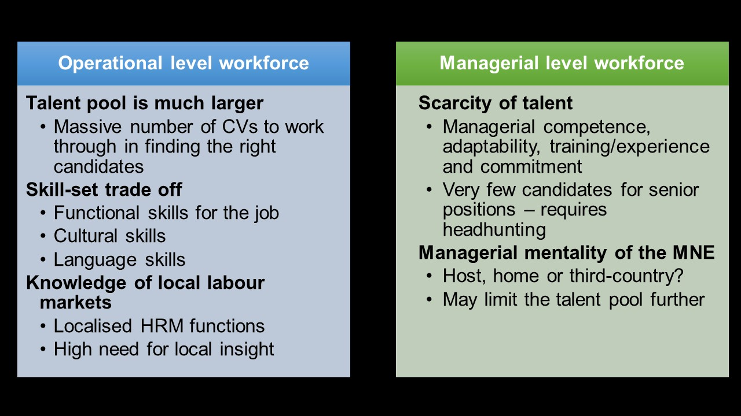
Managing people abroad
Recruitment
  Identify suitable local candidates, get them to apply, and select the best for the job
  Candidate must have functional skills and ALSO multicultural and language skills
  MNEs struggle with accessing local labour markets – motivating for a localized HRM function
Notes:
An MNE also needs to manage its local employees around the world. Because expatriates can be expensive, the MNE has to recruit, select, train and compensate local employees who should be able to function in a multicultural e-work environment on top of the functional skills required for their job. The COVID-19 pandemic restricted international travel, which meant that MNEs could not send expatriates on international assignments, even if they had the resources to do so. Technology was increasingly relied upon to monitor foreign subsidiaries and to upskill host-country nationals (Caligiuri et al, 2020). The pandemic was referred to as a people-based crisis, highlighting the importance of effective human resource management, especially in the digital space (Caligiuri et al, 2020).
MNEs face additional challenges in recruiting the right candidates to fill posts in their foreign subsidiaries. Candidates need to fit in with the multicultural work environment of the MNE and communicate in the language most common across the enterprise – most often English. This forces a trade-off between job-specific and organisation-specific skill requirements and abilities (Peng & Meyer, 2019:458). Let’s look at this figure against the prescribed book.
The prescribed book describes specific considerations that the MNE has to manage when coordinating a global workforce – from low-level workers with limited bargaining power to specialists and managers who are hard to come by (and can demand higher salaries as a result). Whether it is for the operational workforce or the managerial, there are issues in global staffing for each. At operational level, the talent pool is much wider and the MNE benefits from global sourcing. But this means that there is a massive number of CVs! Also, MNEs have to offset the skills requirements against each other as it is not common to find a candidate with all of them. Some MNEs like to hire graduates with degrees in foreign languages and train them in functional skills, rather than hiring people with specialist degrees (say, engineers) whom they would have to train in English, for example. Lastly, MNE subsidiaries, especially recently established ones, lack knowledge of how the local labour market works. For example, how do you make contact with the best university graduates? How do you use job interviews most effectively in a different culture? Due to the need for such local knowledge, the HRM function is often among the most localized units in an MNE subsidiary.
At a managerial level, MNEs have to contend with the scarcity of talent – the opposite of the operational level. There are very few people in the world with the ability to manage a global organization – the result is a lot of headhunting going on (and possibly losing that tacit knowledge we learned about in Lesson 5). Furthermore, if the organization has a managerial mentatilty geared towards being ethnocentric (home-country), then they limit themselves even further. A geocentric mentality would be the best – can you tell me why?

Slide 18
Managing people abroad
Compensation, appraisal and retention
  Low level workers versus specialists and managers who are headhunted and compensated accordingly
  Performance appraisal is an area of cultural differences (sometimes done by expats)
  MNEs need to create an attractive package to retain people – training, travel and career progress
Notes:
There are a few options when choosing compensation for a global business. The first option is to maintain companywide pay scales and policies, so for example, all sales staff are paid the same no matter what country they are in. This can reduce inequalities and simplify record keeping, but it does not address some key issues. For example, this compensation policy does not take into account that it can be much more expensive to live in one place versus another. As a result, the majority of organisations choose to use a pay banding system based on regions, such as Southern Africa, Europe, and North America. This is called a localised compensation strategy and it provides the best balance of cost-of-living considerations. Other compensation issues that the global business should consider, which will vary greatly from country to country, might include the cost of benefits in another country. Many countries offer universal health care (offset by higher taxes), and therefore the employee would have health benefits covered while working and paying taxes in that country. An additional issue is the legally mandated (or culturally accepted) amount of vacation days. For example, in South Africa, 15 annual paid vacation days are mandatory, Australia has twenty paid vacation days, there are ten in Canada, thirty in Finland, and five in the Philippines. Consider also, that a pay system that works with the country culture, such as pay systems based on seniority. For example, Chinese culture focuses heavily on seniority, and pay scales should be developed according to seniority. Lastly, thirteenth month (bonus) structures and sometimes mandated annual lump-sum payments might come into play. In summary, compensation issues are a major consideration in motivating overseas employees. A systematic system should be in place to ensure fairness in compensation for all global staff and should also reflect the availability of the human resource for the position.
Performance appraisal systems are noted as an area needing reflection as cultural differences may create problems during performance evaluations and impact on retention. Retention can be quite challenging in locations where staff frequently jump from one employer to another when better pay packages are offered. Even though Asian cultures traditionally emphasize loyalty and long-term employment, dynamic, competent and ambitious young people frequently depart from this traditional norm. Thus MNEs have to create attractive career prospects, including training, travel and eventually leadership roles to keep their best people on board

Slide 19
Institutions and human resources
Worker safety laws and requirements
Worker compensation laws
Working age restrictions
Maternity/paternity leaves
Unionisation laws
Vacation time requirements
Average work week hours
Privacy laws
Disability laws
Multiculturalism and diverse workplace, antidiscrimination law
Taxation
Source: Peng & Meyer (2019: 349)
Notes:
Formal and informal institutions in host countries influence HR practices. In a telephone interview on 16 June 2020, Mr Isaac Mhopatlane, co-founder and director of the Randvest Group (and co-founder of the Business Connexion Group), claimed that employees (and potential employees) needed the ability to research the institutional environment of their employer’s host countries. Laws and regulations vary widely across countries and, therefore, it is crucial to understand these legal environments and the informal working culture of the MNE’s foreign subsidiaries to avoid costly mistakes. Your research should encompass the following aspects of the labour laws of a host country ("International HRM" by eLearning Support Initiative):
Worker-safety laws
Worker-compensation laws
Safety requirements
Working-age restrictions
Maternity/paternity leave
Unionisation laws
Vacation time requirements
Average working hours
Privacy laws
Disability laws
Multiculturalism and antidiscrimination laws
Taxation
The prescribed book describes some European, Asian and Anglo-American institutions and their HR practices. The unique history of each African country determines its public policies. Many are aimed at generating a competitive advantage and promoting local labour and suppliers. In terms of Black Economic Empowerment (BEE) and Employment Equity (EE) legislation, South African institutions favour previously disadvantaged black employees, suppliers and businesses (Horwitz, 2017).

Slide 20
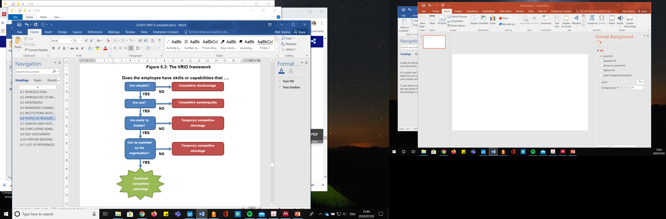
People as resources
V: Low skilled vs specialised. Training can add value
R: Specialised knowledge workers and teams (tacit knowledge)
I: Complex capabilities and tacit knowledge
O: Are the HR skills leveragable only for the employee or for the organisation? Non-transferrable skills dependent on the team are key
Source: Adapted from Miethlich & Oldenburg (2019)
Notes:
The The textbook uses the VRIO framework (VRIO: value, rarity, imitability and organisation) shown in the below figure to evaluate the staff of an MNE from a resource-based view. Thanks to this framework, the MNE is able to identify the staff members who contribute to a sustainable competitive advantage (Miethlich & Oldenburg, 2019).

Slide 21
Debates and extensions
Multi-cultural teams
Success depends on members’ awareness of cultural diversity, and willingness to be open-minded about teammates’ work styles and values.
.
https://youtu.be/r3E15mLO0i0
Notes:
The prescribed book presents two specific challenges in the international human resource space: multi-cultural teams and non-traditional assignments.
Organisations that are polycentric or geocentric in their staffing policies will have diverse teams of people and management that must be skilled at leading these teams. With the emerging markets around the world demonstrating substantial growth, organisations need local talent from these markets to enter the host country and to communicate effectively. These employees add substantial value through their deep understanding and knowledge of local cultures and needs. Multicultural teams are more innovative and more technologically and culturally adaptable. The MNE’s human resource department must, therefore, consider diversity in areas such as hiring practices, promotion, equality of compensation, training, employee policies, legal regulations, and accessibility of important documents (explicit knowledge that may require translation into other languages) In general, African countries – as emerging economies where growth is expected ­– are very diverse, particularly with regards to ethnicity and religion. The continent has been acknowledged as having strength of diversity in their multiculturalism. However, Africa has also been the focus of cultural diversity gaps, with xenophobic attacks and ethnic wars. This reality advocates for diversity management that nurtures an organisational culture of inclusiveness, acceptance and respect within all employees – not just management – if multicultural teams are to be of benefit to the MNE
Watch this video to learn about the benefits and challenges that come with increased diversity in the global digital environment. https://youtu.be/r3E15mLO0i0

Slide 22
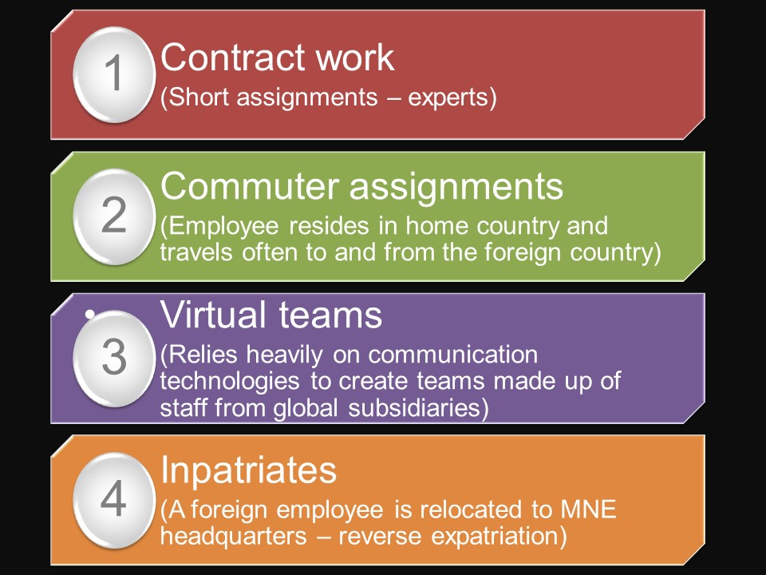
Debates and extensions
Non-traditional assignments
MNEs have moved to shorter assignments and non-traditional forms of expatriation, for example:
.
Notes:
IN the second debate, you are asked to think about non-traditional assignment. Contract work, commuter assignments, virtual teams and inpatriates are discussed as alternatives to the traditional international assignment in the prescribed book. With expatriates unable to travel, MNEs became especially reliant on virtual teams during the COVID-19 pandemic, which catalysed a massive movement into the virtual space and forced many to rely on virtual communication media in order to collaborate. This meant that the requirement for candidates to be able to work over distances using technology grew in importance. But it also means more exposure to multicultural teams, discussed in the first debate

Slide 23
Summary Lesson 6
Need to know formal and informal rules of the game governing HRM in all regions of operations.
Develop organizational capabilities that drive business success.
Challenge the leaders of your firm to take people and career issues seriously.
HR managers need to nurture and develop people.
Notes:
International human resource management is complex and has many layers – it deals with people, after all! You need to engage with this unit, spending time on understanding and internalising the concepts and contexts described. Cultural diversity is a reality of the MNE, but it is even more relevant if you are a student in Africa or are part of an MNE that is operating (or hoping to expand to) an African country. Lastly, given the resonating impact of COVID-19 on working conditions throughout the world, the ability to manage people and teams in the virtual space, and in consideration of changing HR laws and practices, is one you will need to acquire to successfully leverage international human resources for sustained competitive advantage.

Slide 24
Test yourself
GO READ THE SHORT CASE ON MYUNISA AND ANSWER THE FOLLOWING QUESTION:
Evaluate the management practice approach at WHL, including their approach to dealing with the challenges of attracting a committed workforce to their global subsidiaries.
ASSESSMENT CRITERIA
Identify the management approach adopted by WHL. (1 mark)
Motivate this approach by explaining an example from the case study. (2 marks)
Analyse WHL’s approach to recruitment challenges. (5 marks)
POST YOUR ANSWER ON THE DISCUSSION FORUM

Slide 25


