Slide 1

Open Educational Resources (OERs) and the Role of the Library
Acknowledgements: Kerry de Hart, Margarette van Zyl, Leslie Adriaanse, Melanie Malan, Aaron Tshikotshi, Lorraine Grobler

Slide 2
Purpose of Presentation
The purpose of this presentation is to:
create an awareness of OERs
how the librarians may assist you
the various resources and formats of OERs
how to find and evaluate OERs
copyright and licensing
An abridged version of this handout will be emailed to you so that you can work through the links at your own pace.

Slide 3
Role of the Library
The Personal Librarians can assist with:
Identifying resource types
Identifying search engines
How to search
Basic guidance on how to evaluate resources
The Digital Resources Developer can assist with:
Guidance on placing your own OER on the Unisa Institutional Repository (UnisaIR).
The Cataloguers can assist with:
metadata

Slide 4
Outside the scope of the library
For background information and the various policies and strategies please consult UnisaOpen
The following activities fall outside the scope of the library:
  Reuse
  Repurpose
  Remix
  Copyright and Licensing (included in this presentation for information)
  Inserting into myUnisa

Slide 5
UnisaOpen (1)
The following are sites on UnisaOpen which you need to work through at your own pace and to get a deeper understanding of OER:
About OER Start your OER journey with some introductory material and tools, as well as information about OER at Unisa
Unisa OpenCourseWare Access open course materials that are already available from Unisa
Unisa Institutional Repository The Unisa Institutional Repository has some 5000 items to share and gets around 300 000 hits per month.

Slide 6
UnisaOpen(2)
Find OER Access global, African and South African resources or use the OER search engine links to find resources to suit your needs
OER Funding Find resources to help secure funding for developing your OER
Open Access Many options exist for academics to contribute to Open Access publishing. This page provides resources to support them in this endeavour.

Slide 7
Unisa OpenCourseWare
A number of colleges are also involved in OER production at Unisa
Please check UnisaOpenCourseWare regularly to find open resources

Slide 8
What are Open Educational Resources
Basically Open Educational Resources (OERs):
" ... are any type of educational materials that are in the public domain or introduced with an open license. The nature of these open materials means that anyone can legally and freely copy, use, adapt and re-share them. OERs range from textbooks to curricula, syllabi, lecture notes, assignments, tests, projects, audio, video and animation." (UNESCO).

Slide 9
What are Open Educational Resources
Thus, an OER is simply an educational resource that incorporates a licence that facilitates reuse, and potentially adaptation, without first requesting permission from the copyright holder
See more at:
What are Open Educational Resources (2:36 minutes on YouTube).

Slide 10
What is Open Course Ware
OpenCourseWare (OCW) is a “free and open digital publication of university-level educational materials. These materials are organized as courses, and often include course planning materials and evaluation tools as well as thematic content” (OCW Consortium), for example MIT’s OCW programme which started in 2001. Read more at Get Started with OCW
OCW is not to be confused with MOOCs – there are some differences
  MOOC ? OCW ? Which One
  What is the difference between OCWs and MOOCs – managing expectations

Slide 11

Open access publishing / journals

Slide 12
What are open access journals
Open-access journals are scholarly journals published electronically and available freely
Typically, open-access publishing involves a one-off charge to the author (an article processing charge)
They are not to be confused with OERs as content may not be changed or remixed

Slide 13
Difference between OER and Open Access Publishing / Journals (1)
Open access publishing is an important concept, which is clearly related to – but distinct from that of OER
the term ‘open access’ is applied to many concepts, but usually refers either to:
‘open access (publishing)’; or
‘access to material (mainly scholarly publications) via the Internet in such a way that the material is free for all to read, and to use (or reuse) to various extents’; or
‘open access journal, journals that give open access to all or a sizable part of their articles

Slide 14
Difference between OER and Open Access Publishing / Journals (2)
Open access publishing is typically referring to research publications of some kind released under an open licence.
OER refers to teaching and learning materials released under such a licence.
Clearly, especially in higher education, there is an overlap, as research publications typically form an important part of the overall set of materials that students need to access to complete their studies successfully, particularly at postgraduate level.
Source: What is the difference between OER and Open Access Publishing

Slide 15
Example – Open Access vs Restricted Access
Compare the two references below. The one is open access and the other is restricted access, (ie the institution has a subscription)
Nicol, D.J., & Macfarlane-Dick, D. (2004). Rethinking formative assessment in HE: a theoretical model and seven principles of good feedback practice (Open Access)
Yang, M. and Carless, D. The feedback triangle and the enhancement of dialogic feedback processes. (Restricted Access) This link is accessible to the Unisa Community and also other institutions worldwide who subscribe to the Taylor and Francis Database. So it is not widely accessible for everyone and is not suitable for placement on a MOOC enrolled for a MOOC.

Slide 16
Open Access Journals
Elsevier Open Access Journals:
  All open access journals from Elsevier have undergone peer reviewed
  Upon acceptance are immediately and permanently free for anyone to read and download
  Permitted re-use is defined by the author’s choice of Creative Commons user licenses

Slide 17
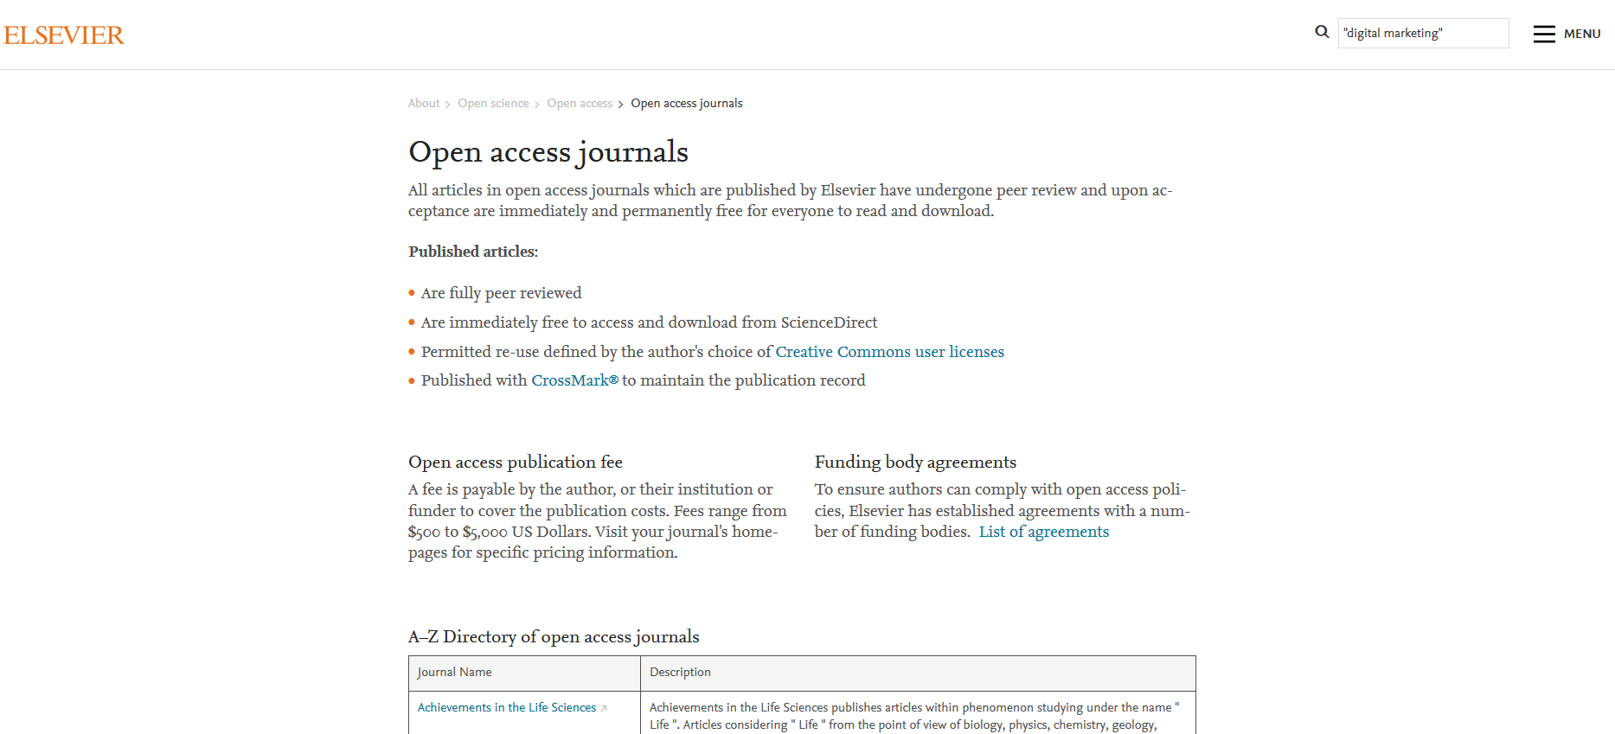
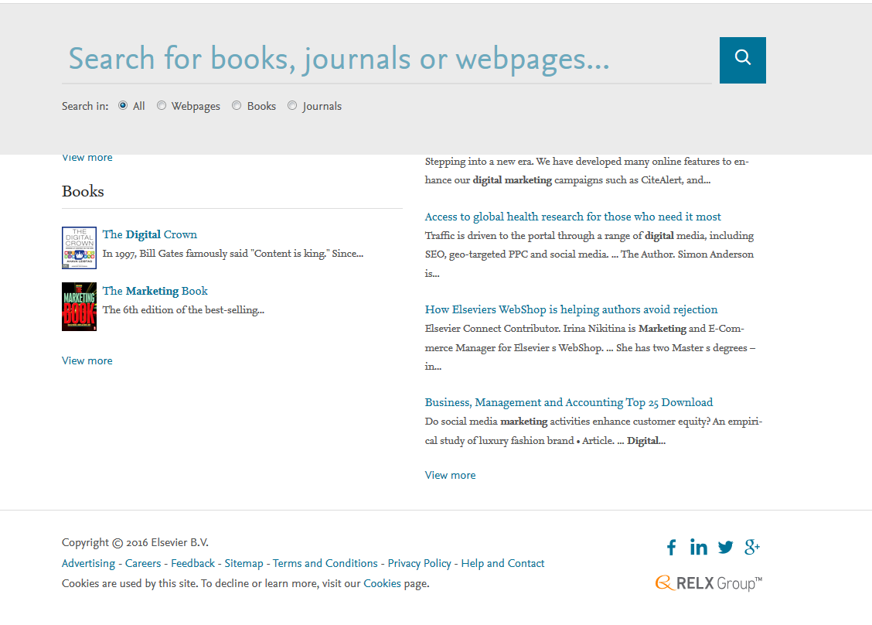
Elsevier

Slide 18

MOOCs

Slide 19
What is a MOOC
A MOOC massively open online course;
it is a model of educational delivery that is, to varying degrees, massive;
with theoretically no limit to enrolment;
open, allowing anyone to participate;
usually at no cost;
online, with learning activities typically taking place over the web;
and a course, structured around a set of learning goals in a defined area of study;

Slide 20
Core Differences between OERs and MOOC’s
OERs | MOOCs
The main feature of Open Educational Resources is their open licenses, allowing for the possibility of use and reuse | Though MOOCs are offered with open education access and are mainly free, in most cases their contents are not necessarily released with open licences
Most materials may be remixed and redistributed in terms of the CC license | MOOCs are not changeable in any way. You use as is
Free materials such outlines and syllabi for creating courses or incorporating into coursework - not full courses | Full or mini courses with a definite start and end date
No faculty or creator participation - the faculty or creators have placed their materials out there for you to use, but there is no further interaction after that | Faculty or graduate assistant participation.
Always accessible | Accessible only for the duration of the course
Developed basically by higher education institutions | MOOC providers are mainly companies

Slide 21
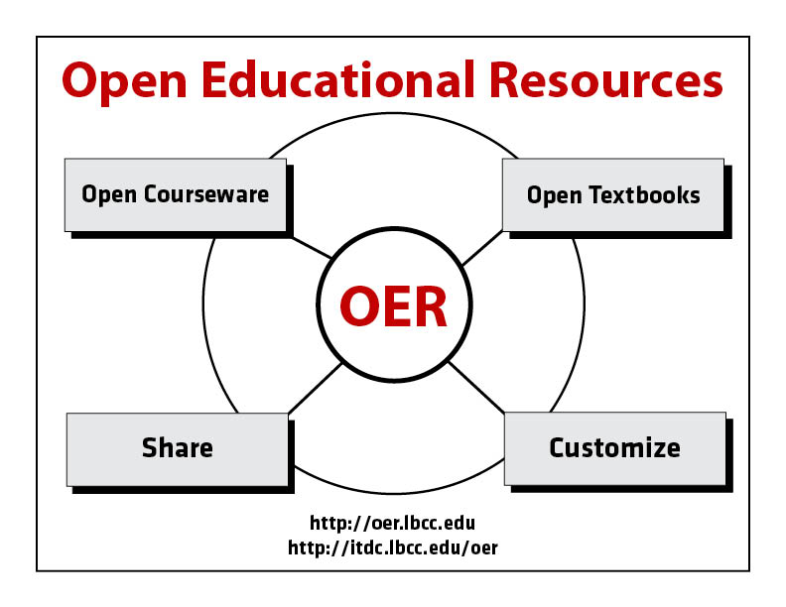
Back to OERs

Slide 22
Benefits of OERs (1)
Open resources have the potential to spur pedagogical innovation, introducing new alternatives for effective teaching
Promising OER learning resources can be modified and reused
OERs can offer savings in the cost of education to students who otherwise cannot afford to buy expensive textbooks or other course materials

Slide 23
Benefits of OERs (2)
Educational resources developed in an open environment can be vetted and improved by a broad community of educators, resulting in materials that represent what the educational community sees as most valuable
The costs can be distributed over a larger number of users
OERs brings a greater range of tools within reach of more users

Slide 24
Benefits of OERs (3)
Maximizes the use and increases availability of educational materials
OERs provide source material to enable academics and instructors to build or add on to course / module – there is no need to invest development effort in creating content that already exists

Slide 25
Benefits of OERs (4)
The resources are licensed to allow the sharing of content, provided that what you want to do falls within the ‘open’ license
Raises standard of educational resources by gathering more contributors and promotes global collaboration

Slide 26
Challenges of OERs (1)
Despite the benefits outlined, using OER is not always straightforward! There are various challenges that face practitioners when it comes to harnessing OER
Sourcing appropriate, relevant and high quality OER is an issue because there is no one-stop-shop for OER – they are scattered across the Internet – no single location and much time wasted on unproductive browsing
Understanding open licenses – not everyone is familiar with Creative Commons open licenses and what they permit
Adaptation of OER requires new skills – to adapt and repurpose OER the practitioner needs more than basic ICT skills and also needs practice in revising and remixing resources

Slide 27
Challenges of OERs (2)
Traditional mind-sets predominate – many educators feel it is wrong to use other peoples work and protect, rather than share, their own resources
Robust Internet connectivity and good access to ICT is essential to access and adapt OER
Universities seldom incentivise lesson creation rewarding research initiatives instead
Not all OERs are standard – there are issues of content consistency and quality
Although there is a large quantity of OERs out there, quality OERs in certain disciplines are difficult to locate

Slide 28
Challenges of OERs (3)
Very limited African content at present –other OERs thus have to be adapted accordingly
While there is a perceived cost benefit to students, there is also the challenge of access, for example:
  – an assumption is often made that most students are “tech savvy” they may not have regular or any access to computers
  – computers on campus may not be available when students need computers and smart-phones are not necessarily the best device for completing coursework

Slide 29
Challenges of OERs (4)
Not all resources are culturally appropriate for all audiences
Ascertaining usage rights and attributing content correctly (for example, copyright and licensing) may be problematic for users

Slide 30
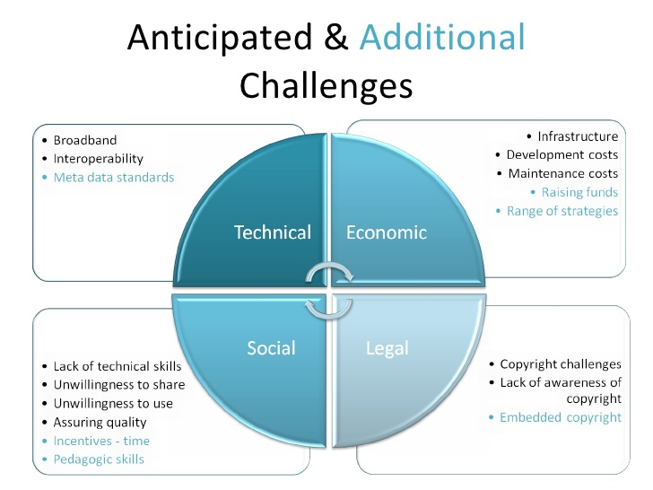
Challenges of OERs
Attribution: Benefits and challenges of OER for higher education institutions

Slide 31
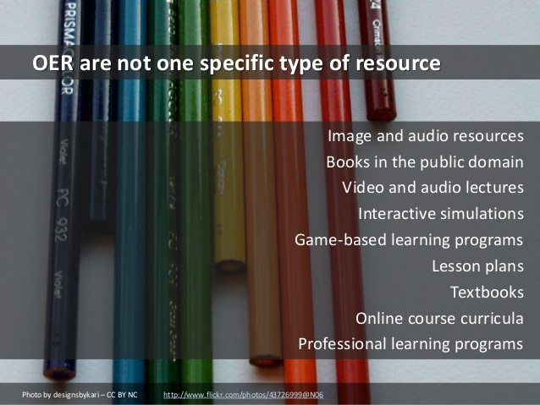
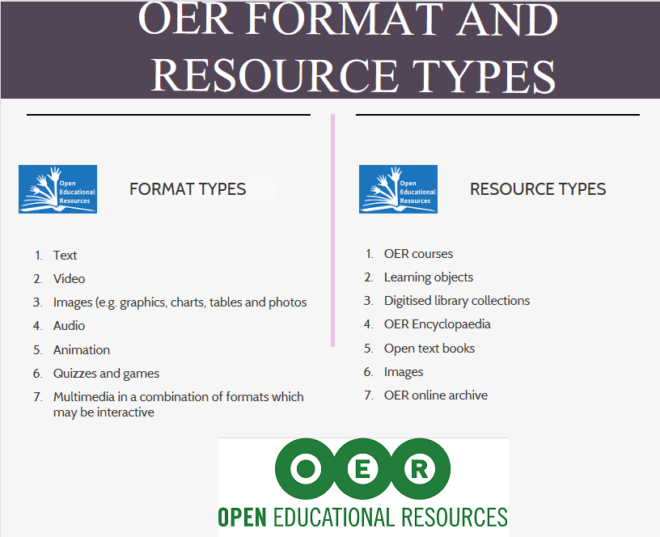
Scope of OERs

Slide 32
Scope of OERs
Open Educational Resources (OER) come in many shapes, sizes and formats
The scope and availability of OER is ever expanding and overwhelming
There is no single comprehensive listing of all OER
The next 4 slides serve to introduce the scope of OER and open courseware “Resource Types” available globally and provide an introduction to some of the major OERs
Please note that the groupings are not necessarily mutually exclusive as many are difficult to categorise this is a selection of sites from UnisaOpen – Finding OERs
For a further selection, please see UnisaOpen – Finding OERs

Slide 33
OER Resource Types (1)
Resource Type and brief description | Examples | Go to UnisaOpen - Finding OERs for complete list
OER courses which are open learning courses (not usually for certification) | Open Culture
 | OpenLearn (Open University)
 | Open Learning Initiative (Carnegie Mellon University)
Learning Objects which are raw materials which may be used to create a set of learning materials | JORUM
 | MERLOT
 | Wisc-Online

Slide 34
OER Resource Types (2)
Resource Type and brief description | Examples | Go to UnisaOpen - Finding OERs for complete list
Digitised Library Collections / Resources which include open access library materials that would typically be found in a library and include books, magazines, professional journals | Harvard’s Open Collections Program (OCP)
 | Khan Academy
 | Digital Library Federation
OER Encyclopedias which are reference material containing authoritative definitions and/or descriptions of a variety of topics | Encyclopaedia of Life
 | Stanford University Encyclopedia of Philosophy
 | Wikipedia

Slide 35
OER Resource Types (3)
Resource Type and brief description | Examples | Go to UnisaOpen - Finding OERs for complete list
Open Text books - these are digitised traditional texts | Boundless Open Textbooks
 | College Open Textbooks
 | Open Academics
Images – these provide photographs, images, pictures, icons and the like | Images google
 | Nounproject
 | Openclipart

Slide 36
OER Resource Types (4)
Resource Type and brief description | Examples | Go to UnisaOpen - Finding OERs for complete list
OER online archives are collections of material available in digital format. These materials can be integrated into formal educational programmes | OpenDOAR
 | OER Knowledge Cloud
 | BBC Creative Archive
 | UnisaIR

Slide 37
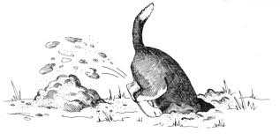
Searching for OERs

Slide 38
Good video – time well spent
Finding and evaluating open educational resources. (YouTube 52.35)
It is worth taking a look at the above videoclip where Lisbeth Levey from the Commonwealth of Learning outlines her experience of what a good OER is. She gives a personal account of locating and using an OER suitable for supporting a postgraduate university course in agriculture within an African context

Slide 39
Understanding some terms
When searching for OER you will need a basic understanding of the terms
search engines
And
repositories

Slide 40
Search Engines
A search engine may be described as:
“…a computer program that searches documents, especially on the World Wide Web, for a specified word or words and provides a list of documents in which they are found.”
“…websites or software that search the Internet for documents that contain a key word, phrase, or subject that is specified by the user to the search engine. Each engine has its own method of searching for information.”
May also be called a “retrieval engine”
Read more at: Browse search engine

Slide 41
Repositories
A repository is a central place in which an aggregation of data is kept and maintained in an organised way, usually in computer storage. It may be directly accessible to users or may be a place from which specific databases, files, or documents are obtained.
Repositories have been created to make it easier to find and access available OER. Some examples are Curriki and Xpert further examples can be found under Tools.
You when searching for OER, you will come across both search engines and repositories.

Slide 42
OER search engines / repositories
There are a number of search engines and repositories available to search for OER ranging from excellent to average.
For the purpose of this presentation we will be looking at a few of the more important ones.

Slide 43
Searching
Before searching for OER you need to be clear on what you are looking for
What you find is very much dependent on your search terms and the search engines you use
You will need to look across a variety of search engines and repositories

Slide 44
Questions to ask before searching
What exactly am I looking for?
What format do I want?
How do I want to use the content?
How recent must it be?
Who is the audience, namely, undergraduate, postgraduate, other?
What are key terms, or concepts or keywords?
Is there an authoritative author on the topic whose name I can use?

Slide 45
Planning your search strategy
Decide on the keywords and keyword combinations
Some sites has options to filter the results in various categories e.g.
  teaching levels
  results which allow for modification
  media types
  by license types
  Will depend on the resource

Slide 46
Registering
Before searching for OER on a particular site or repository, we recommend that you register on the site so that you can get optimal benefit. Most of the sites allow for free registration
By registering, you will enjoy advantages of regular alerts and updates.
You will be able to store your results on the site for later use
Participate in discussion groups

Slide 47

Search Engines
ImageCredit: www.seomastering.com

Slide 48
Recommended search engines
The search engines listed on the next two slides are highly recommended by edtech review
It is recommended that your academics start with these as well as those listed on
UnisaOpen - Finding OERs

Slide 49
Search Engine | Description | Instructional Video
Google University Learning | Brings you the collection of OCW and OER sites in its search results. Add this gadget to your Google homepage for better usage
DiscoverEd | This is a search prototype developed by Creative Commons
OER Dynamic Search Engine | Contains many more site links which store Open Educational Resources
Creative Commons | If you want to find a free course material from world’s top universities, creative commons is the best option for you. It allows you to search your content using a specific website of your choice, eg Flickr, youTube, Google Images, etc | How to find Creative Commons Material using YouTube Using Creative Commons to find images on Google Image
OER Commons | brings over 48,000 OER for sharing curriculum with the world. OER Commons team designs custom tools to support OER networks. It has an efficient search options: you can discover new resources or search by using an advanced (with lot of filtering options) search option. | How to search OER Commons (2.26 minutes on YouTube) Playlist of OER Instructional Vides

Slide 50
Search Engine | Description | Instructional Video
FREE (abbreviation for Federal Resources for Educational Excellence) | Contains links to learning resources created by many organizations and initiatives. You can browse either by subject or by standard
OpenCourseWare Consortium | a collaboration of higher education institutions and associated organizations from around the world dedicated to creating a broad and deep body of open educational content using a shared model. It allows you to search courses in multiple languages. | OpenCourseWare Consortium (4.36 minutes on YouTube)
MERLOT | is a free and open online community of resources designed for faculty, staff and students of higher education to share their learning materials | Merlot Basic Keyword Search Tutorial (2.39 minutes on YouTube) Merlot Advance Search Tutorial (3.21 minutes on YouTube)
Google OCW/OER search Google University Learning | Brings you the collection of OCW and OER sites in its search results. Add this gadget to your Google homepage for better usage | Google Advance Search for OER Materials (2.04 minutes on YouTube) Awesome visual featuring 13 important Google search tips for students.

Slide 51
Approaching the search engines
Searching takes time and you seldom find what you want immediately – you may have to redo searches and use a variety of other search engines
Searching on OER search engines is not as precise as when searching on commercial databases which the library subscribes to
This take a lot of time, so do not leave it for the last minute
Take time to look at the search screen and do not be afraid to experiment
Searching is subjective and there is no hard and fast rule

Slide 52
Basic principles of using the main search screen on search engines (1)
Each search engine has its own search screen layout
Before you start to search it is recommended that you see if you can register on the site
Spend some time on the site so that you can see the various search filters you can use in order to find the content that you want

Slide 53
Basic principles of using the main search screen on search engines (2)
The search screen on most search engines allows you to refine or filter your search according to:
  Education level (for example: undergraduate, postgraduate)
  Material type (for example: video, games)
  Media format
  Conditions of use
It is recommended that you use the Advanced search option if provided

Slide 54
Selected Search Engines in more Detail
ImageCredit: www.seomastering.com

Slide 55
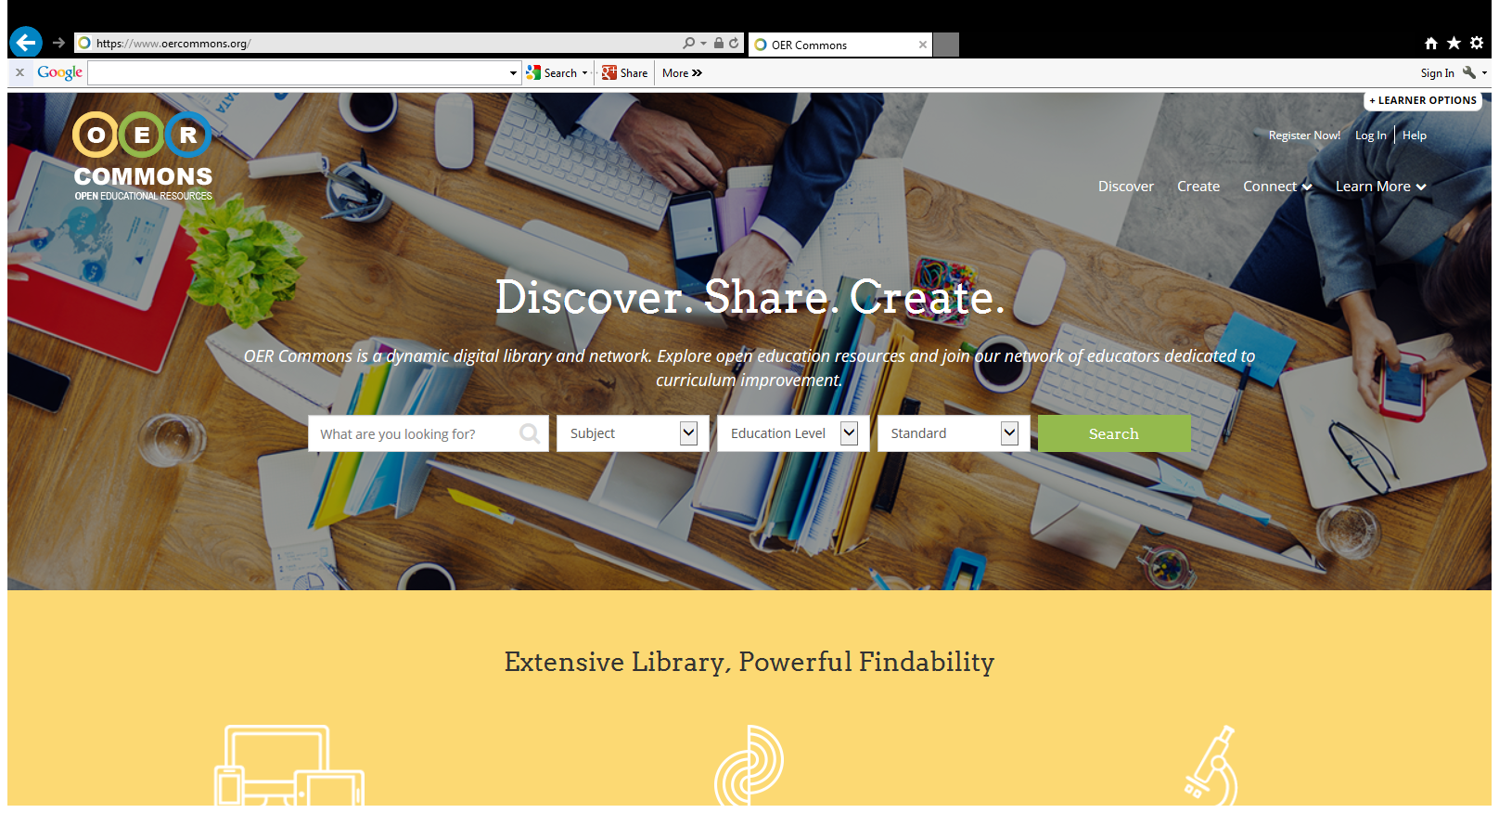
OER Commons

Slide 56
OER Commons
OER Commons
120 major content partners collaborated to provide a single point of access through which educators and learners can search across collections
Provides descriptive information about each resource
These resources are publicly available for all to use mainly through Creative Commons licensing.

Slide 57
Exercise on OER Commons
Open the basic search screen and do the following:
  Register
  Find the advanced search option and open it
  Look at the search filters
  Do a search on your topic using the filters
Basic search screen
Advanced search screen
Training videos:
How to search OER Commons (2.26 minutes on YouTube)
Playlist of OER Instructional Videos

Slide 58
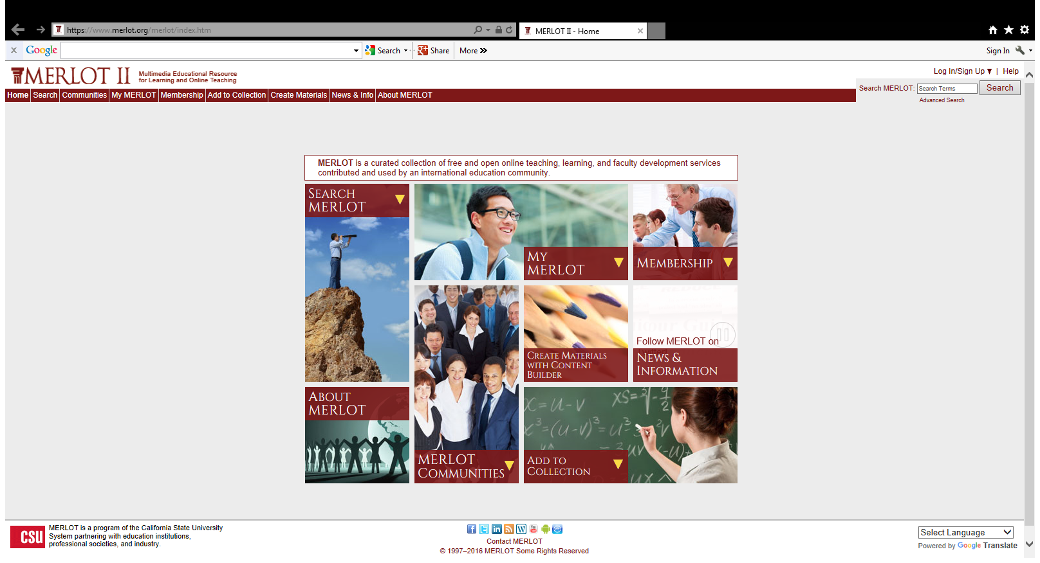
MERLOT

Slide 59
MERLOT
MERLOT is a free and open online community of resources designed for faculty, staff and students of higher education to share their learning materials
MERLOT provides collections of peer reviewed online learning materials
Has a set of faculty development support services.
Merlot resources are Creative Commons licensed

Slide 60
Exercise MERLOT
Open the basic search screen and do the following:
  Register
  Find the advanced search option and open it
  Look at the search filters
  Do a search on your topic using the filters
Basic search screen
Advanced search screen
Training Videos
Merlot Basic Keyword Search Tutorial (2.39 minutes on YouTube)
Merlot Advance Search Tutorial (3.21 minutes on YouTube

Slide 61

About OER Africa

Slide 62
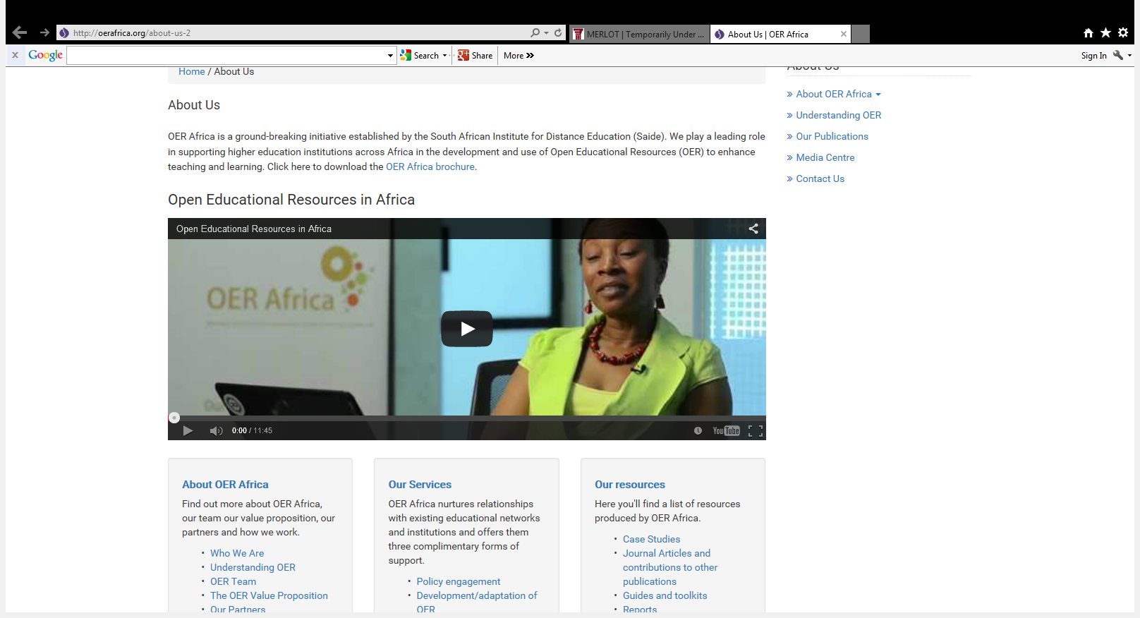
OER Africa

Slide 63
OER Africa
OER Africa is an initiative established by the South African Institute for Distance Education (Saide)
They play a leading role in supporting higher education institutions across Africa in the development and use OERs to enhance teaching and learning
Their projects and partnerships focus primarily, on teacher education, academic skills for higher education, agriculture, and health education
It is not a search engine for African content, but provides access to various OER search engines and repositories – content still has to adapted, remixed and made relevant for Africa

Slide 64
Exercise OER Africa
Familiarise yourself with the content on OER Africa
Open OER Africa
Go to the tab Understanding OER and the section on find OER
Training Videos
OER Africa (YouTube 11:44) You will see other video content on this page produced by OER Africa.

Slide 65
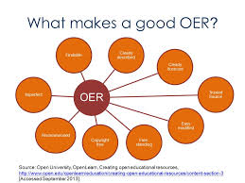
Evaluation criteria

Slide 66
What makes a good OER
A good OER includes basically the following:
Being findable – it can be in multiple locations
Clearly described
Clearly licensed (normally through Creative Commons)
From a reputable source or one that you trust
Easy to modify (if permitted in terms of the license)
Free-standing, that is, it does not assume knowledge of other resources
Free of copyright content
Being used by or recommended by your peers or colleagues
Sourced from: The Open University. OpenLearn. Creating open educational resources. What makes a good OER?

Slide 67
Evaluation criteria
It is important for academic and teaching staff to carefully evaluate OERs before re-using them. Basic criteria include:
  author: Is it clear who developed and wrote the material? Are the author’s qualifications for creating the material clearly stated?
  organization: With what organization, association, or sponsor is this page's author affiliated?
  point of view/bias: Is any type of bias present?
  purpose: Is there a Statement of Purpose, and does it really indicate the purpose of the page?
  documentation: Does the author cite other sources?
  timeliness: Is the resource up-to-date and/or is a creation or update date visible?
  suitability: Is the audience identified in the Statement of Purpose?

Slide 68
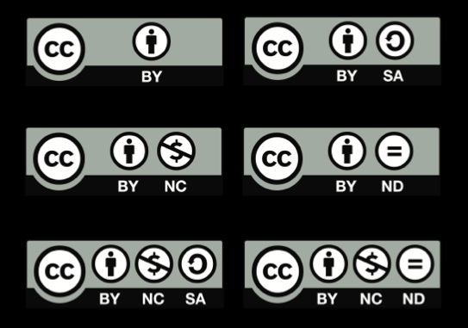
Licensing
This section falls outside the scope of the library, but you need to be aware of how it works

Slide 69
Licensing
Open educational resources often involve issues relating to intellectual property rights. Traditional educational materials are protected under conventional copyright terms. Alternative and more flexible licensing options have become available as a result of the work of Creative Commons, an organization that provides ready-made licensing agreements that are less restrictive than the "all rights reserved" terms of standard international copyright
Sourced from: Open Educational Resources

Slide 70

Creative Commons
Creators may offer their work on the Web for use under a Creative Commons license
Creators specify the rights under which their work may be used
http://creativecommons.org/licenses/

Slide 71
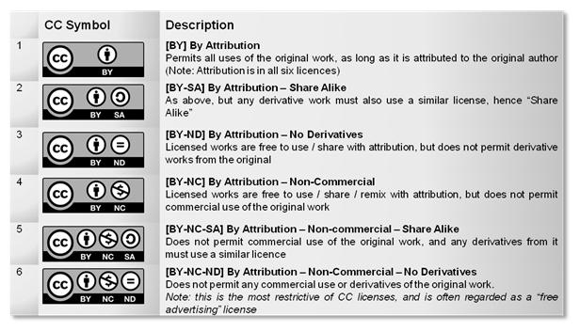

Slide 72
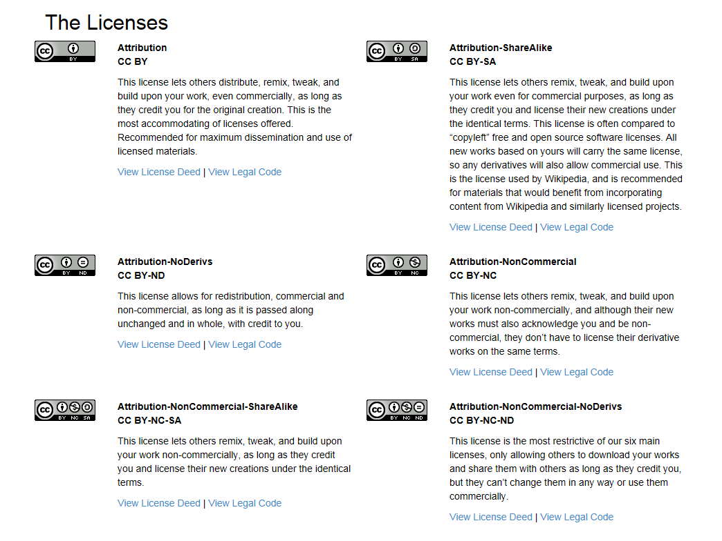

Slide 73
Creative Commons (CC)
Always verify that the work is under CC by finding the link to terms of use or copyright and following the instructions
Contact the copyright holder directly or the website where the content was found should this not be obvious

Slide 74
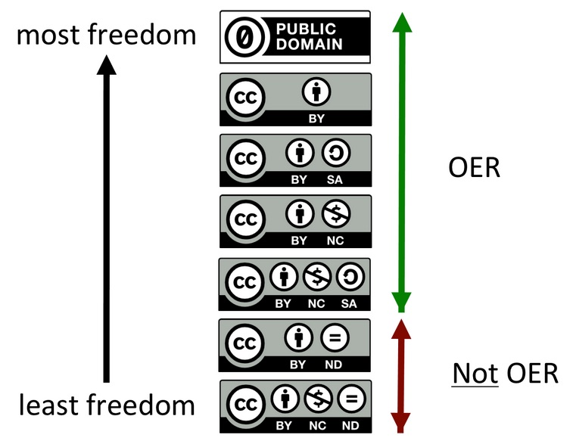
Bird’s eye of view of the types of CCL
Source Credit: Lorna Campbell Wordpress

Slide 75

Creating a license
Source: Creative Commons

Slide 76
Turning a Resource into an Open Educational Resource (OER)
Creative Commons Licenses Explained (YouTube Video - 5.32 minutes)
Creating OER and Combining Licenses (YouTube Video - 9:16 minutes)
Creative Commons Attribution license quick and awesome review
(YouTube Video - 5:35)
Creative Commons License Chooser Demo (YouTube Video – 4.54)
Creative Commons License and how it helps us share digital content (YouTube Video – 5:32)

Slide 77
Steps to license your OER
Gather together all the resources you are going to use in your OER
Find out who created the resources you are going to use in your OER and request permission as per license if necessary
Decide how open you want your OER to be and what type of license are you going to use

Slide 78
Steps to license your OER
Create metadata for your OER
  Author
  Title
  Date
  License
Link the metadata to your resource

Slide 79
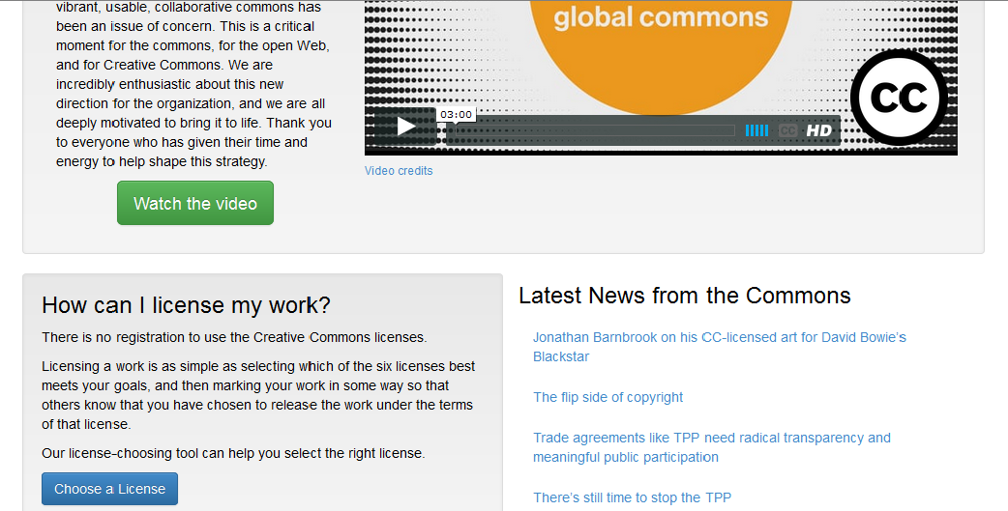
Licensing your work
http://creativecommons.org/

Slide 80
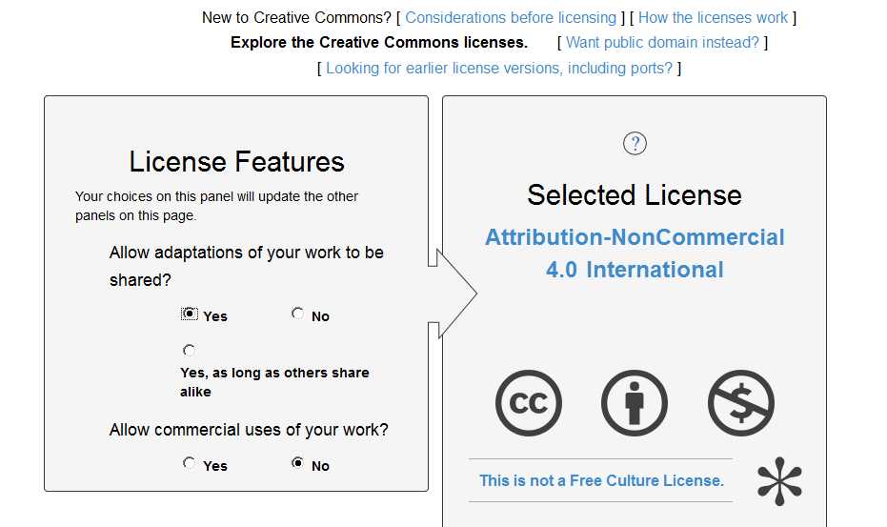
http://creativecommons.org/choose/

Slide 81
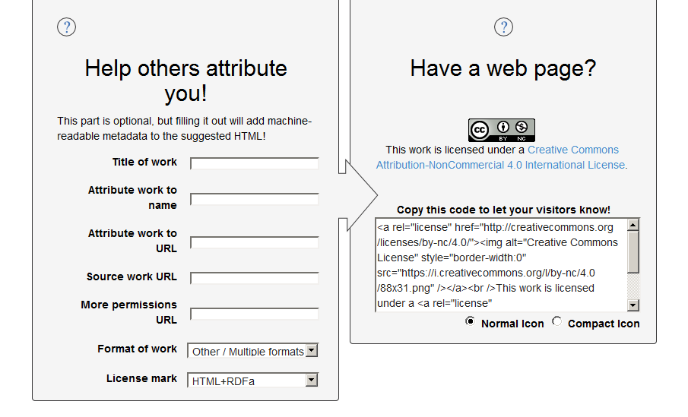

Slide 82
Unisa contributing to OER initiatives
Unisa
    Unisa Open Courseware
    Institutional repository
  OER Africa is an initiative established by the South African Institute for Distance Education (Saide)

Slide 83

GNU Free Documentation License
The GNU Free Documentation License is a copyleft license - which means that derivative works must be made available under the same or a similar license
The creators of the license recommend that it is used “principally for works whose purpose is instruction or reference.” Its most prominent user is Wikipedia
Read more at: Open Definition

Slide 84
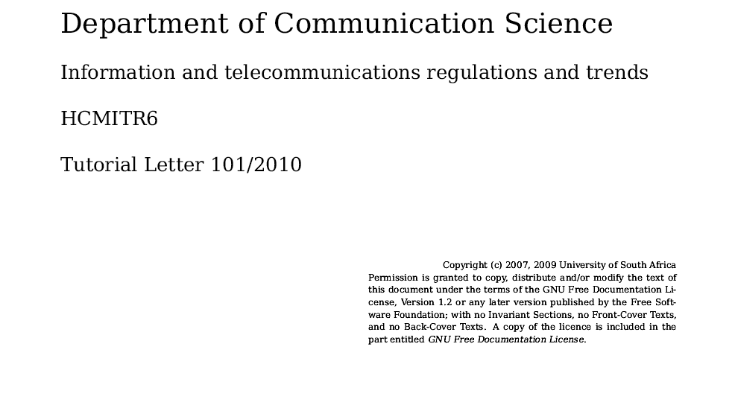
Example of a GNU Free
Documentation License

Slide 85
What is the Unisa Institutional Repository?
The Unisa Institutional Repository (UnisaIR) is an open digital archive of scholarly information and research outputs of the University of South Africa.
Its benefits include:
  Visibility of African scholarship worldwide
  Open access to research information
  Long term digital preservation
  Self-archiving of research outputs
  Sharing of learning resources across institutions

Slide 86
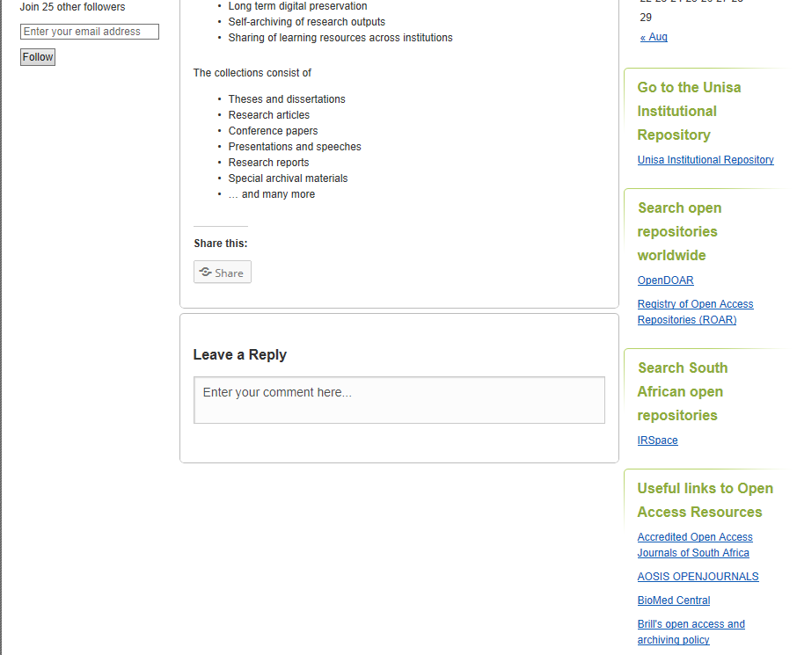
https://unisair.wordpress.com/

Slide 87
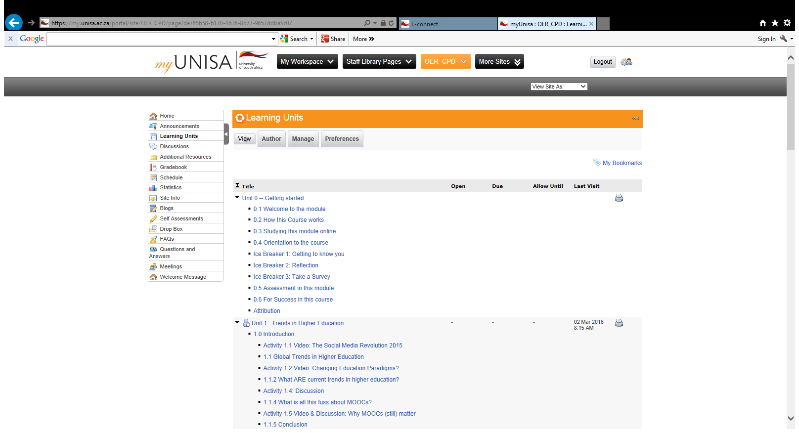
myUnisa Online Course developed by CPD – An introduction to OERs at Unisa
Offered from the second half of 2016
Contact CPDinfo@unisa.ac.za to be placed on the mailing list

Slide 88
List of resources
A Basic Guide to Open Educational Resources - COL : A basic guide and good starting point
The OERs - Open Education Resources : A video about how technology is transforming our system of education, generating equal opportunities for all.
UNESCO: What are Open Educational Resources? : UNESCO Communication and Informationon OERs
What is OER (Open Educational Resource)? - EdTechReview™ (ETR) : Free Newsletters & get all updates on News, Trends, Practices, Product Reviews, Reports, Resources, Events and much more on Education Technology

Slide 89
List of resources
A Basic Guide to Open Educational Resources This is a free eBook from UNESCO
CCCOER Webinars Discover how other community colleges are adopting and creating OER via 20 minute webinars.
Guidelines for open educational resources (OER) in higher education "Given the potential of OER to improve higher education systems, UNESCO and the Commonwealth of Learning (COL) have developed these Guidelines … to support governments, higher education institutions/providers, academic staff, student bodies and quality assurance/accreditation and recognition bodies."
Learning about OER - videoclip
OER Handbook for Educators "Welcome to the world of Open Educational Resources (OER). This handbook is designed to help educators find, use, develop and share OER to enhance their effectiveness online and in the classroom.“
FAQs from OER Africa

Slide 90
List of resources
A Brief Guide To Understanding MOOCs Ken Masters (Sultan Qaboos University) writes a very accessible analysis of how MOOCs have developed, and what separates them from other models of online education.
What You Need to Know About MOOCs This is The Chronicle of Higher Education's launchpad for MOOC-related materials; notice the timeline of news and features, which the Chronicle continues to expand.
7 Things you should know about MOOCs

Slide 91
List of resources
Unisa Open
OER LibGuide : Serves as a point of departure in finding information OERs
MOOCs LibGuide : Gives and overview and guidance in finding information on MOOCs as well as providing further avenues for self-exploration
What is a MOOC

Slide 92
Thank you
CheeriOER !

