Slide 1
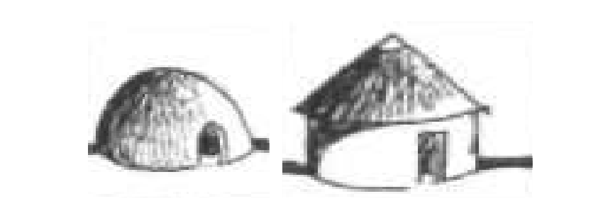
Inkolelo yokuphila ungunaphakade e-Alkabulan [Afrika]: Umnyombo wesakhiwo sendilinga/iqhugwane/ uguqasithandaze
Dkt Ntokozo Mthembu
Emnyangweni wezokufunda ngabantu, Esikhungweni semfundo ephakeme yaseNingizizumu neAfurukanu mthemnc@unisa.ac.za

Slide 2
OKUQUKETHWE
Isingeniso
Isisekelo sesakhiwo esiyindilinga - uguqasithandaze njengendlela yokucwaninga nokuhlaziya
Ukudingidwa kwendlu yendilinga ukuqasithandaze
Isiphetho

Slide 3
ISINGENISO
Ukuwa kombuso wobandlululo eNingizimu Afrika, ngo-1994;
Umkhankaso obizwa ngo-#Ushintsho lohlaka lokufunda ezikhungweni zemfundo yonkana (Higher Education South Africa, 2014:4);
Ziningi izinhlelo ezilandelwayo nezihlongozwayo ukulungisa lesi simo: kunomthelela, ebuka isimo aphila ngaphansi kwaso, noma nendlela abuka ngayo izinto kanye nokuqonda indima okumele ayidlale;
Leli phepha lizoqhakambisa izimpande kanye nemigomo yokwenza ucwaningo ngendlela yokubuka ngeso lase-Akabulan kubukwa igalelo lendilinga uma kucwaningwa isimo kanye nempilo yomuntu;
Emizamweni yokubuyisela amagugu namasiko kanye nezindlela zokufunda kanye nokuhlaziya noma ukucwaninga ezikhungweni zemfundo ephakeme njengoba - uMthethosisekelo, okuyisu nomkhankaso wokuzibuka kabusha – rennaisance, futhi nokuziqonda kabusha – self discovery nokugcinwa futhi kuvuselelwe ‘umthetho omdala wokuzazi’ – know thyself principle (Asante, 2015:30)
Ukuchazwa kwegama – ba: ntu - ba, uchaza umphefumulo wakho, uyingxenye kaMdali uBa, wona ongumphefumulo oMkhulu - ingakho ke uma sichaza igama elithi ram ngokwaseKhenu lisho ukuthi ba futhi uRa, siqusakhe wayezibiza ngokuthi unguBa wayokhokonke okuphilayo; u- ntu – uchaza ingqikithi yomuntu
Okunye: banamasilo amaningi kodwa bakholelwa kuMdali oyedwa;
Amabizo chaza isimo somuntu: ubunye, isijobelelo u-Mu or M; ubuningi – Ba (Hurskainen, 2003:65)

Slide 4
Uhlaka lokuhlaziya: Imfundo yaseKhushi
Injulalwazi yaseKhushi igcizelela ukubaluleka kokuzazi wena, umlando kanye nendabuko yomuntu omnyama kwiZwekazi i-Afurukanu, okuyindlela yokuzikhulula engcindezelweni yabezizwe njengamanje kwezemfundo nolwazi, ikanye nesikompilo, emnothweni kanye nendlela yokuxhumana emhlabeni. Echaza uMthembu (2015:145) uthi:
  ...indlela yamandulo yokubuka ngesolaseKhushi ephinde ibizwe ngobuTopiya.... Lendlela iqhakambisa indlela eyodwa eqondile ekucwaningeni izingqinamba izwe elibhekene nazo... Lendlela ingabuye ibaluleke kakhulu uma labo abayimiphakathi ebicindezelwe benikwa ithuba futhi nezindlela zabo zolwazi ezifaka umnotho wendalo onjengomhlaba nabantu...
Lokhu kugcizelelwa u-Heeren (1832: 101) lapho ethi:
Lapho sebesungule umbuso ngaphandle kwendluzula, ngobuhlakani beqophelo eliphezulu nentuthuko exhumene nokholo. Bona abaseGibhithe babekusho lokhu uma bechaza ngezimpande zemvelaphi yentuthuko yabo, babebhekisa konkulunkulu babo ikakhulukazi u-Osiris, Isis no- Ammon.
Labo onkulunkulu ababedunyiswa Meroe babedunyiswa ngisho kwizindawo ezisemazansi namaphethelo ... imidwebo efanayo ezakhiweni, imisebenzi yokubaza efanayo, kanye nemidwebo ... imibhalo efanayo; nemibhalo yezithombe efanayo...

Slide 5
Ukudingidwa kwendlu yendilinga ukuqasithandaze
Isisekelo sohlaka lwaseKhushi
Ukuqonda ngokuhleleka: komzimba womuntu
*Umthetho wokuhleleka ngokwendalo
Kubalulekile ukuqonda ngomthetho wokuhleleka, order;
Isakhiwo somuntu siziqumbili: umzimba nomphefumulo;
Uma ukhuluma ngempilo kanye nenhlalo yabantu base-Afrika, izakhiwo kanye noma ini eyakhiwe e-Afrika ithathelwe kwindalo njengoba nendlu uguqasithandaze ulandela kulowomgudu wendalo.
Lokhu kufakazwa u-Heeren (1832:89) lapho ethi:
Lezi zinto zimayelana nempilo yokuhlala kwabantu baseGibhithe; isibonakaliso somuntu yinto ehlala ibonakala njalo. Yonke into ithathelwe kahle kwindalo futhi kungaba iqiniso ukugcina ngokuphetha ngokuthi nalezi zinto ngokunjalo.
Imbewu
Isihlahla
Imbali
Isithelo

Slide 6
Isisekelo sesakhiwo esiyindilinga - uguqasithandaze njengendlela yokucwaninga nokuhlaziya
Ukubuyekezwa kwamagugu esintu –ababhali abanje ngo - Chinua Achebe nabanye (Ndandani 2015:100) ;
Ukuqonda ngesiko uZungu benoSiwela ( 2017:7) bayachaza bathi:
  Isiko lichaza inqolobane yolwazi, impilosenzeko, izinkolelo, izincazelo, ukwehlukana ngokwamazinga, inkolo, umumo ngokwesikhathi, ukuhlobana ngokwezendawo, imicubungulo- micabango yomkhathi kanjalo nezinto eziphathekayo kanye nezitholwa yiqoqo labantu ngokwezizukulwane ngokuzijuba komuntu ngamunye noma kweqembu.

Slide 7
Isisekelo sesakhiwo esiyindilinga - uguqasithandaze njengendlela yokucwaninga nokuhlaziya - kuyaqhubeka 2
Ukuqonda ngokubaluleka kwendlu yendilinga u-Naude (2007:220) uyagcizelela lapho echaza kanje:
  Indlu eyindilinga yotshani yendabuko akumele ithathiswe njengento yokusetshenziswa njengenye yezinto ezisetshenziswa enqolobaneni yokugcinwa komlando namagugu kodwa kumele iqondwe mayelana nomlando wempilo. Lezizakhiwo zendabuko zinomsuka kuhlaka lwempilo oluthizeni, ‘zisebenzile’ futhi zizoqhubeka ‘nokusebenza’ ngoba kunezimo-mnotho ezibandakanyekayo. Indlu yokuhlala eyindilinga imayelana nenhlalo eyindilinga futhi nesabundilinga eyayiyingxenye yabo. Indlu eyindilinga ngenye yezehlakalo zendawo yokuhlala, njengoba uhlaka lwayo lumayelana nendlela umuntu kanye nezakhamuzi bechaza ngayo ‘indawo’ yabo (inhlalo yokuhweba kanye nendlela yokubusa) kuleyondawo encanyana kanye nobubanzi besimo sempilo abayiphilayo. Izindawo zokuhlala ezindala lapha ... e-Afrika bezivele ziyindilinga. Ubuntu ... isibaya sezinkomo, izinkundla kanye nezakhiwo zokuhlala nazo zaziyindilinga. Kungumphumela wendlela ‘yokwakha-indawo’ – ngokukhomba indawo ngokubethelela isikhonkwane emhlabathini.

Slide 8

Isisekelo sesakhiwo esiyindilinga - uguqasithandaze njengendlela yokucwaninga nokuhlaziya
Ngokuqonda isimo sokuphila Komuntu – “Omnyama”;
Uphawu olukhombisa ukuhlanganiswa kukaguqasithandaze/Isikokelo noma indilinga/ ‘ronti’ noxande;
Isihlahla siwuphawu lomthetho wendalo futhi sichaza nempilo eqhubekayo, namandla njengeNkosi-kazi kubantu emhlabeni, futhi uyimbubekazi – lioness ehlangene nomame womuntu omnyama - kuchaza ukuthi umame uyingxenye yokunika impilo.

Slide 9
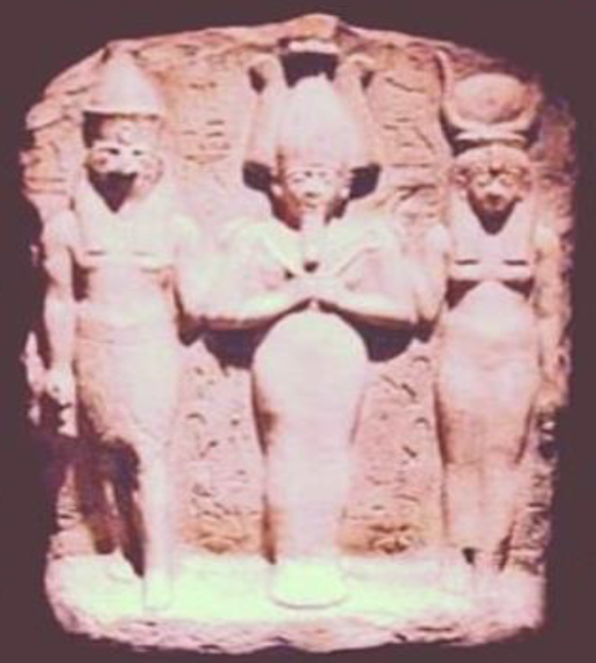
UKUDINGIDWA KWENDLU YENDILINGA UKUQASITHANDAZE
Imele isiqu zesakhiwo somuntu ezimbili njengobabesekuchaziwe ngaphambilini futhi nophawu lwesithathu esingcwele – (Hola Triad) – Okungubaba, umama kanye nomntwana;
Isithathu esingcwele saseThebes -Wase noma Wo’se noma (ukusukela ngo c. 21st century bce) Nowe noma Nuwe – esimele ubunye: Mut/Nut- umama, Amun –ubaba kanye nengane- Khonsu;
LesiThathu sidunyiswe kakhulu ngo1500BC eThebes eyaziwa njengeldolobha lamasango angu-100 futhi nedolobha elisikhungo semfundo ephakeme, ilapho bekudunyiswa khona esigodini saseAsher/Ashrel. Ithempelini iHet-Mut, elingezansi kwethempele likaAmun- Ra.

Slide 10
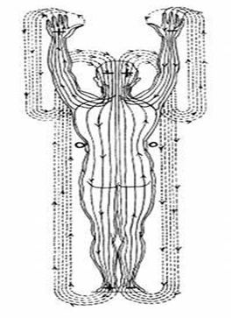
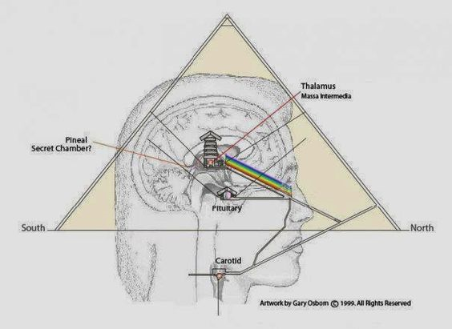
UKUDINGIDWA KWENDLU YENDILINGA UKUQASITHANDAZE
Iphinde futhi ixhunyaniswe nesakhiwokazi esikhulu sikanxantathu – pyramid, sona esiqondene nokufundisa kokuphila komphefumulo ngokungenamkhawulo
UBaloyi noMakobe-Rabothata, (2014:24) lapho bethi:
Abantu base-Afrika abakubuki ukufa nokuphila njengezigaba ezimbili ezahlukene, kodwa babona kukhona ukubambisana okunokuxhumana okukhona phakathi kwale mimoya emibili yokuphila ... umuntu wase-Afrika ngokokuqonda ngokokhololwakhe komphakathi ombili okowabaphilayo kanye nabasebedlule ...

Slide 11
UKUDINGIDWA KWENDLU YENDILINGA UKUQASITHANDAZE – kuyaqhubeka 2
Isibonakaliso: Indlu yendilinga
Amasango emimoya ekufikeleleni ekiqondeni okuseqophelweni eliphakeme/eliphezulu:
a) owesimame,
b) owesilisa kanye
c) umgogodla.
Ukuqonda ngokuphelele kwesakhiwo sikangxantathu:
- Kumele kugcwaliswe isigqoko, sona esiqedelela ubude balesisakhiwo x Pi (Giza Pi ka 480.9’ /153 = 3.14313725 noma ukuphakanyiswa kuhlukaniswa kangangezinhlanzi ezingu 153 ezadotshwa olwandle lwaseGalilee uJohn 21:11 (gal = indilinga) = 3,024 ububanzi (isb., 756’*4=3,024) noma isibalo esingcwele esifingqiwe [SC]

Slide 12
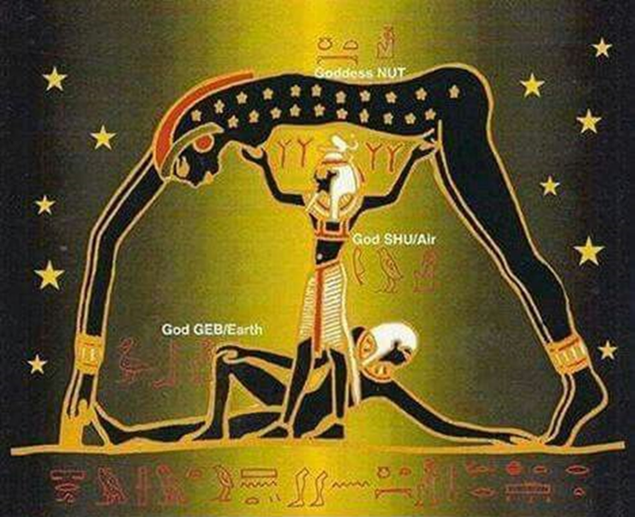
UKUDINGIDWA KWENDLU YENDILINGA UKUQASITHANDAZE – kuyaqhubeka 3a
Uhlaka lwendlu yendilinga/ Uguqa
Isibonakaliso 1a: Owesifazane ebonakaliswa njengezulu
U-Obosom(Idlozi) elichaza Yena nqotho zakhe ozibiza njengo Ra. Uxhunyaniswa nokuphuma kwelanga uAten ekuqaleni – emanzini, waqhamuka njengeNkosi/Umbuso omileyo. Kuchazwa lapho izinsika noma ukuxhaswa kukaShu kubekhona, ngaphambi kokuba uShu ahlukanise uGeb, umhlaba kuNut, isibhakabhaka;
Ebusuku kubukeka sekungathi Isibhakabhaka samukela uMhlaba; entathakusa umoya wesimosezulu ubukeka sekungathi uchilizela Isibhakabhaka sasebusuku kude kunoMhlaba;

Slide 13
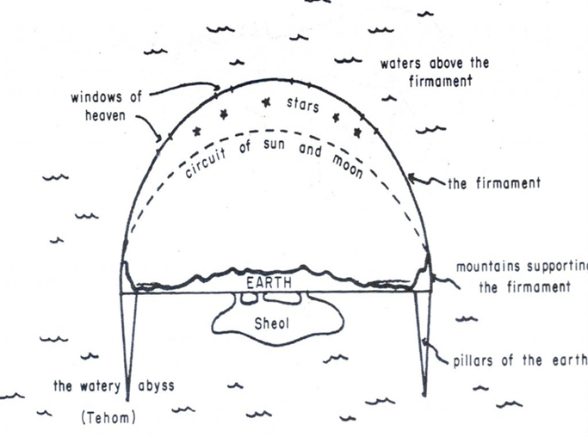
UKUDINGIDWA KWENDLU YENDILINGA UKUQASITHANDAZE – kuyaqhubeka 3b
Isibonakaliso 1b:
Ngokufinqiwe:
U-Ra wayalela uShu ukuthi enze lomsebenzi emuva kokusungulwa koMhlaba, lapho ethi uShu aphinde asebenze njengedlozi uObosom eMoyeni ngokwehlukanisa uNut kuGeb noma eMhlabeni;
Isithathu esingcwele Thebes-ubunye: Mut/Nut, her Amun kanye nengane- Khonsu; Ukudunyiswa kwaleSithathu – Akhenaten, ongubaba kuTutankhamen.

Slide 14
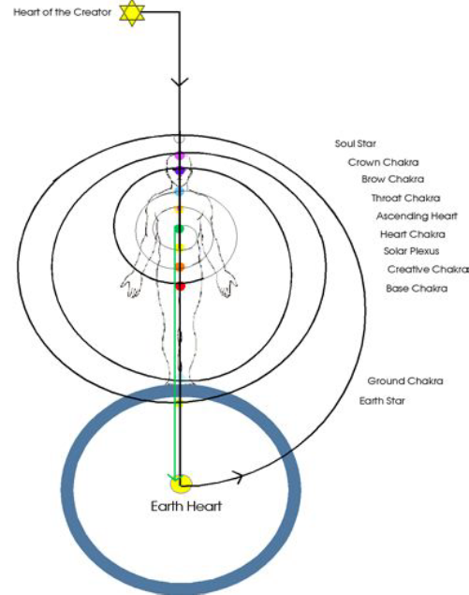
UKUDINGIDWA KWENDLU YENDILINGA UKUQASITHANDAZE – kuyaqhubeka 4
            Kumele futhi siqonde ukuthi kulabonxantathu, unxantathu obheke phezulu umele owesimame kubesekuthi obheke phansi wona umele owesilisa.
            Ngamanye amazwi kusho ukuthi ngokubambisana kwale mimoya emibili kubalulekile ukuze ikwazi ukukhuphuka ngomgogodla ufikelele ekuzazi okuseqophelweni eliphezulu, ukuphila okungunaphakade kuyenzeka.

Slide 15
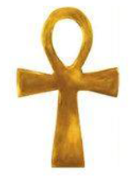
ISIPHETHO
Uma sichaza ngokuphila komzimba womuntu, indlu yotshani yendilinga – uguqasithandaze, iyona echaza ngaloludaba.
Loluhlobo lwendlu lutholakala cishe kuwo wonke amagumbi ezwekazi i-Alkabulan. Lesisakhiwo sinomlando futhi siqukethe amasiko namagugu abantu abamnyama, njengoba kunendlela nemithetho elandelwayo kuyo.
Uma kuchazwa ngendlu yendilinga e-Afrika, iye ichazwe njengesakhiwo esifaniswa nomzimba womuntu, wona osebenza ngemimoya emibili – owesinxele [negative] kanye nowesokudla [positive]
Lemimoya iphinde ichazwe ngokobulili, okusho umama nobaba. Ngamanye amazwi ukuze impilo yomuntu iphile kumele kubekhona ukulingana kwemimoya ukuze kubekhona ukuthula nenqubekela-phambili.
Uma sibona isithombe kwisibonakaliso iAnkh uphawu olumele ukuphila okungunphakade- luhlanganisa owesimame nowesilisa ukuze kubekhona ukuphila komzimba nomphefumulo womuntu ubonekophila okungenamkhawulo.
Ukuze umzimba uqhubeke nokuphila, kumele imimoya ihlangane ukuze kube khona umntwana, yena ogcwalisela umgomo ongcwele weziquzintathu umunye.
Leli phepha lizamile ukuvala igebe elimile ngokuchazwa kwenndlu yotshani, njengoba iphinde yaziwe kanjalo abayaziyo, futhi kuncane okushiwo ngomlando wayo futhi nendima esiyidlalile kwizakhiwo zendabuko emazansi ne-Afrika.
Uphawu iAnkh- oumele ukuphila okungenmkhawulo

Slide 16
Imisebeni esetshenzisiwe:
Achebe C. 1958. Things Fall Apart. Great Britain: Heinemann
Akhan Odwirafo Kwesi Ra Nehem Ptah (13011 (2011). Afuraka/Afuraitkait - The Origin of the term 'Africa': Parts 1-4. Available from: www.odwirafo.com [accessed Jan 02 2018].
Baloyi L. & Makobe-Rabothata M. (2014). The African Conception of Death: A Cultural Implication. - Jackson, L., Meiring, D., Van de Vijver, F., & Idemudia, E. (Eds.) Toward sustainable development through nurturing diversity: Selected papers from the Twenty-First Congress of the International Association for Cross-Cultural Psychology. Melbourne, FL: International Association for Cross-Cultural Psychology.
Drunvalo, 2000. The Ancient secret of The Flower of Life, Vol. 2. Nashville: Clear Light Trust.
Heeren AHL 1832. Reflections on the politics, intercourse and trade of the ancient nations of Africa. Oxfors: D.A. Taalboys.
Hurskainen Arvi. 20O3. Early Records on Bantu. Remota Relata Srudia Orientalia, Helsinki,pp.65-76
Masolo D. A – 1994. African Philosophy in Search of Identity, Edinburgh.
Mthembu, N. C. 2015. Finding our head without losing our feet. Wandsberg: Reach.
Naude M. 2007.A legacy of rondavels and rondavel houses in the northern interior of South Africa. SAJAH, 22(2): 216-237.
Ndandani, M. 2015. Living in a hut in 21st Century South Africa. Sun Media: Stellenbosch
Nyamnjoh F B. 2014. A Relevant Education for African Development—Some Epistemological Considerations (PDF Download Available). Available from: https://www.researchgate.net/publication/267362379_A_Relevant_Education_for_African_Development Some_Epistemological_Considerations [accessed Jan 02 2018].

Slide 17
NGIYABONGA.

