Slide 1

STRENGTHENING HEALTH MANAGEMENT INFORMATION SYSTEMS IN AFRICA
Department of Health Studies
UNISA
Notes:
WELCOME TO THE UNISA DEPARTMENT OF HEALTH STUDIES’ OER ON STRENGTHENING HEALTH MANAGEMENT INFORMATION SYSTEMS IN AFRICA. WE HOPE THIS OER WILL TRIGGER DEEPER REFLECTIONS AND GENERATION OF SOLUTIONS FOR DATA MANAGEMENT PROCESSES IN YOUR FACILITY << Unisa’s Department of Health Studies welcomes you to the Open Educational Resource (OER) on strengthening health management information systems in Africa. We hope that this resource will trigger deeper reflections and generation of solutions for data management processes in your facility. >>

Slide 2

INTRODUCTION TO HEALTH MANAGEMENT INFORMATION SYSTEMS (HMIS)
This is part one of a series of four OERs that aim to engage with the audience to generate solutions to one of the key challenges in Africa, namely health information management.
The purpose of this series of OERs is to provide opportunities for
reflection
on your own situation and generation of
solutions,
specifically with regard to contextual/organizational, behavioural and technical factors that influence the quality of health data generated from the health information system.
This series of OERs will enable managers to ensure effectiveness and efficiency of HMIS.

Slide 3
INTRODUCTION TO HMIS
The effectiveness of Routine Health Information Systems (RHISs) in improving the performance of the health systems, has raised several questions in developing countries.
Data from any form of a HIS play a vital role in:
resource allocation and
day-to-day management decisions in health care.
Therefore, strategic decisions in health service provision depend on the quality of data generated from RHIS in order to make informed decisions.

Slide 4
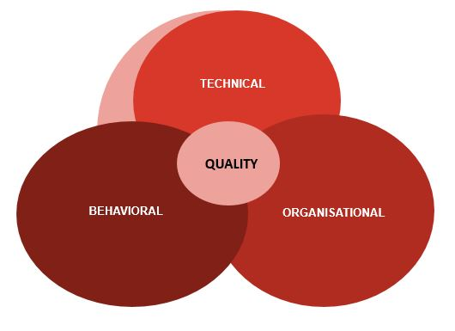
INTRODUCTION TO HMIS
This series of OERs draws on the Performance of Routine Information System Management (PRISM) framework that assumes a relationship between technical, behavioural and organisational determinants of the routine information processes and performance.

Slide 5
Getting to grips with HMIS
We begin by discussing what Health Information Systems (HIS) are:
A good start
We then proceed with an analysis to differentiate between RHIS and HMIS:
HMIS in Ethiopia
HIS Resources
Notes:
ADD A TEXT

Slide 6
ACTIVITY: REFLECT ON DATA MANAGEMENT IN YOUR HEALTH FACILITY…
Use the SWOT analysis to evaluate health data management currently implemented in your facility.
Identify and explain the current processes that are in place to instill a culture of information management in your facility.
To what extent are the health professionals in your unit aware of the importance of health data management processes?

Slide 7
WHAT NEXT?
The series of OERs that follow will elaborate on the organisational, technical and behavioural aspects of HMIS.
Once you have studied the series of OERs offered, you will be able to develop strategies to strengthen HMIS.

