Slide 1
Quality imperatives versus funding: A case of filial cannibalism in South African Higher Education?
Dr Thomas Groenewald
15th IEASA - 2 September 2011

Slide 2
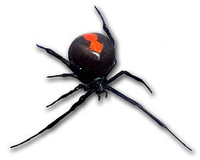
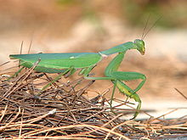
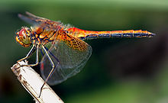
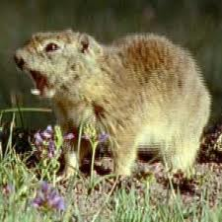
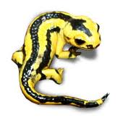
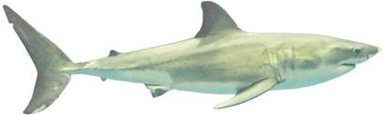
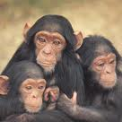
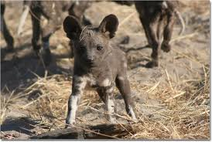
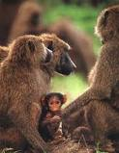
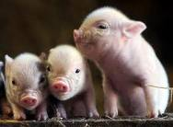
Cannibalism
Sexual
Size-structured
Intrauterine
Cannibalistic infanticide / filial
Notes:
Sexual cannibalism — a female organism kills and consumes a conspecific (same species) male before, during, or after copulation. Rarely, these roles are reversed. Recorded in, among others, the female redback spider, black widow spider, praying mantis, and scorpion.
Size-structured — large individuals consume smaller of the same species. In such size-structured populations, cannibalism can be responsible for 8% (Belding's Ground Squirrel) to 95% (dragonfly larvae) of the total mortalitymaking it a significant and important factor for population and community dynamics. Such size structured cannibalism has commonly been observed in the wild for a variety of taxa.
Intrauterine cannibalism — a behaviour in some carnivorous species, in which multiple embryos are created at impregnation, but only one or two are born. The larger or stronger ones consume their less-developed siblings as a source of nutrients. In adelphophagy, the fetus eats sibling embryos, while in oophagy it feeds on eggs. Intrauterine cannibalism is known to occur in lamnoid sharks[19] and in the Fire Salamander, as well as in some teleost fishes.
A common form of cannibalism is filial cannibalism (a form of infanticide) where adults eat the young of their own species (sometimes even their own immediate offspring). Classical vertebrate examples include the chimpanzees where groups of adult males have been observed to attack and consume conspecific infants and cats, elephants, dogs, baboons, bears, lions, and some types of fish, where adult males commonly kill infants when they take over a new harem after replacing the previous dominant males. In agricultural settings, pigs are known to eat their own young, accounting for a sizeable percentage of total piglet deaths. There have been sightings of infanticide in the leopard population.
Abstract: Lindström, K. 2000. The evolution of filial cannibalism and female mate choice strategies as resolutions to sexual conflict in fishes. Evolution, 54(2), 617-27.
Filial cannibalism (the consumption of one's own viable offspring) is common among fish with paternal care. In this study, I use a computer simulation to study simultaneous evolution of male filial cannibalism and female mate choice. Under certain conditions, selection on parental males favors filial cannibalism. When filial cannibalism increases a male's probability to raise the current brood successfully, filial cannibalism also benefits the female. However, when egg eating is a male investment into future reproduction, a conflict between female and male interests emerges. Here I investigate how female discrimination against filial cannibals affects evolution of filial cannibalism and how different female choice criteria perform against filial cannibalism. The introduction of discriminating females makes the fixation of filial cannibalism less likely. I introduced three different female choice criteria: (1) females who could discern a male's genotype, that is, whether the male was going to eat eggs as an investment in future reproductive events; (2) energy-choosing females that preferred to mate with males who had enough energy reserves to live through the current brood cycle without consuming eggs; and (3) females that preferred to mate with already mated males, that is, males with eggs in their nest. Genotype choice never coexisted with filial cannibals at fixation and filial cannibals were unable to invade a population with genotype-choosing females. Energy choice was successful only when males had high energy reserves and were less dependent on filial cannibalism as an alternative energy source. The egg choosers frequently coexisted with the cannibals at fixation. When the female strategies were entered simultaneously, the most frequent outcome for low mate sampling costs was that both the cannibals and the egg choice was fixed and all other strategies went extinct. These results suggest that sexual conflicts may not always evolve toward a resolution of the conflict, but sometimes the stable state retains the conflict. In the present case, this was because the egg-preference strategy had a higher fitness than the other female strategies. The outcome of this simulation is similar to empirical findings. In fish with paternal care, male filial cannibalism and female preference for mates with eggs commonly co-occur.

Slide 3

A metaphor reveals striking and surprising similarities and indicates correspondences of dissimilar phenomena

Slide 4
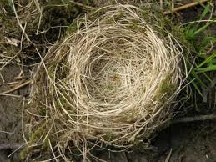
Mating and nesting in a changing landscape
Restructuring of higher education in South Africa has been unique
  Politically driven
  Fitness of & for purpose
From a binary system to three types
  Academic freedom vs. stakeholder consulting

Slide 5
Quality imperatives
Inclusivity of stakeholders in curriculum design
Obligation to place students for obligatory WIL
Effective management and coordination
Adequate infrastructure
Learning agreements & communication
  Clarifying roles and learning outcomes
Mentoring
Recording & monitoring of progress
Academic & workplace assessment

Slide 6
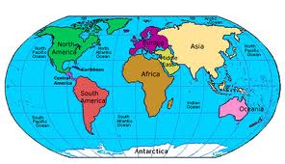
Governments and universities deeply interested in work-integrated learning
Became a vital higher education enterprise
Important aspect of branding
Important provision strategy

Slide 7
International imperatives
Intentional engagement of multiple stakeholders in programmes
  Mutual benefit, reciprocity & partnerships
Integral to institutions & sponsorship of university leadership --- visibly pivotal
Core set of underpinning values
Curriculums thoroughly integrated
Practice and core feature of learning

Slide 8
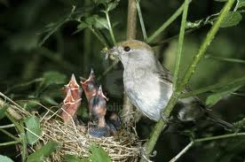
Selective distribution of nutrition
Technical team 2003-4 investigated funding
SA government does not fund costs
  encourage delivery
  institutions must manage costs
Yet, former university programmes full funding

Slide 9
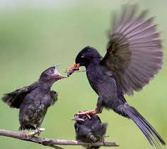
Parental conflict-or-favouritism
Former opposing views about scarce and critical skills vs. productivity
Legacies of Apartheid, geo-political & economic isolation
Skills Development & Levies Acts (1998+9)
National Skills Authority & Skills Development Strategy

Slide 10
Sectoral Education & Training Authorities (SETAs)
Discretionary grants for workplace experience
NSDS targets; SETA priorities and sector needs
Tedious procedures to obtain
Grants not necessary extend to higher education institutions to provide for management & monitoring

Slide 11
Filial cannibalism?
To what end?

