Slide 1
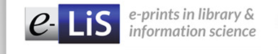

The quest for African Librarians
Fatima Darries
E-LIS South African Editor

Slide 2

Largest open access archive for Library and Information Science
More than 14 000 items at June 2013
Established 2003, 10 years old
http://eprints.rclis.org/
Volunteers edit, supporting 22 languages
Representation from 21 African countries

Slide 3
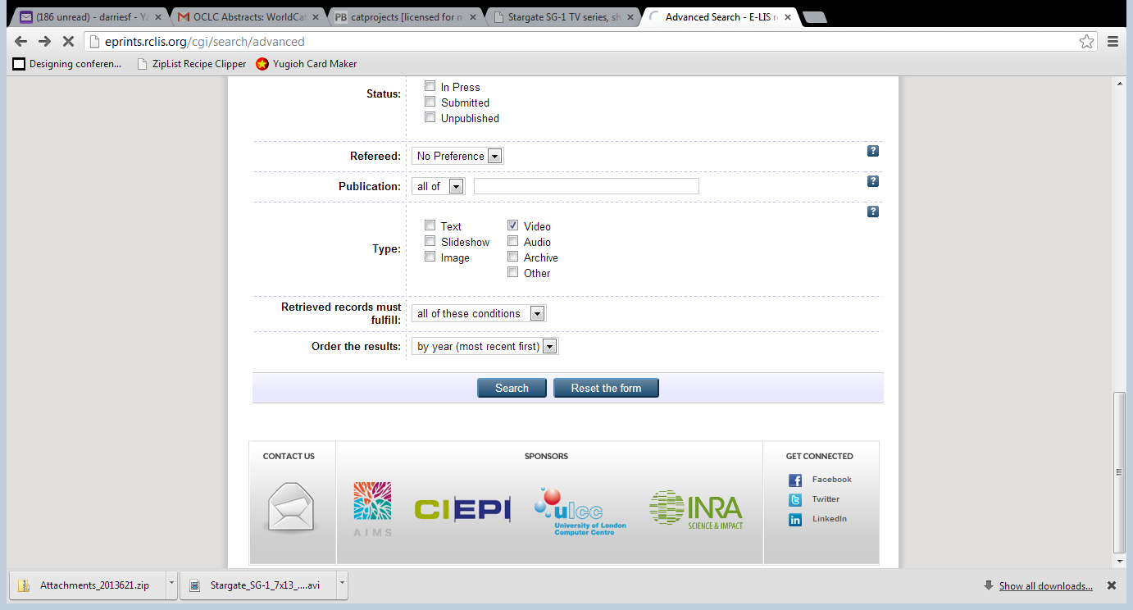

Slide 4
Why the quest for African Librarians
Quest
  (noun) mission
  Duty and pursuit of African Librarians to self archive Library and information output,
  Are you practicing what you preach, African Librarian?
  (Verb) search
  Seeking African Librarians, where are they? Where are they archiving their discipline output?

Slide 5
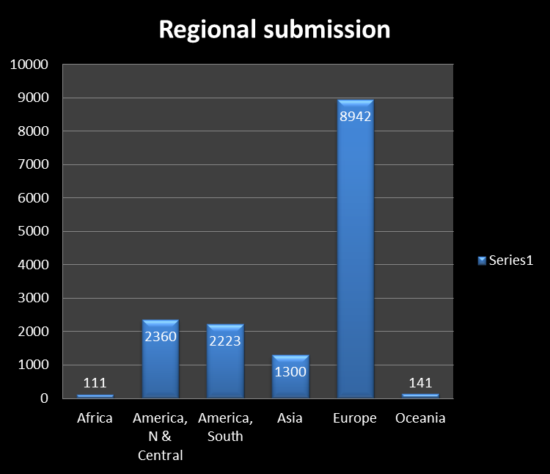

Slide 7
http://eprints.rclis.org/

Slide 8
Submit in 2 easy steps
Create an account on http://eprints.rclis.org/ or login
2. Submit metadata and upload item
Congratulations you are self archiving!

Slide 9
Get connected
Egypt - Mandy Taha
South Africa - Fatima Darries
Zimbabwe - Thembani Malapela
https://www.facebook.com/pages/E-LIS-E-prints-in-Library-and-Information-Science/46416119492
https://twitter.com/EprintsELIS
http://www.linkedin.com/groups?home=&gid=1879664
RSS feed for the latest submissions

Slide 10
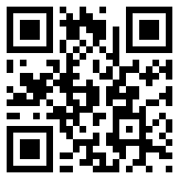
This poster is available here
http://hdl.handle.net/10760/19611
URL http://eprints.rclis.org/19611/
Fatima Darries, E-LIS South African Editor, @ darriesfa@gmail.com

